Slide 1
February 7th, 2024
Current and Future Uses of VR for Economic Development

Slide 2
We envision a collaborative future where education is accessible, engaging and impactful for all.

Slide 3
Quick Agenda
What is VR, AR, MR, XR?
How can Virtual Reality be utilized in economic development strategies?
Skills and Labour development utilizing VR
Demo of Skills training utilizing VR
Notes:
Make sure to touch on what the status quo is

Slide 4
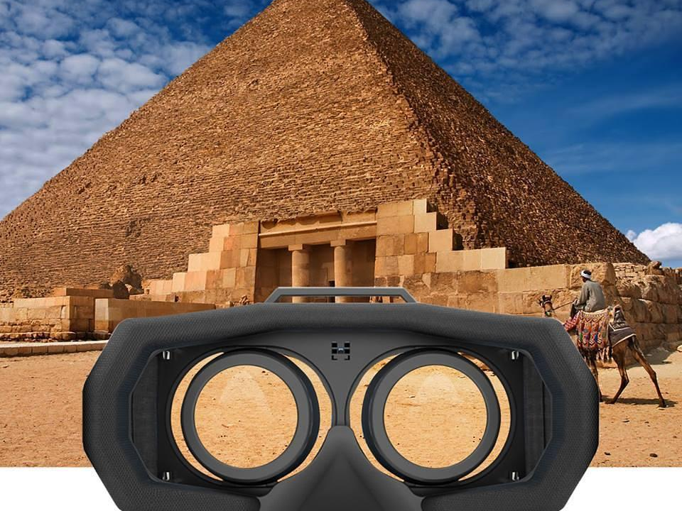
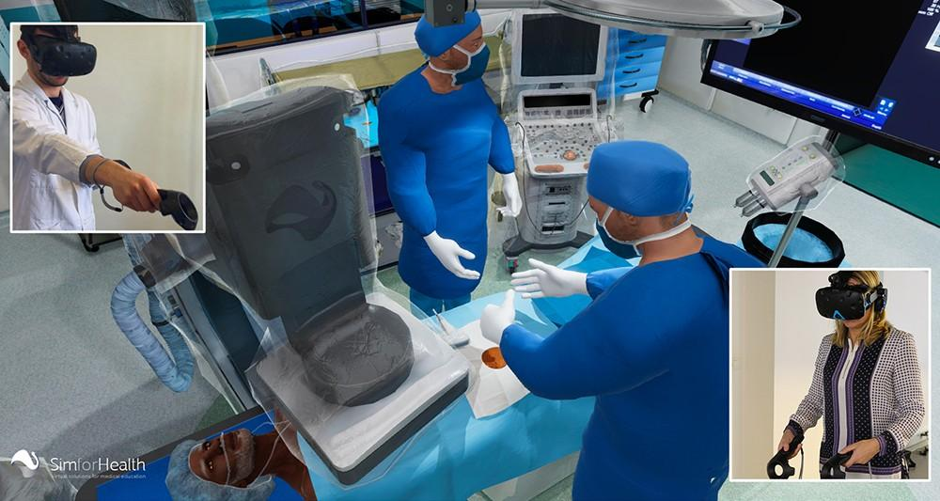
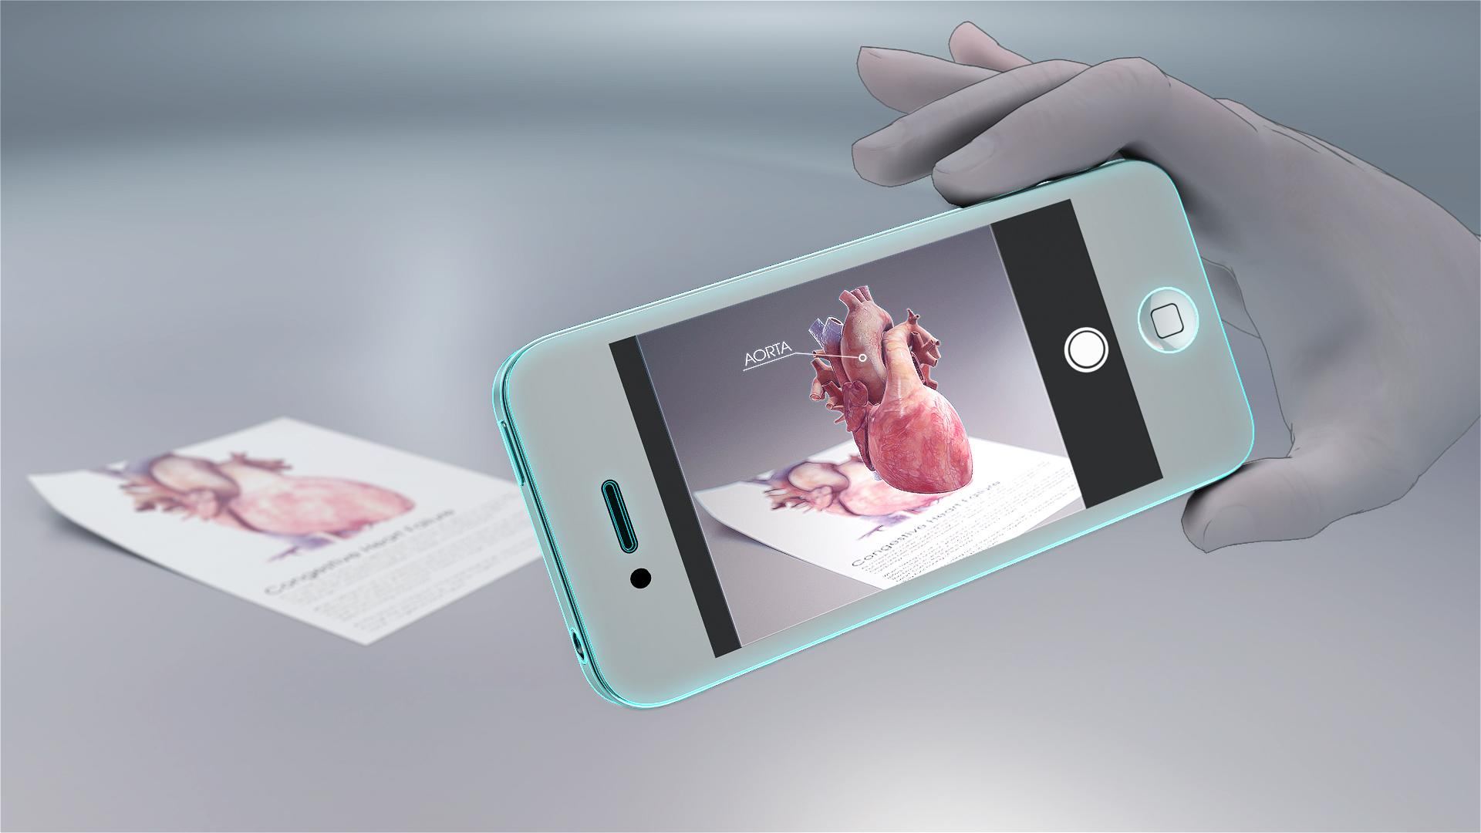
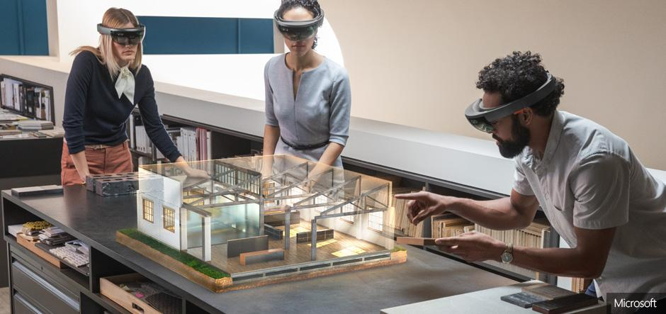
VR, MR, AR, XR
360 Videos
VR
XR
AR
MR
Notes:
We specialize in VR and 360 videos

Slide 5
360 Videos - Tourism, Education of current Developments
Immersive Video Content
360 Tours
Historical Landmarks
Prime locations
Developments in Progress
Live Events
NYE Times Square
Shows and Concert
More engaging than traditional video, Spatial sound.

Slide 6
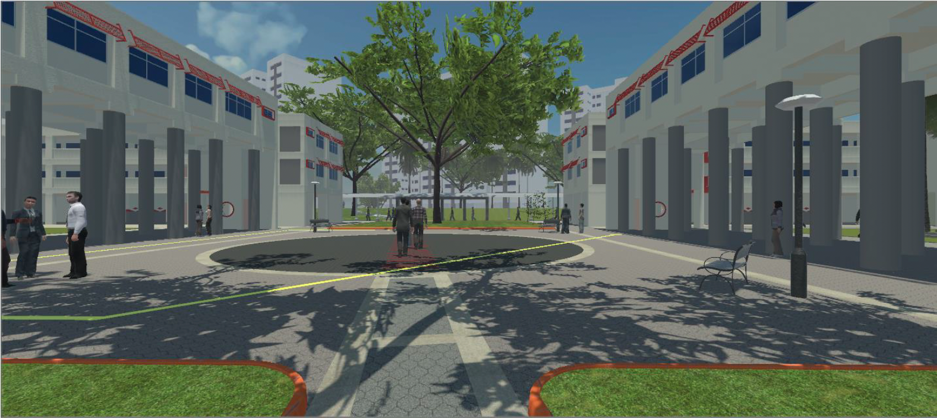
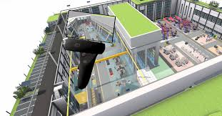
VR - Urban Planning
Interactive Mockups
Can navigate city streets in first person view
Zoom out and manipulate at large scale
View a variety of options very quickly and immersively

Slide 7
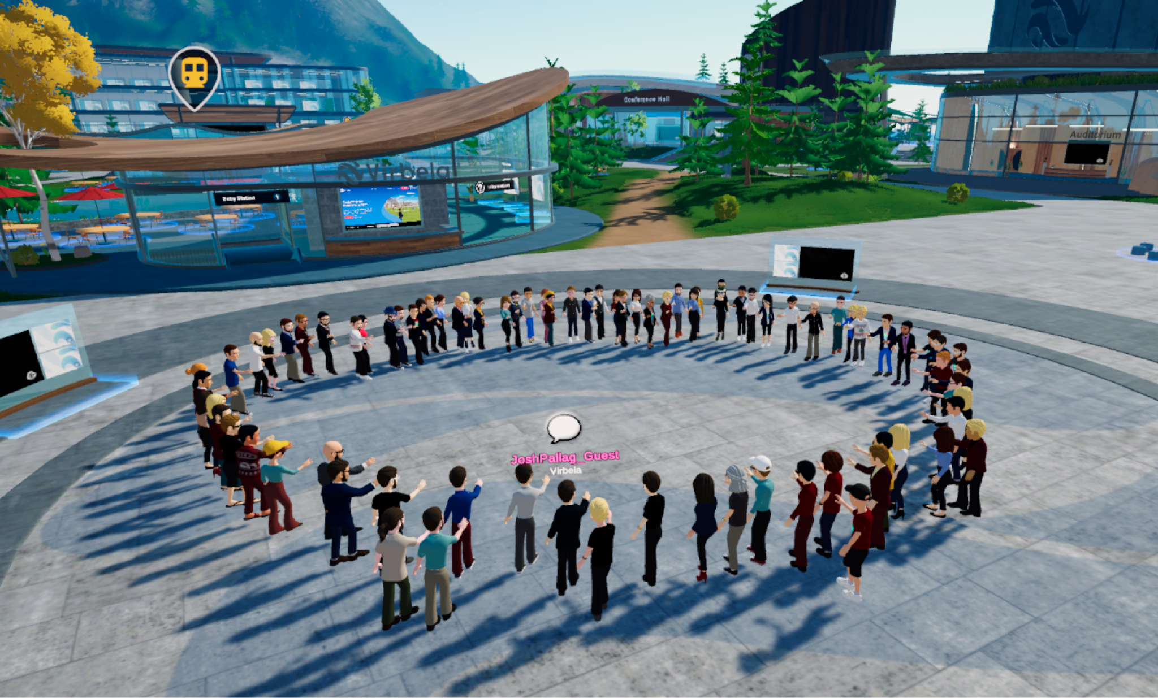
VR/Metaverse - Interactive virtual cities
Explore and engage with other individuals in virtual versions of real life places.
Replication of current locations is becoming much more realistic
College Campuses
Downtown cores
Use of Google Maps
Opportunity for quick feedback from the community and stakeholders

Slide 8
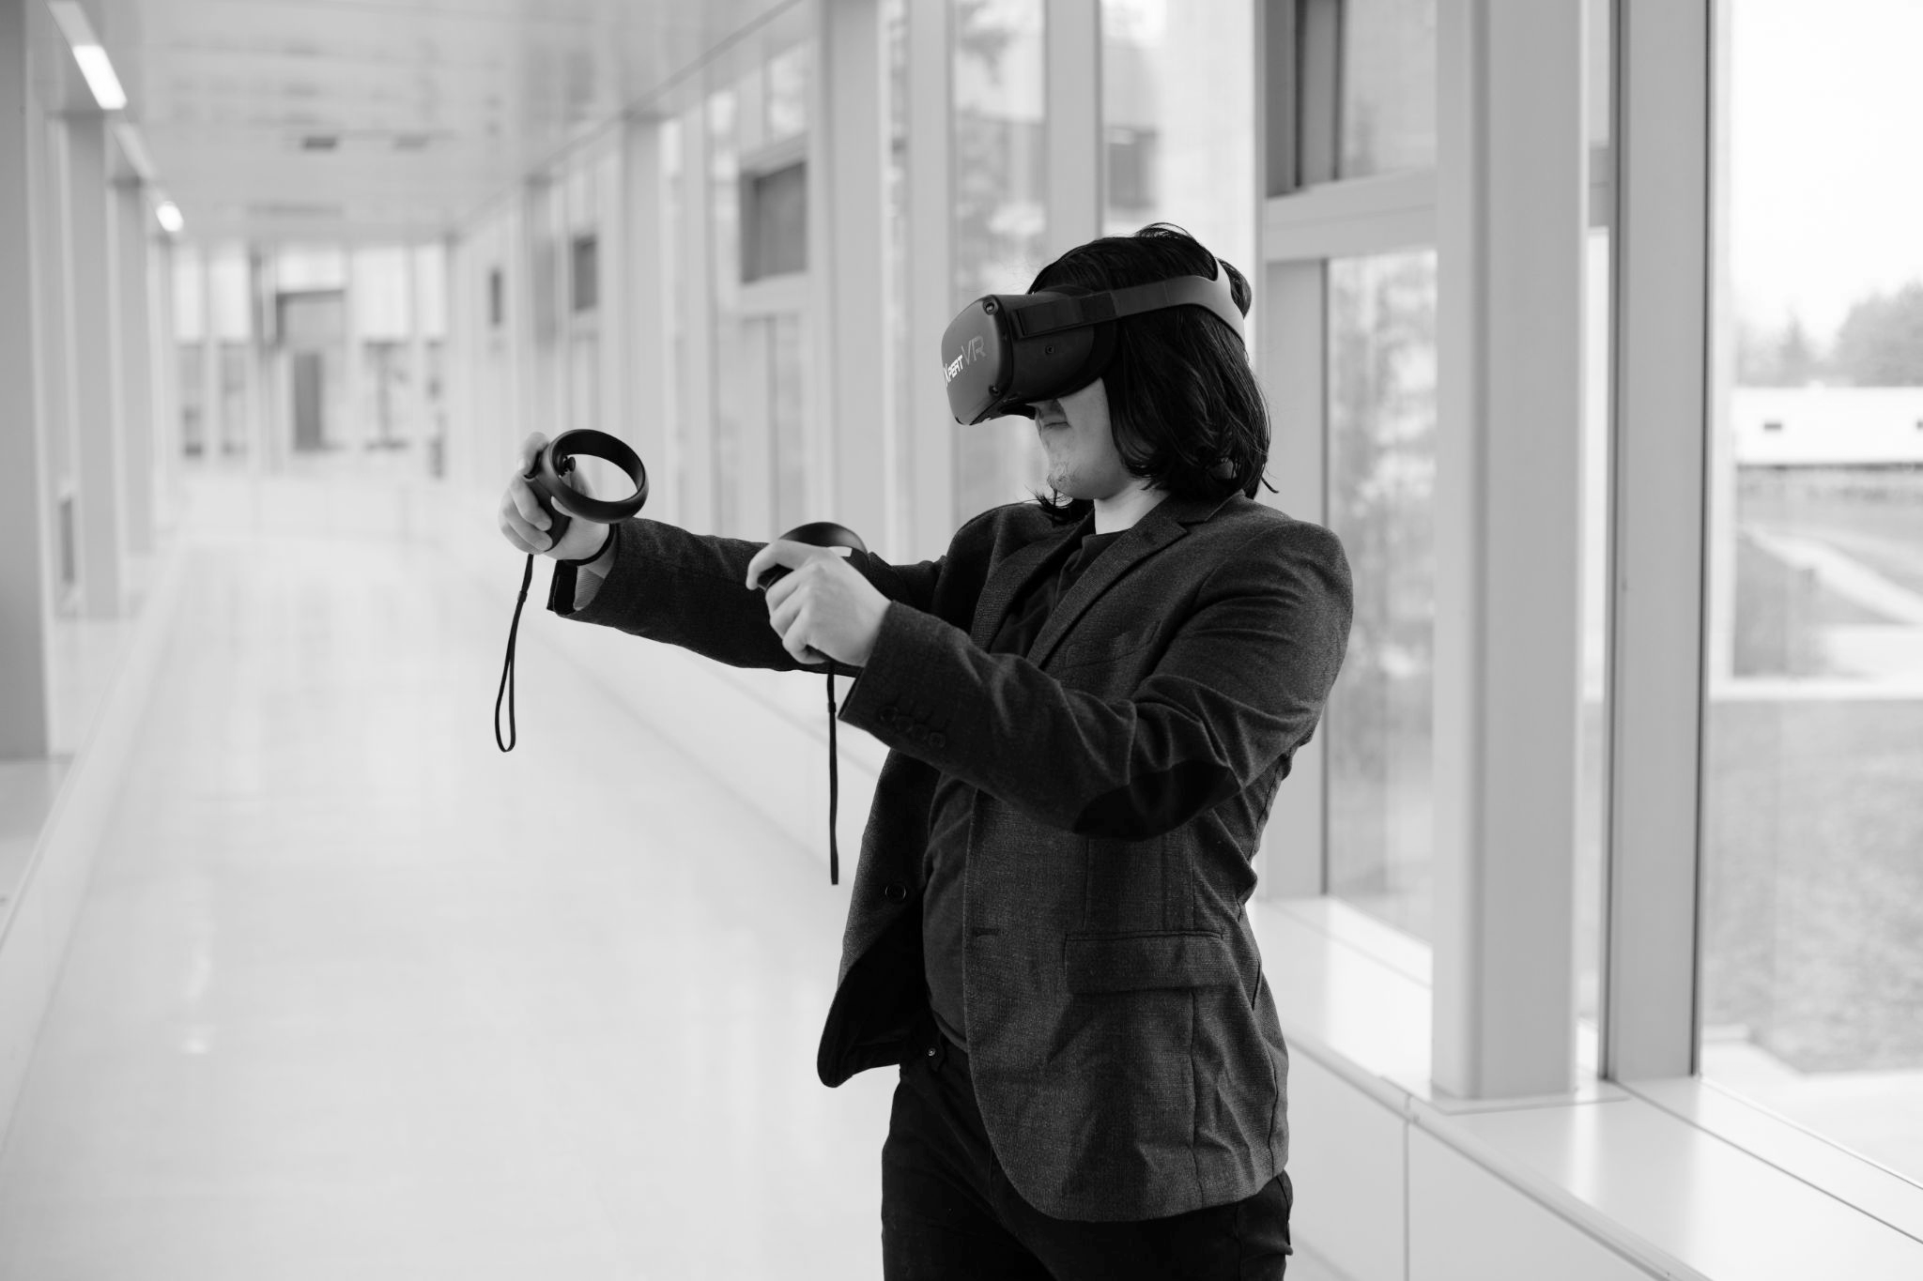
VR for skills development

Slide 9
4x
More focused

Slide 10
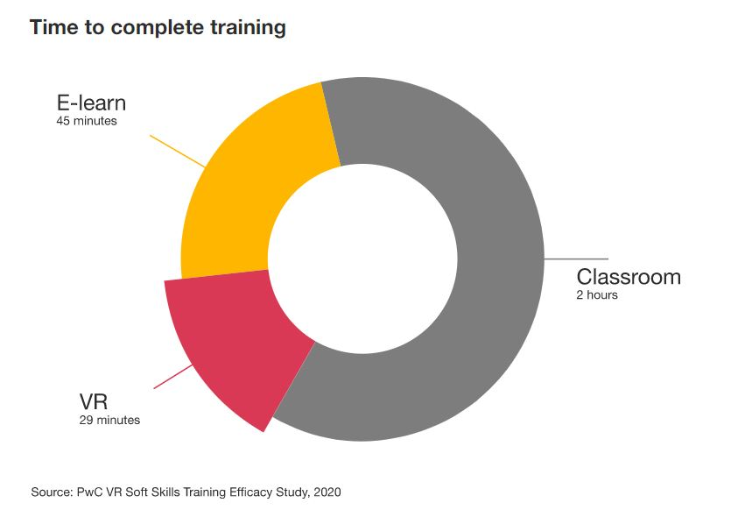
Further Comparison

Slide 11
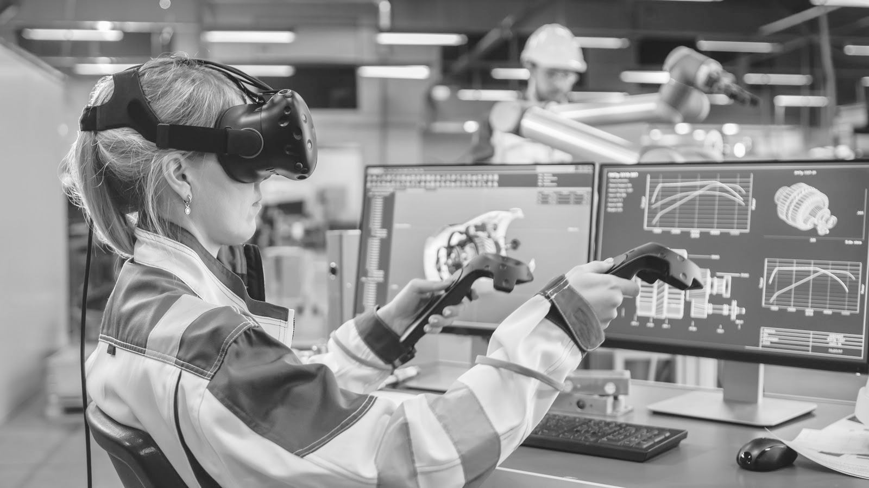
275%
More confident to apply skills learned after training
Notes:
https://www.pwc.com/us/en/services/consulting/technology/emerging-technology/vr-study-2020.html

Slide 12
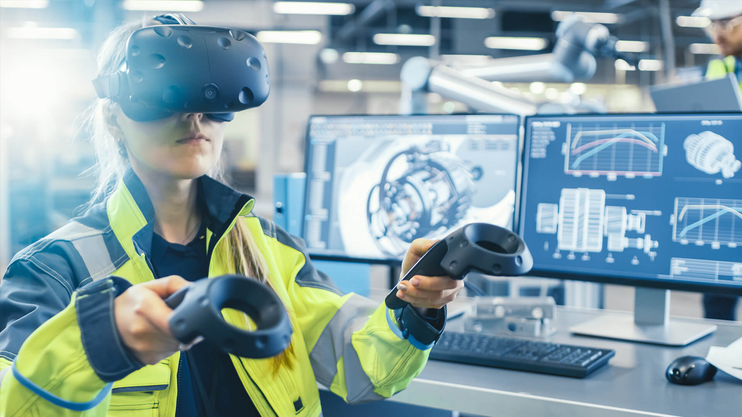
Promote skills development initiatives through VR technology
Microcredentials and certifications will be achieved and or supplemented through the use of VR.
Support recruitment efforts to local schools through the use of VR
Develop better talent within the region

Slide 13
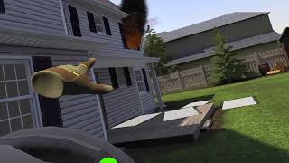
4. Custom Simulations by XpertVR
Completely customizable
Design every second of the scenario timeline
Collect data and send to your LMS
Accessibility features (AODA)

Slide 14
Demo of EDI Skills training

