Slide 1
ECONOMIC DEVELOPERS COUNCIL OF ONTARIO
The AI
advantage
A NEW CHAPTER IN ECONOMIC DEVELOPMENT

Slide 2
About the Speaker(s)
Along with her AI collaborator, DigiKath, she helps clients achieve ROI through insights-based content marketing.
Katherine Scarrow is the manager of creative strategy at The Globe and Mail's Globe Content Studio.
Image generated with Canva’s Headshot AI Tool
Notes:
I'm the manager of creative strategy at The Globe and Mail. I'm also leading the AI integration plan for the revenue department of The Globe and Mail.
Meet DigiKath, my professional digital counterpart, instrumental in crafting this Canva presentation. In the dynamic realm of content marketing, our relationship with AI has been a journey of awe, curiosity, and occasional skepticism. The pivotal question remains: Is AI merely a tool, or can it evolve into a cognitive collaborator, augmenting our capabilities instead of replacing them?
Aware of AI's remarkable feats—natural language processing, knowledge extraction, and sentiment analysis—we navigate the balance between human creativity and AI efficiency. Despite apprehensions about AI replacing the human touch, it stands as a valuable ally. Enter DigiKath, your digital doppelgänger—an enhanced version thriving between human ingenuity and AI precision.
This presentation explores AI's role in economic development across industries, emphasizing immediate opportunities for real outcomes. Utilizing tools like Canva, we exemplify how AI, epitomized by DigiKath, can assist in content creation, virtual interactions, and personalized digital experiences, showcasing the transformative potential of this collaboration.

Slide 4
AI in the everyday
Notes:
Artificial intelligence (AI) has been around for decades and has been used in many applications that we use every day. Here are some examples of AI that we have been using for years:
Search engines like Google, Bing, and Yahoo! use AI algorithms to provide relevant search results to users 1.
Email providers like Gmail and Yahoo! use AI algorithms to filter spam emails and categorize emails into different folders 1.
Voice assistants like Siri, Alexa, and Google Assistant use AI algorithms to understand natural language and respond to user queries 1.
Navigation systems like Google Maps and Waze use AI algorithms to provide real-time traffic updates and suggest the fastest route to a destination 1.
Online shopping: Online shopping websites like Amazon and eBay use AI algorithms to provide personalized product recommendations to users 1.
Social media: Social media platforms like Facebook and Twitter use AI algorithms to personalize user feeds and suggest content that users might be interested in 1.
Video streaming: Video streaming services like Netflix and YouTube use AI algorithms to suggest videos and movies that users might enjoy watching 1.

Slide 5
Notes:
SOPHI
Other examples:
Content Recommendation Algorithm
(‘For You’, article page and emails)
Churn and acquisition propensity
modelling
Advertising revenue generation
Lookalike modelling
• Age and Gender Prediction
Automated Comment
Moderation
An exemplary showcase of AI application in the media industry is Sophi, a powerful tool developed by The Globe and Mail. Sophi utilizes artificial intelligence to optimize and automate various aspects of the content creation and publication process. From identifying trending topics to predicting engagement metrics, Sophi enhances the efficiency of newsrooms, allowing journalists and editors to focus on high-impact storytelling. This innovative use of AI underscores the technology's adaptability and transformative potential in even the most traditional industries. The recent sale of Sophi to Mather Economics signifies an openness to partnerships and a dynamic shift within the organization.

Slide 6
Why now?
AI funding soars to $17.9-billion while rest of tech slumps
-Bloomberg
GenAI could add between $2.6-$4.4 trillion annually to the global economy
-McKinsey
Notes:
Why GenAI ... why now? Factors:
The rapid adoption of GenAI tools in the past year can be attributed to several factors. Firstly, the increasing availability of these tools has made it easier for businesses to adopt them ³. Secondly, the growing demand for AI-powered automation has led to an increase in the use of GenAI tools ³. Thirdly, the potential for GenAI to create new and innovative products and services has made it an attractive option for businesses ³.
According to McKinsey research, generative AI (gen AI) features stand to add up to **$4.4 trillion** to the global economy annually ¹. The advanced machine learning that powers gen AI-enabled products has been decades in the making, but since ChatGPT came off the starting block in late 2022, new iterations of gen AI technology have been released several times a month ¹. In March 2023 alone, there were six major steps forward, including new customer relationship management solutions and support for the financial services industry ¹.
Moreover, the road to human-level performance has become shorter for most of the technical capabilities shown in this chart, and its performance will compete with the top 25 percent of people completing any and all of these tasks before 2040 ¹. This is because of generative AI's ability to predict patterns in natural language and use it dynamically ¹.
In addition, generative AI startups raised over **$1.6 billion** in Q1 2023, indicating that investors are paying attention to this field ⁵.
In 2023, over 25% of American startup investments have been channeled into artificial intelligence-related companies, more than doubling the previous year's levels, according to Crunchbase data. Despite a 50% decline in overall North American venture funding in the first half of 2023, AI has not only proven resilient but has emerged as a standout, showcasing its versatility and increasing ubiquity across various industries.
Enterprises are facing multiple bottlenecks that are restricting faster adoption. Chief constraints are the challenges in identifying appropriate use cases (53 percent), followed by legal issues, risk, and compliance (38 percent) ⁵. While the accelerated adoption of GenAI has created a demand for technology workers, a significant skill gap remains ⁵.
The increasing availability of GenAI tools, the growing demand for AI-powered automation, and the potential for GenAI to create new and innovative products and services have contributed to the rapid adoption of GenAI tools in the past year. McKinsey research suggests that gen AI features stand to add up to $4.4 trillion to the global economy annually ¹. Generative AI startups raised over $1.6 billion in Q1 2023, indicating that investors are paying attention to this field ⁵.
Source: Conversation with Bing, 2023-12-08
(1) The explosive growth of generative AI tools in 2023 | AI Magazine. https://aimagazine.com/articles/the-explosive-growth-of-generative-ai-tools-in-2023.
(2) What is the future of Generative AI? | McKinsey. https://www.mckinsey.com/featured-insights/mckinsey-explainers/whats-the-future-of-generative-ai-an-early-view-in-15-charts.
(3) New Data Unveils Realities of Generative AI Adoption in the Enterprise. https://www.datanami.com/2023/11/21/new-data-unveils-realities-of-generative-ai-adoption-in-the-enterprise/.
(4) Five Signs Your Company Is Ready For Generative AI - Forbes. https://bing.com/search?q=GenAI+rapid+adoption+factors.
(5) 3 Organizational Imperatives, Accelerating GenAI Adoption - Forbes. https://www.forbes.com/sites/forbestechcouncil/2023/10/16/3-organizational-imperatives-accelerating-genai-adoption/.

Slide 7
"These are the stupidest the models will ever be."
-Sam Altman, CEO of OpenAI

Slide 9
Calling generative AI revolutionary is no hyperbole. Business leaders should view it as a general-purpose technology akin to electricity, the steam engine, and the internet.
How to Capitalize on Generative AI - A guide to realizing its benefits while limiting its risks by Andrew McAfee, Daniel Rock, and Erik Brynjolfsson
Notes:
Given the potential of generative AI to improve productivity in many other functions—indeed, any that involve cognitive tasks—calling it revolutionary is no hyperbole.
Business leaders should view it as a general-purpose technology akin to electricity, the steam engine, and the internet. But although the full potential of those other technologies took decades to be realized, generative AI’s impact on performance and competition throughout the economy will be clear in just a few years.
That’s because general-purpose technologies of the past required a great deal of complementary physical infrastructure (power lines, new kinds of motors and appliances, redesigned factories, and so on) along with new skills and business processes. That’s not the case with generative AI.
Much of the necessary infrastructure is already in place: The cloud, software-as-a-service, application programming interfaces, app stores, and other advances keep lowering the amount of time, effort, expertise, and expense needed to acquire and start using new information systems. As a result, it keeps getting easier for companies to deploy just about any digital technology. That’s a big reason ChatGPT went from zero to 100 million users in 60 days. As Microsoft, Google, and other technology providers incorporate generative AI tools in their office suites, email clients, and other applications, billions of users will speedily gain access as part of their daily routine.
Generative AI will also deploy quickly because people interact with these systems by talking to them much as they would to another person. That lowers the barriers to entry for some kinds of work (imagine writing software by explaining to an LLM in everyday speech what you want to accomplish). In addition, these systems won’t necessarily require companies to change entire business processes; at first they will be used for discrete tasks only, which will make them much easier to adopt. Using technology to reengineer every aspect of how a company interacts with its customers, for example, is a major undertaking; using it to suggest better chat responses to customer service agents is not. Over time, however, generative AI will bring large and deep changes in how companies do their most important work.
Consequently, business leaders shouldn’t sit on the sidelines and wait to see how the use of generative AI develops. They can’t afford to let competitors steal a march on them.

Slide 11
The dilemma
Notes:
One of the most significant issues is that generative AI systems can fabricate answers, which can lead to misinformation and confusion. Additionally, these systems can invade privacy by collecting and analyzing personal data without consent. Finally, generative AI systems can violate intellectual property rights by creating works that infringe on existing copyrights or trademarks.
According to a recent article in the Harvard Business Review, the legal implications of using generative AI are still unclear, particularly in relation to copyright infringement, ownership of AI-generated works, and unlicensed content in training data1. Several cases have already been filed, and courts are currently trying to establish how intellectual property laws should be applied to generative AI2. To mitigate these risks, companies that use generative AI need to ensure that they are in compliance with the law and take steps to protect themselves, such as using training data free from unlicensed content and developing ways to show provenance of generated content.
Given these concerns, should you take a cautious wait-and-see approach or dive in?

Slide 12
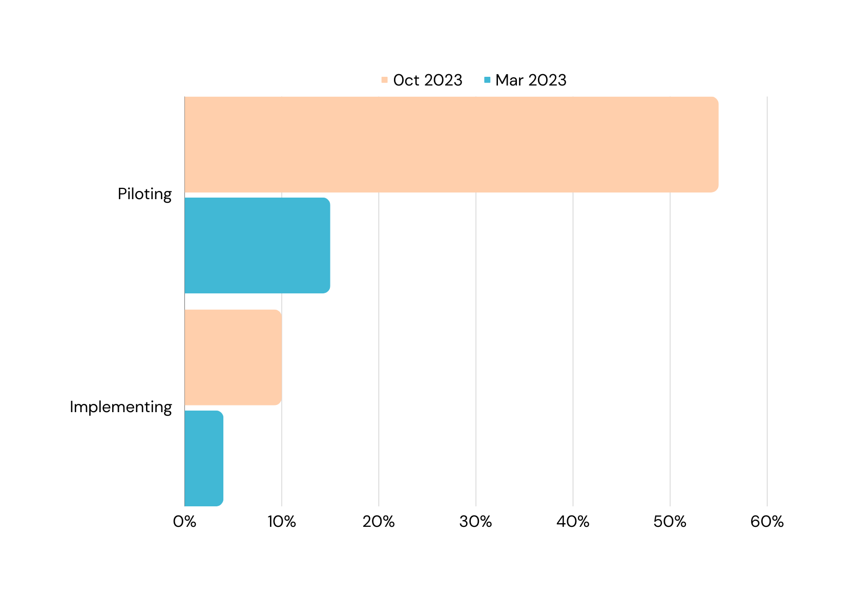
Source: Gartner Survey Insights

Slide 13
Notes:
Leaders can undertake a version of this research approach to get a sense of where generative AI might be most productively applied in their organizations. Every board should expect its CEO to develop an actionable game plan. Doing so is a three-part process.
The STEP framework, developed through a three-year research project, is designed to help organizations effectively manage the challenges associated with the adoption of Generative AI (GenAI). It consists of four interrelated activities:
Segmentation:
Leaders should analyze how AI will impact various tasks performed by employees.
Employees categorize tasks into three groups: those AI can't or shouldn't do, tasks for which AI can augment workers, and tasks that can be automated by AI.
Encourage experimentation and involvement of employees in determining how AI can be best utilized for their specific tasks.
Transition:
Recognize that AI, through augmentation or automation, may alter the volume and nature of tasks, potentially leading to changes in work roles.
Consider strategies like deepening roles, allowing employees to focus more on certain tasks, or upgrading roles, where employees take on more critical responsibilities as AI handles routine tasks.
Education:
Acknowledge the need for continuous employee reskilling to adapt to evolving AI capabilities.
Provide training programs, such as boot camps or custom courses, to enhance employees' understanding of AI, data skills, and related technologies.
Embed a culture of learning and allocate time for employees to engage in ongoing education.
Performance:
Reevaluate performance metrics to align with the dynamic nature of AI-impacted tasks.
Shift from traditional annual evaluations to shorter, more frequent assessment periods, often quarterly.
Focus on collaboration and adaptability as key performance indicators, considering the changing dynamics of tasks and roles.

Slide 14
Employees categorize tasks into three groups: (1) those AI can't or shouldn't do (2) tasks for which AI can augment workers and (3) tasks that can be automated by AI.

Slide 15
Key principles for managers
Set broad objectives or themes and trust employees to segment their roles
Encourage experimentation
Create conditions for learning and sharing
Rethink your workforce
Reimagine your own role and focus on higher-value tasks
Notes:
Key Principles for Managers:
Trust Employees to Experiment:
Allow employees to lead in discovering how AI can best be used for their tasks.
Set broad objectives and trust employees to make decisions regarding task segmentation.
Create Conditions for Learning and Incentivize Helping:
Prioritize ongoing education, framing AI as a learning opportunity.
Adjust evaluation and reward systems to motivate employees to assist each other in adapting to AI.
Rethink Workforce Planning:
Anticipate that work roles will become more dynamic with AI adoption.
Plan for a workforce with a range of abilities and the potential to learn in adjacent areas.
Reimagine Your Own Role:
Develop a digital mindset and create conditions that enable employees to adapt to changing technologies.
Find ways to provide value personally within the organization as employees leverage AI for higher-value tasks.

Slide 16
Pre-sale
Audience Analysis
Trend Forecasting
Custom Designed Pitches
Competitive Insights
Personalized Decks
Production
Content Brief Summaries
Headline writing
Social Media Scheduling
Ad Targeting
Graphic Design
Post-sale
Performance reporting
ROI analysis
Content insights
Future recommendations
Notes:
Artificial Inspiration
On the design side
Briefs for clients - mashing up audience (responding to RFPs)

Slide 18
Thoughtstarters
Market research and analysis
Optimizing urban planning
Enhancing workforce development
Strategies for business attraction and retention
Leveraging GenAI for marketing and promotion
Fostering local innovation ecosystems
Implementing real-time economic monitoring

Slide 19
Create your own GPT!

Slide 20
Notes:
Leaders contemplating Generative AI (GenAI) must weigh its significant potential against risks like fabrication, privacy invasion, and intellectual property concerns. Despite challenges, GenAI's rapid impact sets it apart, similar to past transformative inventions.
To navigate this moment, leaders should assess the jobs, prioritize projects, implement risk mitigation and adopt an agile approach. This strategic approach empowers leaders to embrace GenAI's capabilities while responsibly managing associated risks.

Slide 21
Thanks!
kscarrow@globeandmail.com
Notes:
Closing:
Thank you all for your active participation today. Experimentation in B2B content marketing is our path to delivering more valuable and engaging content to our audience. Have a fantastic day, and let's continue experimenting, learning, and optimizing our content with AI at the forefront of our strategies!

