Slide 1
Future of …
Rob Theriault Immersive Technology Manager, Georgian College
Notes:
Rob Theriault LinkedIn XR Georgian College

Slide 2
immersive
experiential
& A.I. assisted

Slide 3
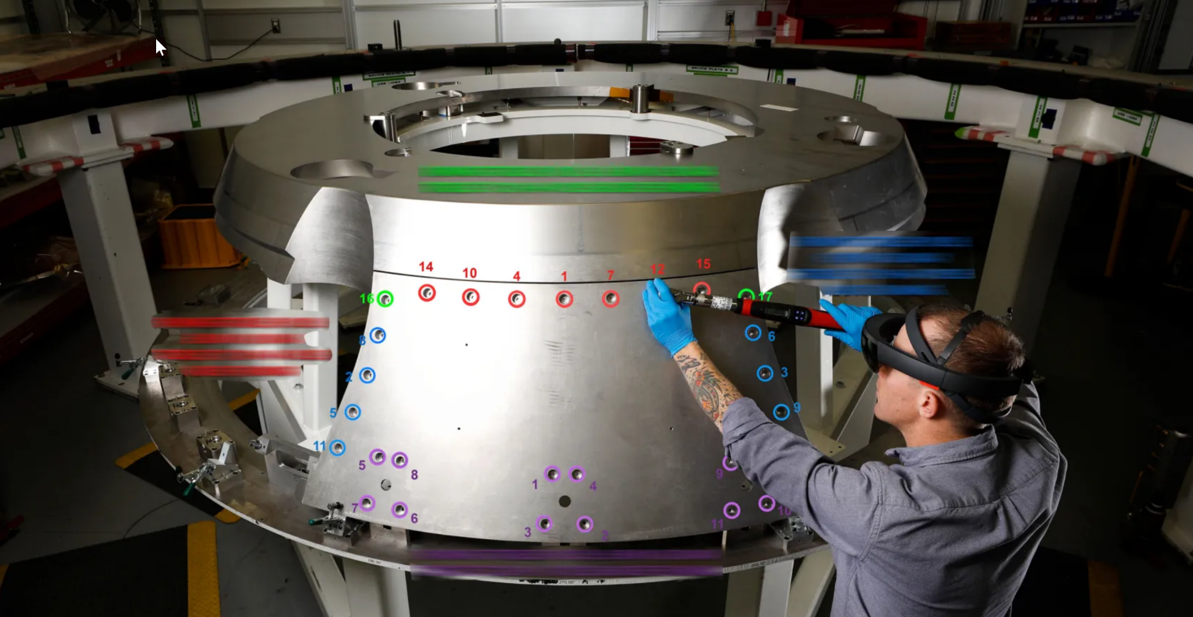
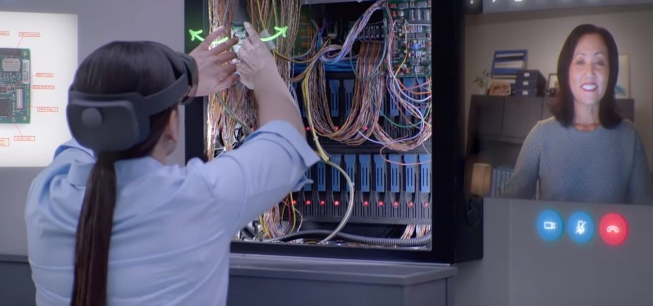
augmented
Notes:
No need to read thousands of pages of instructions (article)
Augmented reality used for “overlay”
Work normally completed in 8-12 shifts, completed in 1 shift with AR
12 hours of work completed in 45 minutes with AR

Slide 4
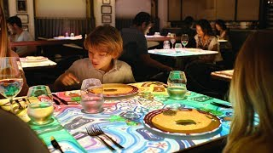
Le Petit Chef

Slide 5
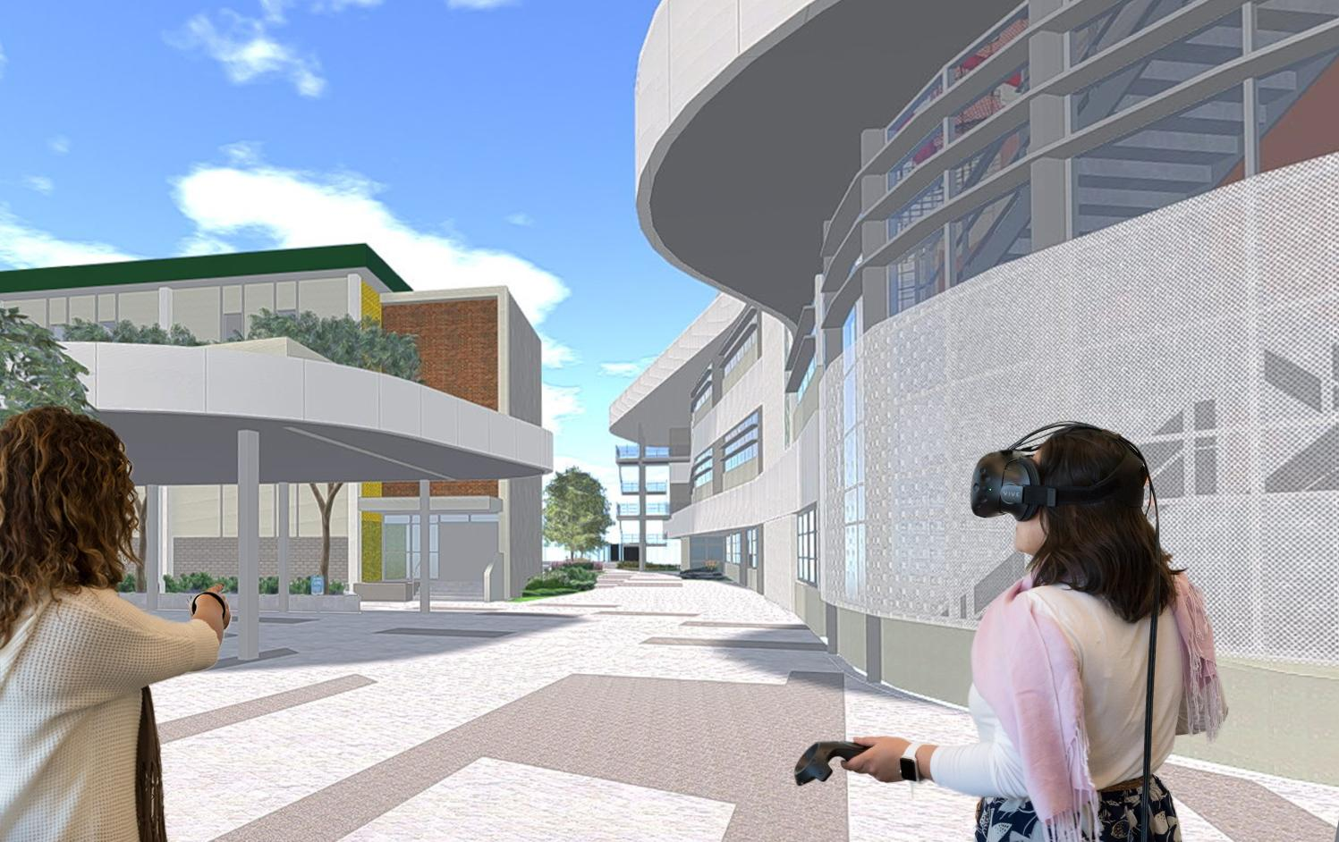
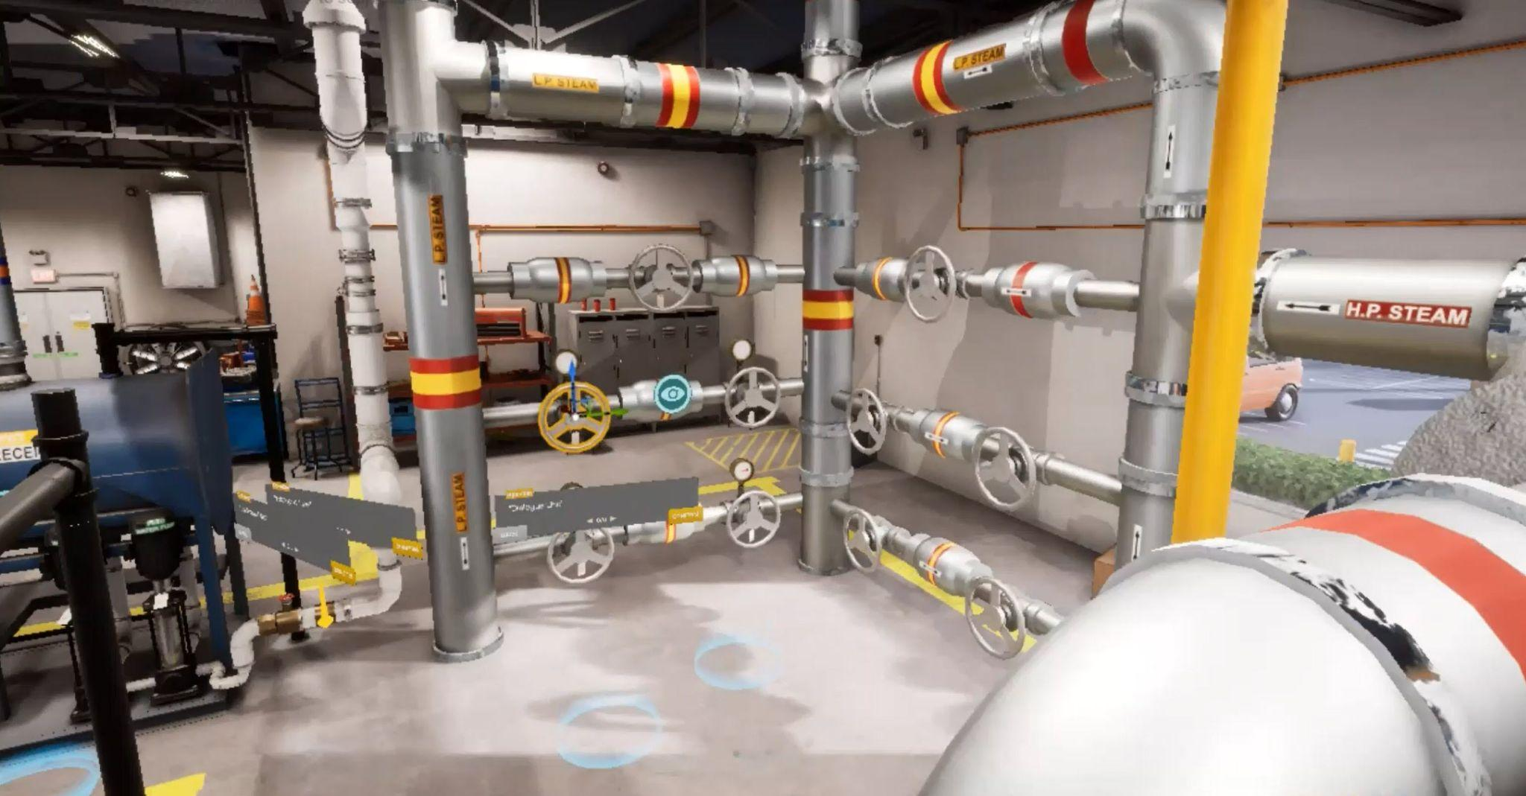
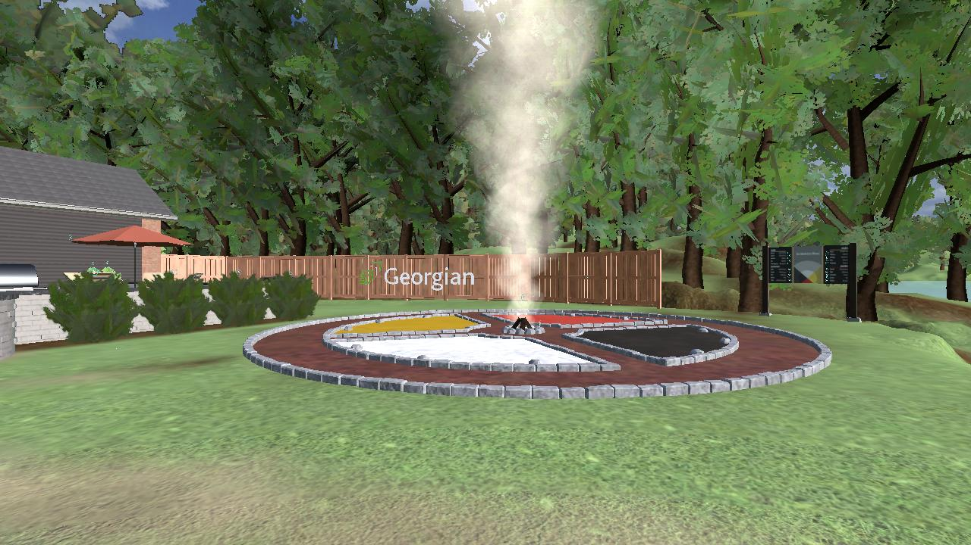
immersive
Notes:
Image on the top right is from HealthScholars. It uses voice recognition and AI to enable the learner to give voice commands to the avatars.

Slide 6
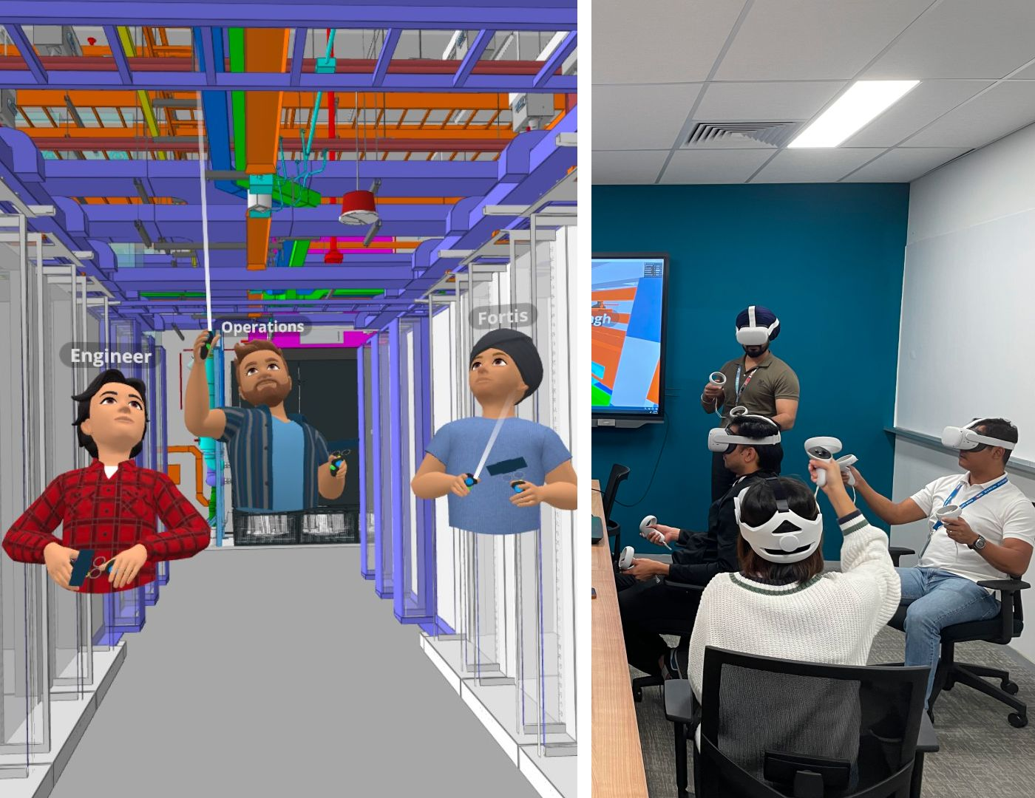
Fortis Construction
Numbers at a glance
~ 9 companies collaborating
~ 30 users reviewing BIM
~ $3 million saved from avoided rework
~ 1.8 million sq. ft. data center reviewed in VR

Slide 7
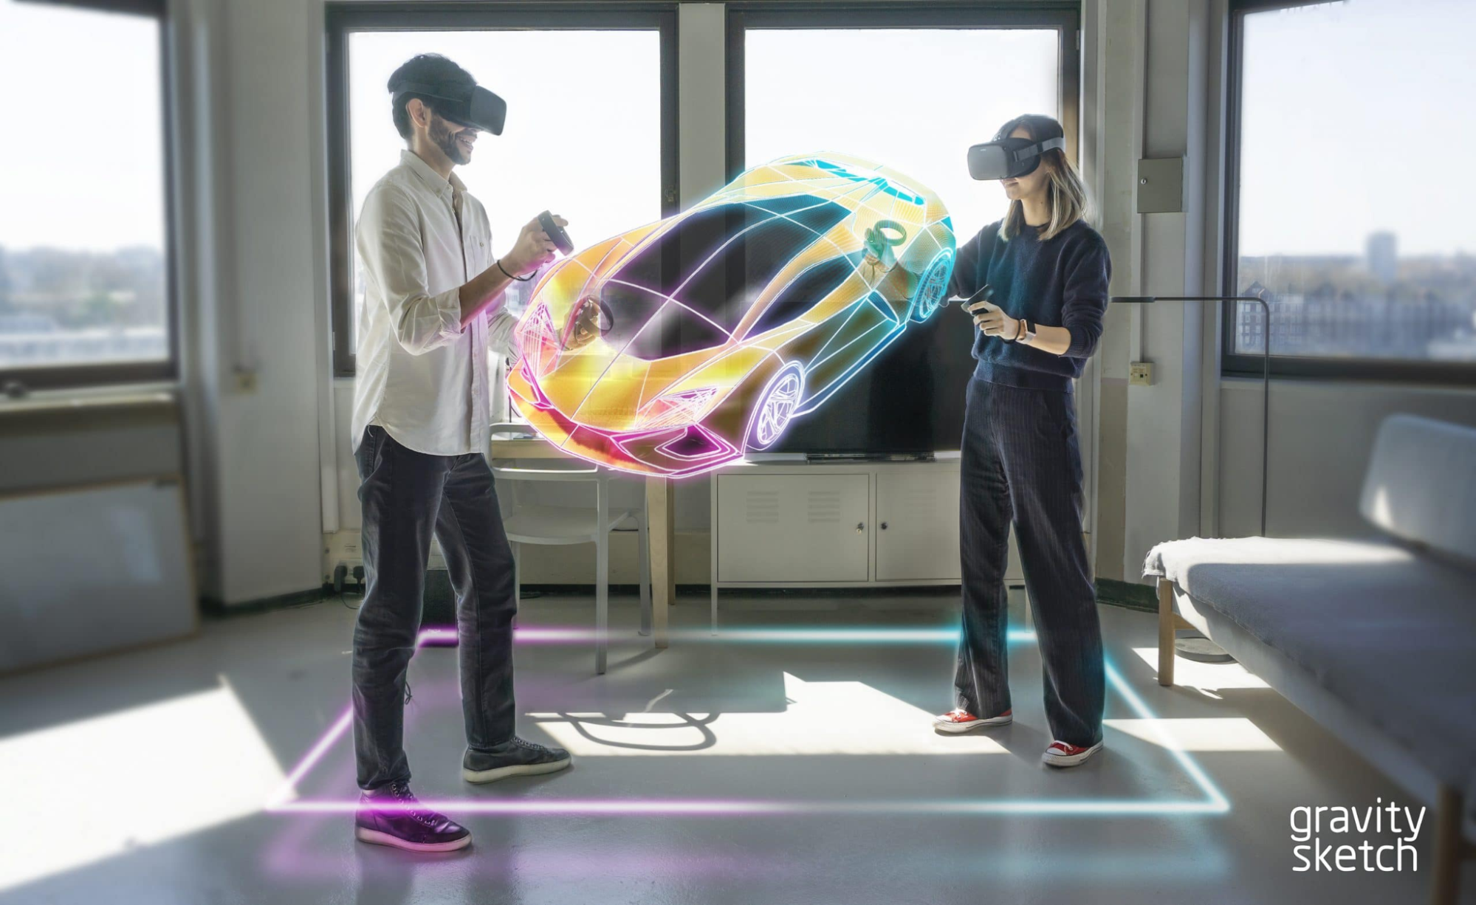
3D Design

Slide 8
Meetings

Slide 9
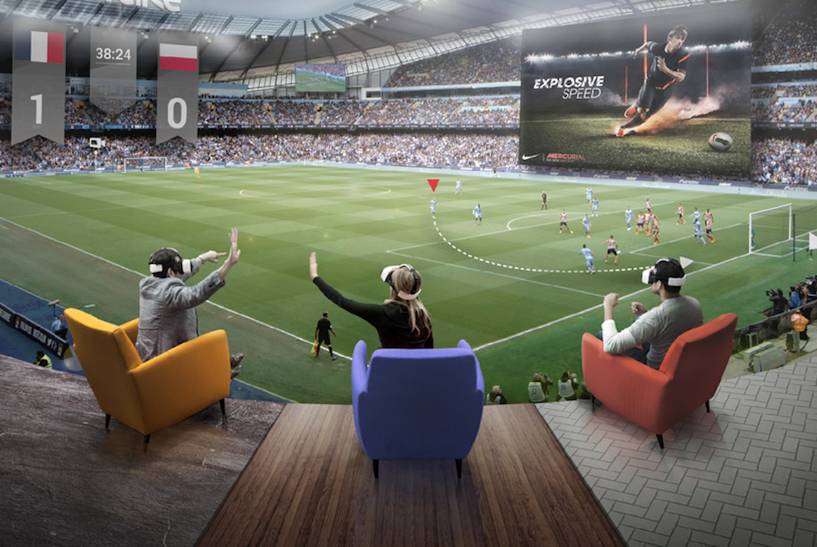
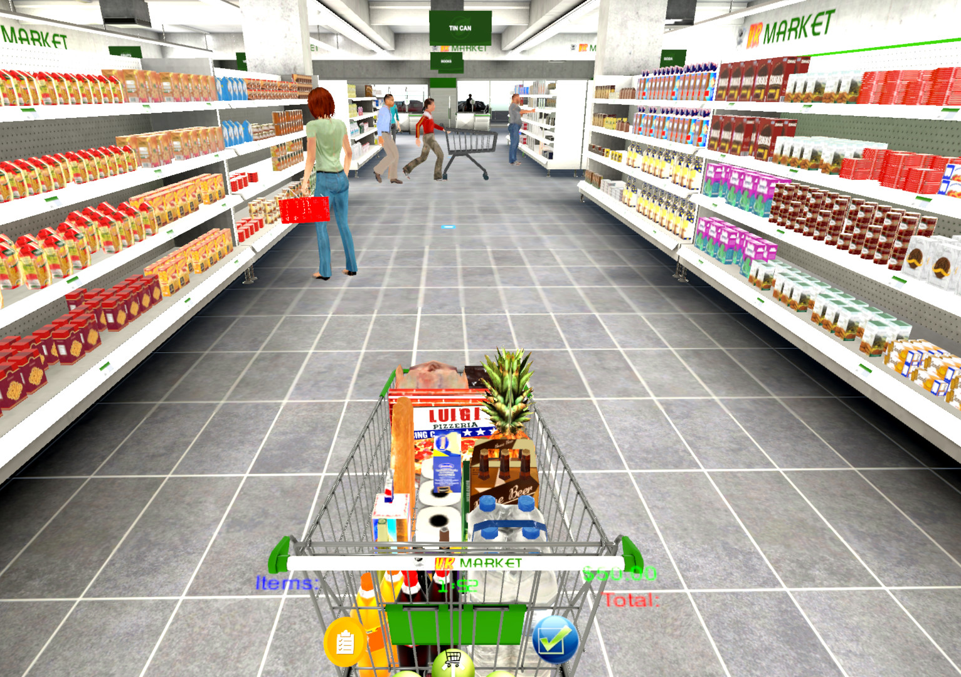
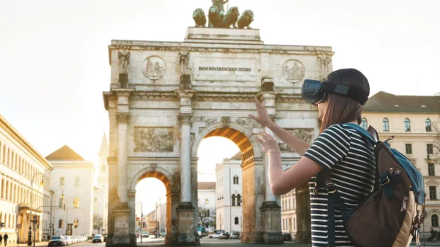
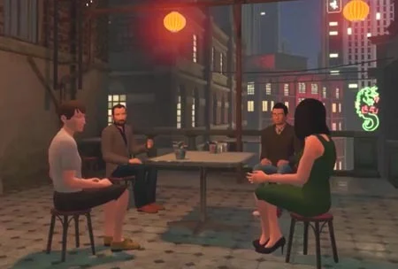
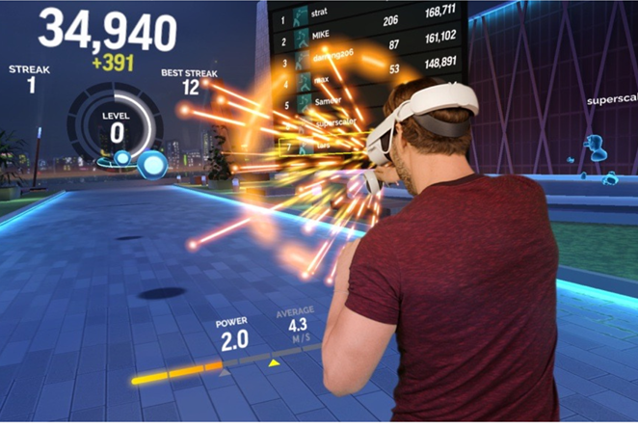
Metaverse

Slide 10
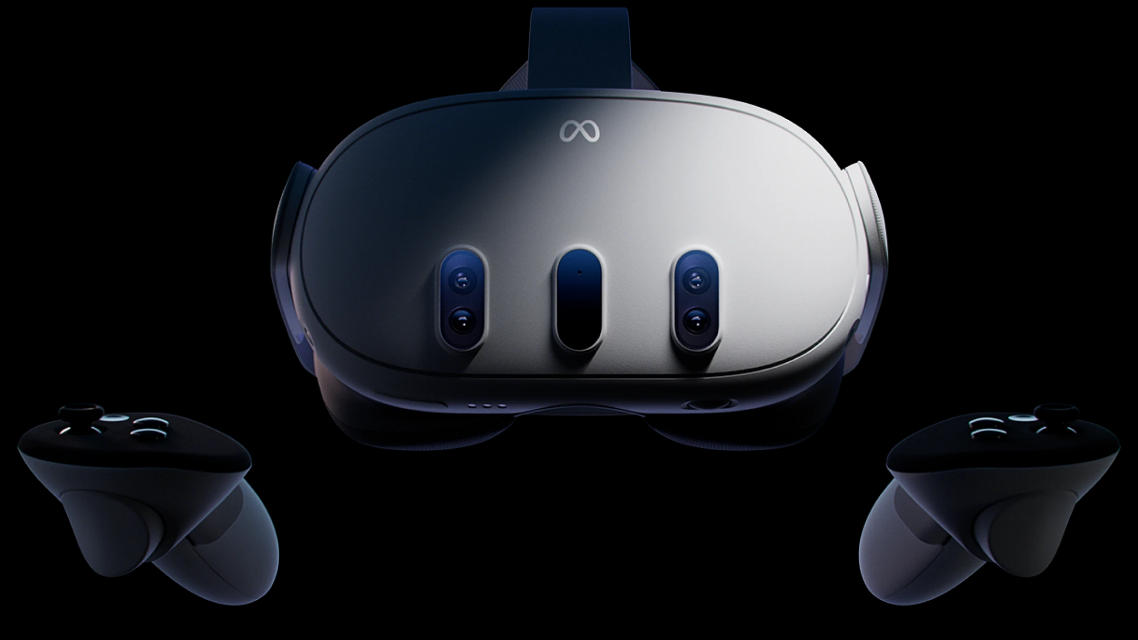
AR/VR & GenAI
Notes:
AI will become increasingly undetectable and pervasive
People will wear augmented reality glasses or contact lenses that will give them access to AI anywhere
Intelligent tutoring will be common place

Slide 11
Future
immersive, experiential & A.I. assisted

Slide 12
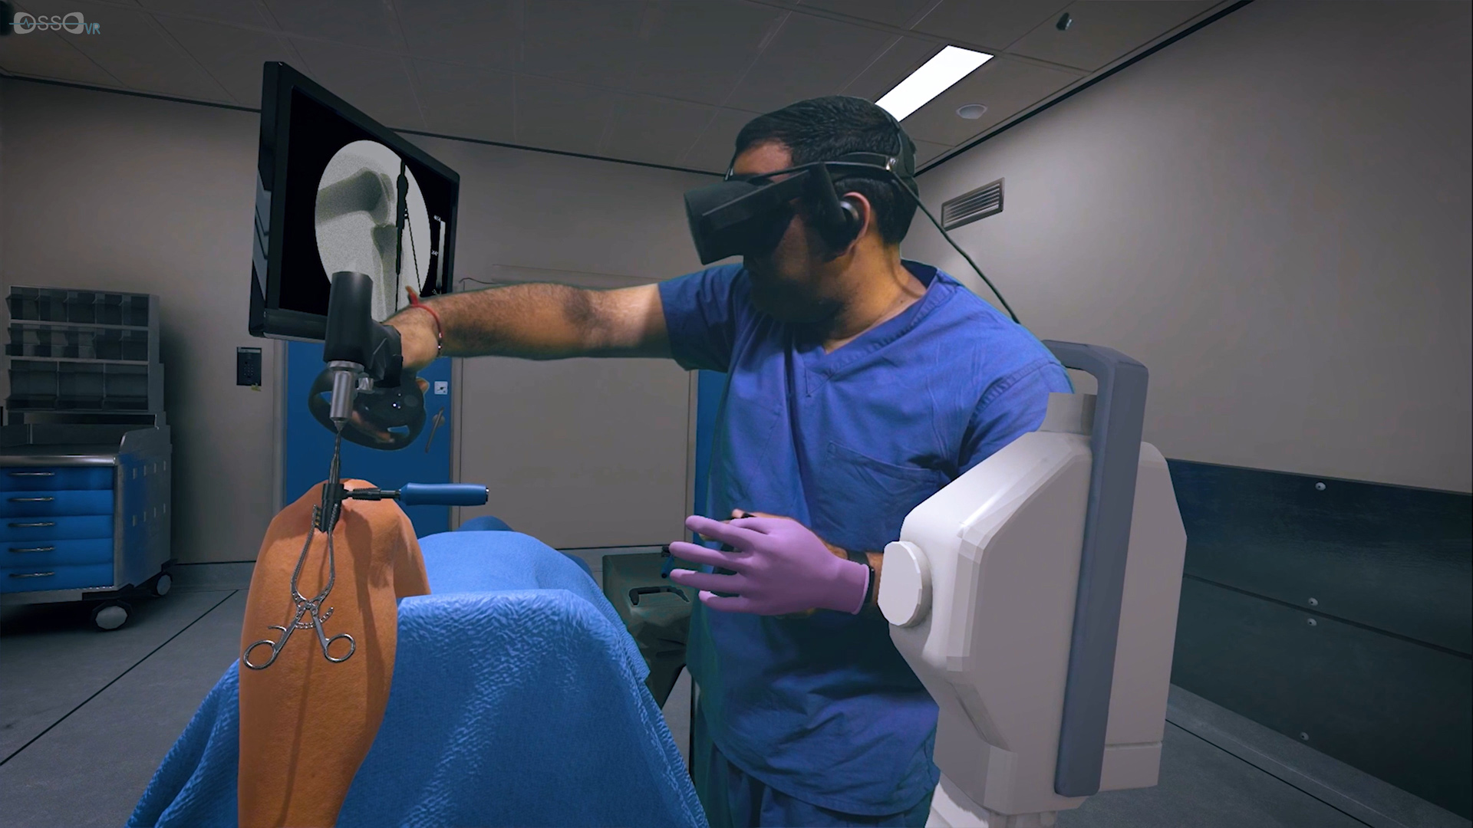
% steps done correctly VR vs Standard 63% vs. 25%.
Higher knowledge retention in VR group: 50% vs 11%”
Blumstein, G., et. al.
Notes:
% steps done correctly VR vs Standard 63% vs. 25%.
Higher knowledge retention in VR group: 50% vs 11%”
Blumstein, G., et. al.

