Slide 1
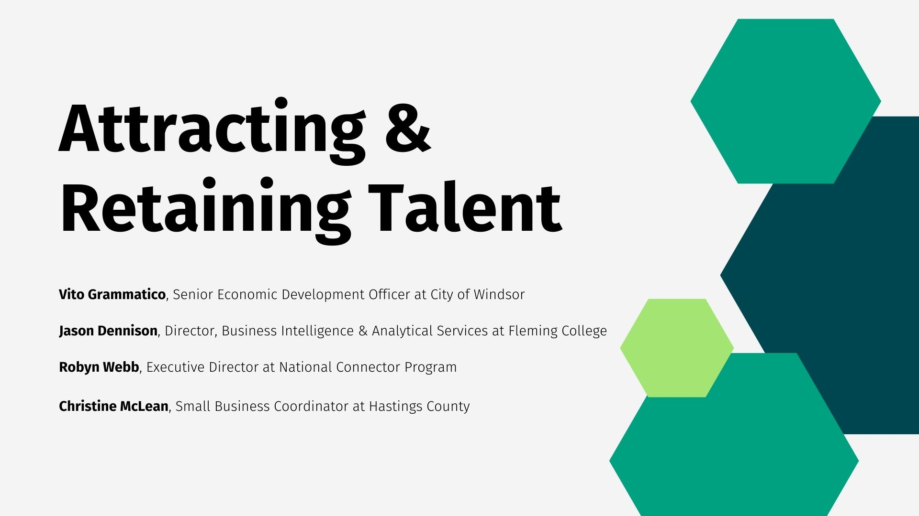

Slide 2
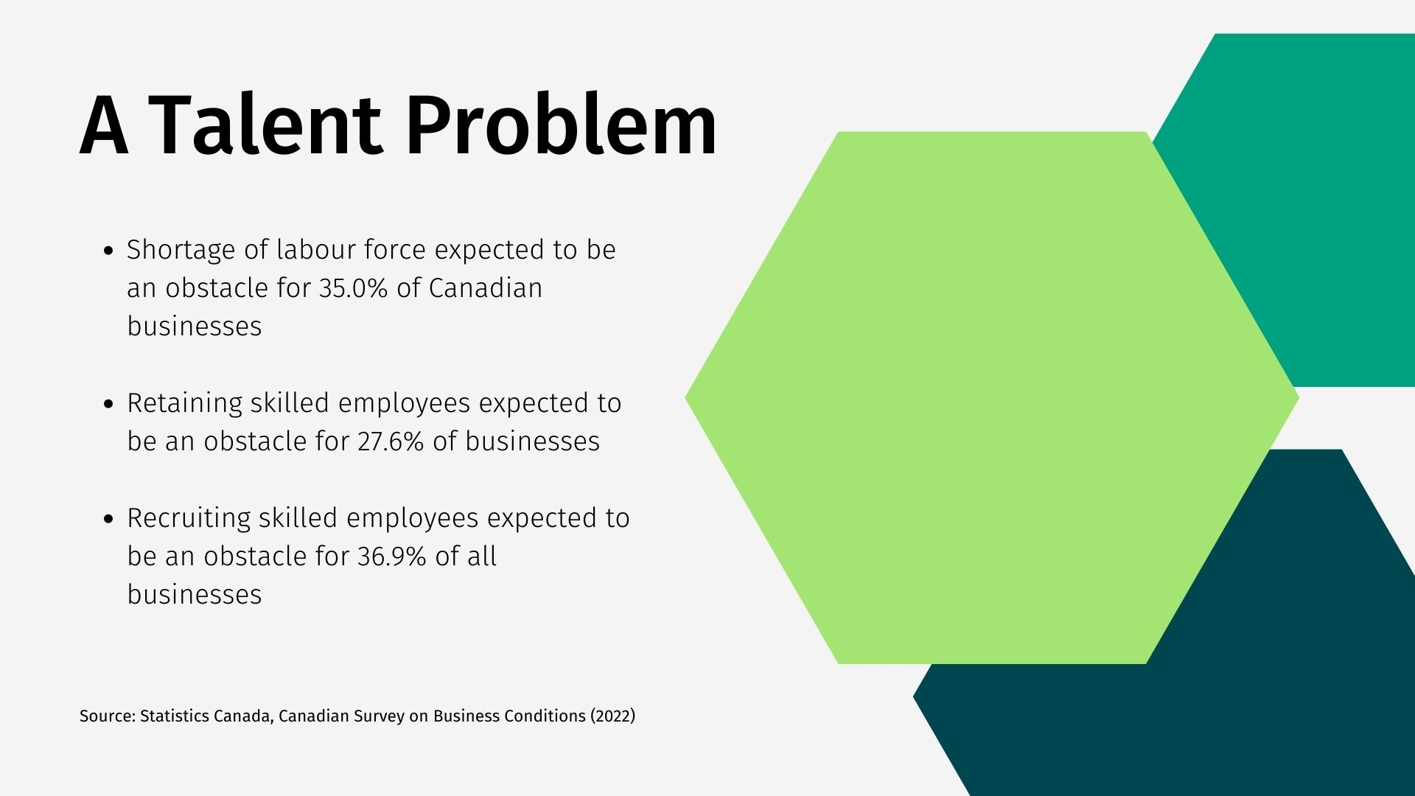
Notes:
Led by those in construction (49.5%), manufacturing (47.4%), and accommodation and food services (46.3%)

Slide 3

Notes:
Let's take a quick look at what we'll cover today in our discussion:
Talent Trends: We'll delve into the latest trends shaping the talent landscape, understanding how these shifts impact our region.
Welcome Network: Exploring the importance of creating a warm and supportive environment for newcomers.
Small Business Support: Understanding how fostering local entrepreneurship contributes to our community's growth.
Q&A: And finally, an opportunity for your questions and insights, fostering an engaging dialogue.

Slide 4


Slide 5
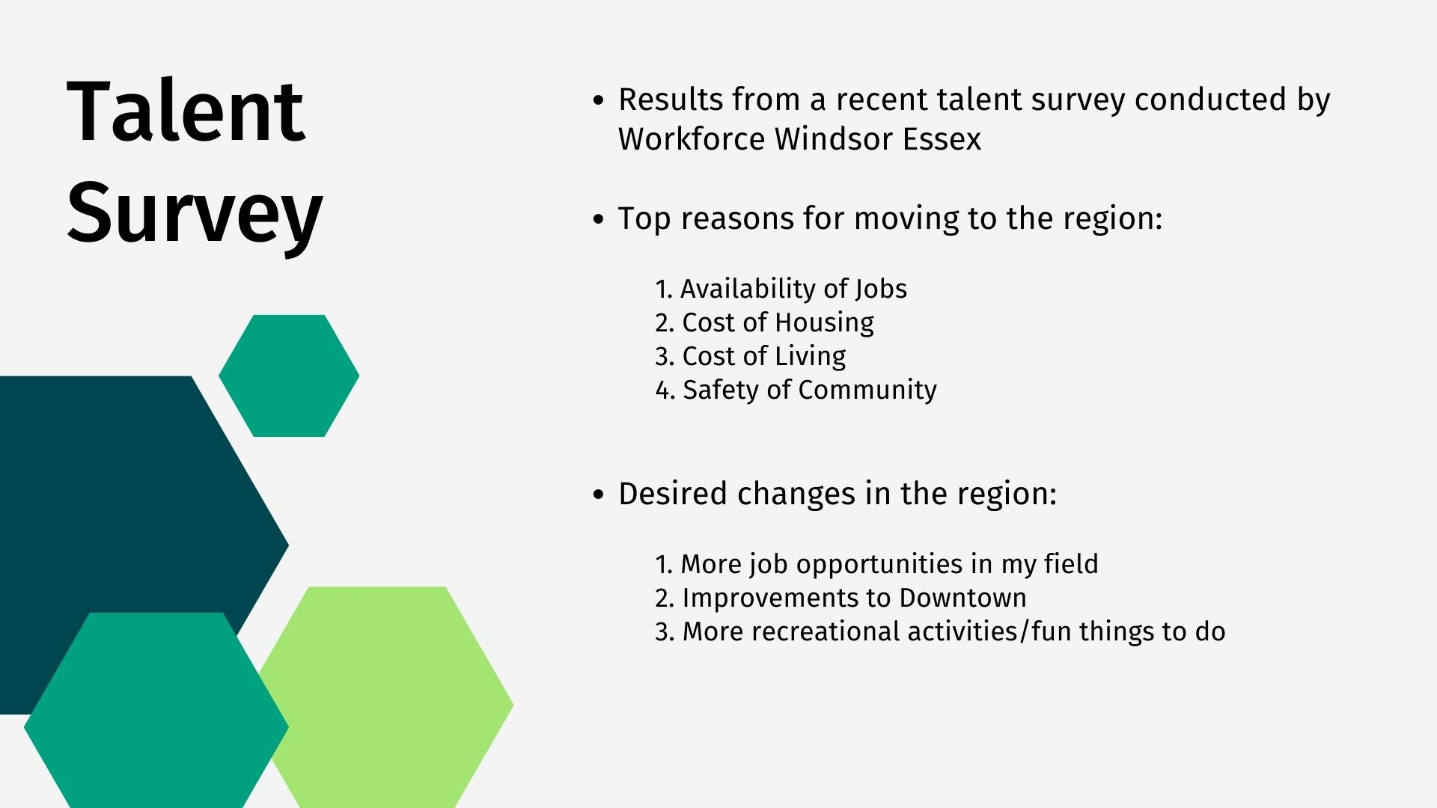

Slide 6
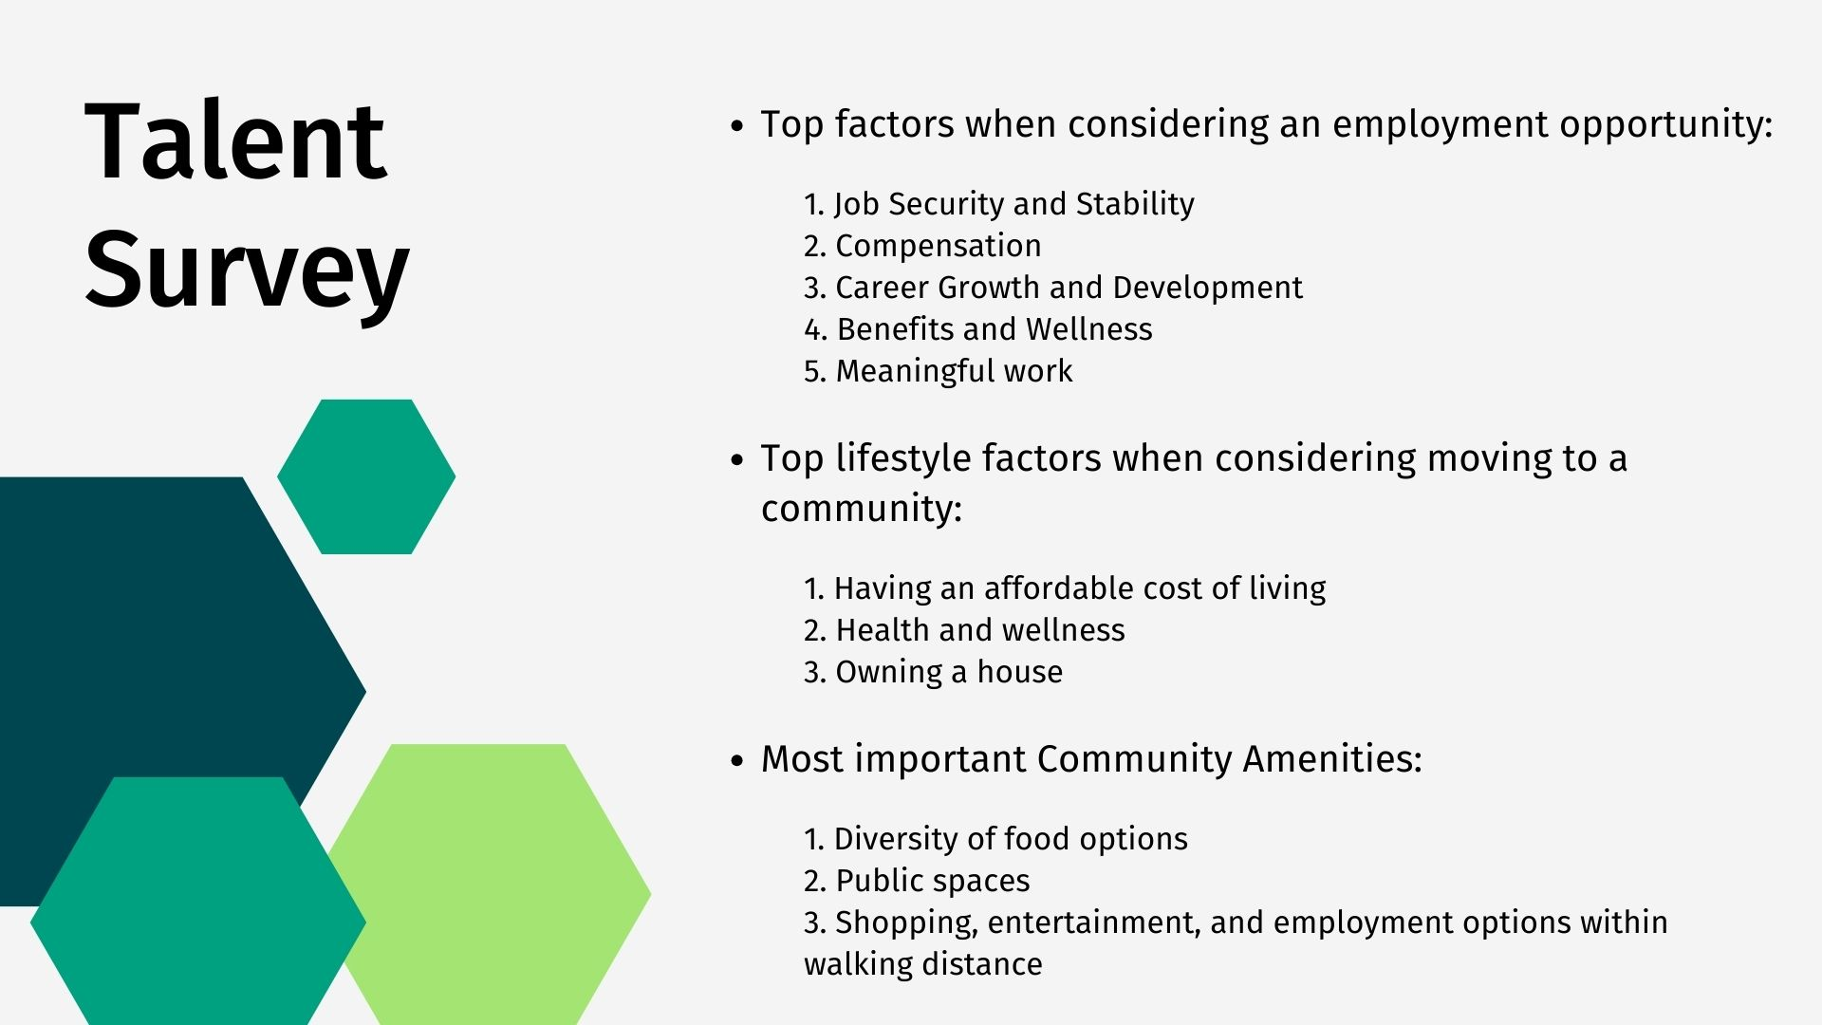

Slide 7

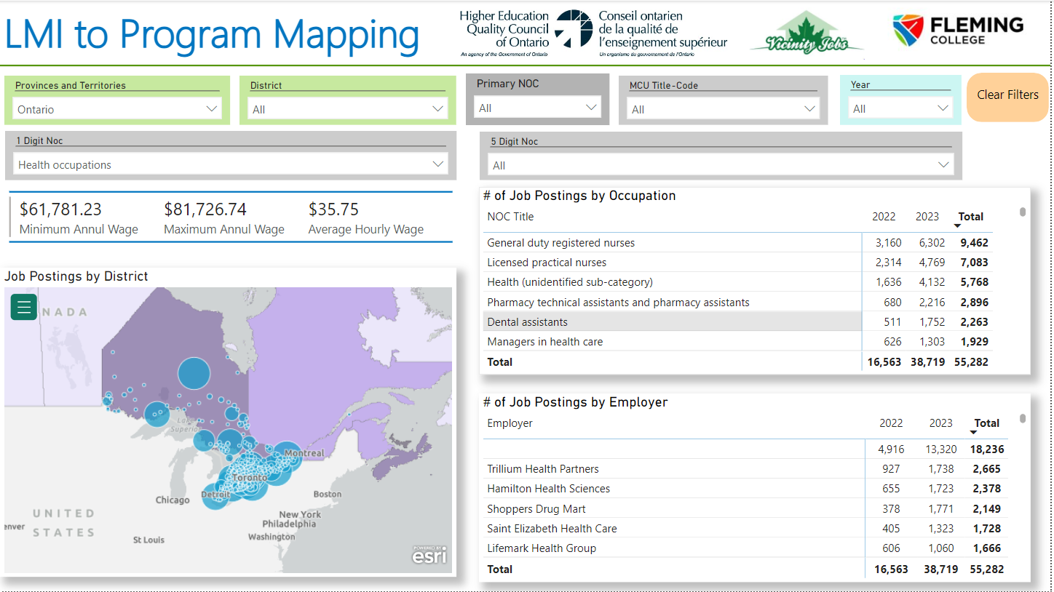
Student Impacts to the Local Labour Market

Slide 8
Common Questions
Do we offer programming that meets the labour market needs of community?
Are the skills and competencies needed by businesses to embedded in our programs?

Slide 9
Emerging Talent Pipeline - International
A growing proportion of enrolment in Fall 2023 and Winter 2024 were international students

Slide 10
New Questions
What is the current employment footprint of international students in community?
Are there opportunities for international students to stay in communities?
What is the overall economic impact of international students in communities?

Slide 11
Economic Impact of Student Spending
Region | Per Student Economic Impact
Brant Niagara Haldimand Norfolk | $49,947
Dufferin Waterloo Guelph -Wellington | $48,935
East | $48,555
Greater Toronto Area | $53,783
Grey Bruce Perth Huron Simcoe | $52,377
Hamilton | $47,868
London Elgin Oxford | $45,591
North | $47,721
Ottawa | $48,122
Southwest | $46,104
Coleman, A. (2023, November 6). Calculating Ontario's Living Wage.

Slide 12
Case Study: International Student Employment (Fall 2023)
Peterborough and Lindsay Campus (n=370)
75% of international students are working
93% of students actively looking for work

Slide 13
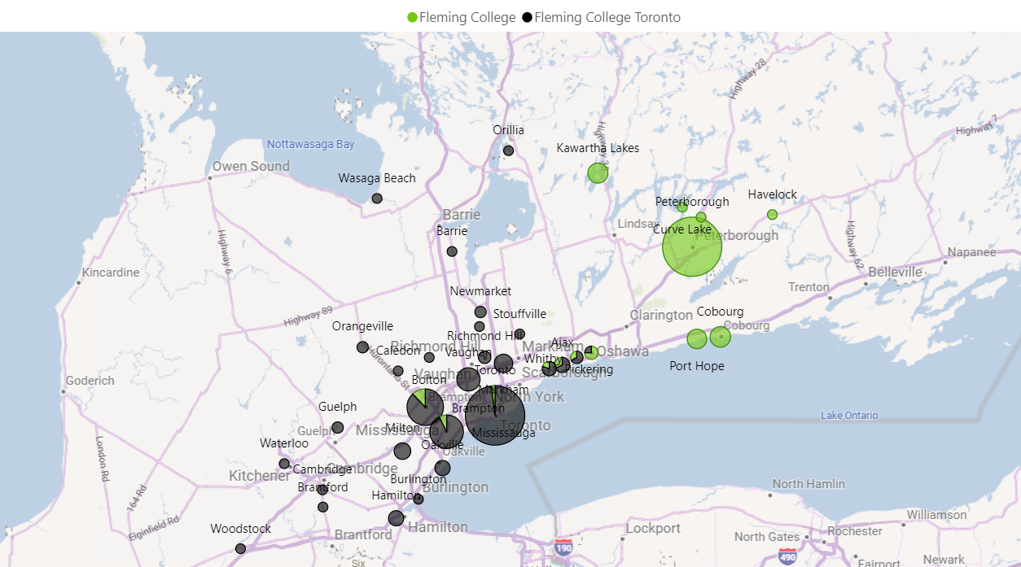
Employment Footprint

Slide 14
What will the graduate impact be on local communities?

Slide 15


National Connector Program

Slide 16


About Halifax Partnership
Lead Halifax’s economic strategy.
Sell and market Halifax to attract business, talent and investment.
Help business and talent reach their full potential. .
Track and report on Halifax’s economic progress.
Notes:
The National Connector Program is based in Halifax, Nova Scotia, the birthplace of the initial Connector Program. The program is delivered by Halifax Partnership
Halifax Partnership is Halifax’s public-private economic development organization. Over 100 private, public and post-secondary partners invest in the Partnership to support economic development.
The Partnership drives and accelerates economic growth by:
Leading the development and implementation of Halifax’s five-year economic strategy in collaboration with the Halifax Regional Municipality and our private, public, post-secondary and community partners. In April we launched Halifax’s Inclusive Economic Strategy for 2022-27 entitled People. Planet. Prosperity.
Selling and marketing Halifax to the world - We promote Halifax's business value proposition of talent, location, cost and, innovation on the world stage and work with partners to attract and grow business and talent.
Helping businesses and talent reach their full potential - We know Halifax and can make the connections that fuel business and economic growth, such as our labour market programs to attract internationally trained professionals which I’m here to talk to you about today.
Tracking and reporting on Halifax's economic progress - We are the go-to source on data, research and insights into Halifax’s economy.

Slide 17
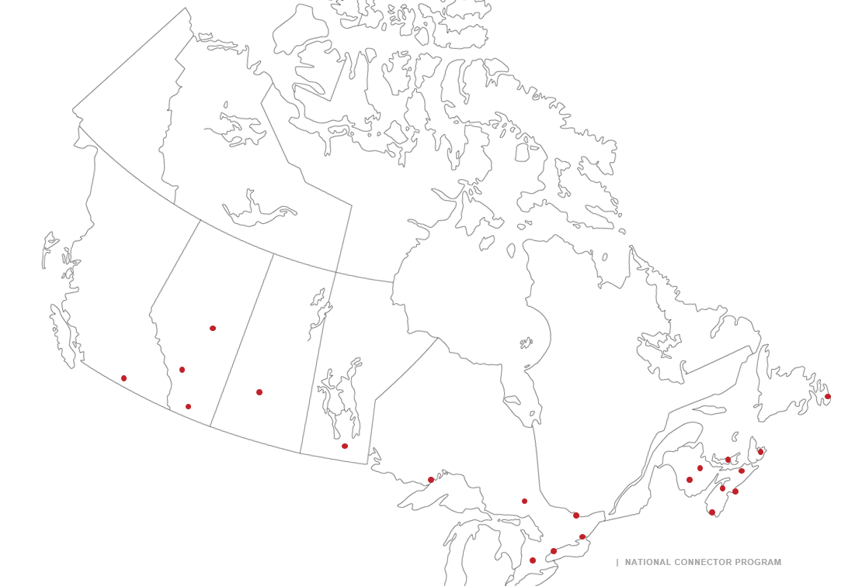
NATIONAL
CONNECTOR PROGRAM
Network of 32 Connector Programs in Canada, in addition to communities in the US and Europe
Notes:
The success of the Halifax Connector Program led the Partnership to develop the National Connector Program in 2013 with funding from the Government of Canada.
The National Connector Program supports 32 communities across Canada, as well as a few in the US and Europe, in creating and offering Connector programs in their locations.
Collectively, the NCP network is committed to building diverse and inclusive communities nationally and internationally through the process of intentional professional networking.
The National Connector Program provides support to 32 communities across Canada, including the 5 Connector Programs across Nova Scotia
Started in 2009 in Halifax, Nova Scotia
Network of 32 communities in Canada, and 7 internationally
5 in Nova Scotia
Halifax
Cape Breton
Western Region
Valley Region
Northern Region
All communities share resources, best practices, learnings, and information and make each program stronger
Through the program, cities, towns, and rural areas become more inclusive, grow their economies and help people to stay in their chosen community

Slide 18
How Does Connector Work?
Match | Connect | Refer
Notes:
The Connector Program matches community and business leaders (Connectors) with pre-qualified recent international and local graduates and internationally trained professionals (Connectees) in their industry.
The Connector Program’s innovation and effectiveness lies within three simple steps:
Local immigrant serving organizations and post-secondary career centers refer employment-ready participants (Connectees) to the program.
Program staff coach the Connectee and match them with a Connector in their field.
The Connector and Connectee meet face-to-face. After the meeting, the Connector links the participant to at least three other people in their business network. Those three people also refer three more people to the Connectee.
Through direct referrals from Connectors, Connectees learn about the local job market and rapidly grow their business network which increases their likelihood of finding a job and staying in their community.
Connectors benefit by gaining access to pre-qualified job seekers and helping to grow their industry and the local workforce.
It’s a win-win-win - for the Connector, the Connectee, and the economy

Slide 19
Connecting Newcomers to Opportunity
Newcomers face many challenges finding meaningful employment
  Cultural, language, experience, bias
  Lack of established networks​
  Circles of trust ​
  Knowing where to look, who to ask, what to say
Finding the right contact is a big challenge for a newcomer
Notes:
In 2009, the Halifax Partnership noticed a trend in talking with the business community – consistently one of the top 3 challenges business was facing was access to talent. On the flip side, many highly skilled and experienced immigrants were moving to the city, but were not being hired…mostly due to lack of networks and not being within those circles of trust that matter in most business settings.
Imagine moving to a brand new city, not knowing anyone or maybe even having a strong command of the language or culture of that city yet. Would you know what services are available? Where to start? Even what companies work in your industry? This is the challenge most newcomers face. The Connector Program can help alleviate this challenge by connecting a newcomer to someone already working in their industry, who knows the companies and the people this person should meet with.

Slide 20
Engaging Business
Filling labour gaps​
Talent retention for businesses​
Increasing diversity in companies (in all forms)​
Growth in local economy​
Businesses as leaders in community
Notes:
If workforce availability is a chief concern for business, then why are so many young professionals and immigrants finding it difficult to secure employment? ​
​
It is clear that a gap exists between businesses looking for talent and talented immigrants and local and international post-secondary graduates looking for employment opportunities.

Slide 21


ATTRACTING TALENT
Think Different
Let Them Tell Your Story

Slide 22




Think Different
Notes:
Who is your target market?
Dying and underpaid industries – The arts, journalism, etc.
Build your network outside of your industry – diverse economies are strong economies

Slide 23
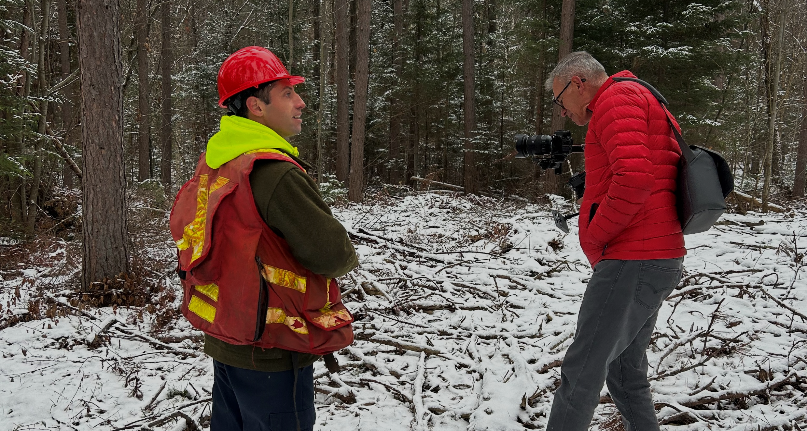
Let Them Tell Your Story
Notes:
Video Testimonials / I Left the City
Mutually beneficial (County, Business, Videographer) + cross-promotion

Slide 24

RETAINING TALENT
Value Them
Help Them Grow

Slide 25

Help Them Grow
Notes:
Business Coaching
Events + Networking

Slide 26

To Attract, You Have To Be Attractive

Slide 27


