Slide 1
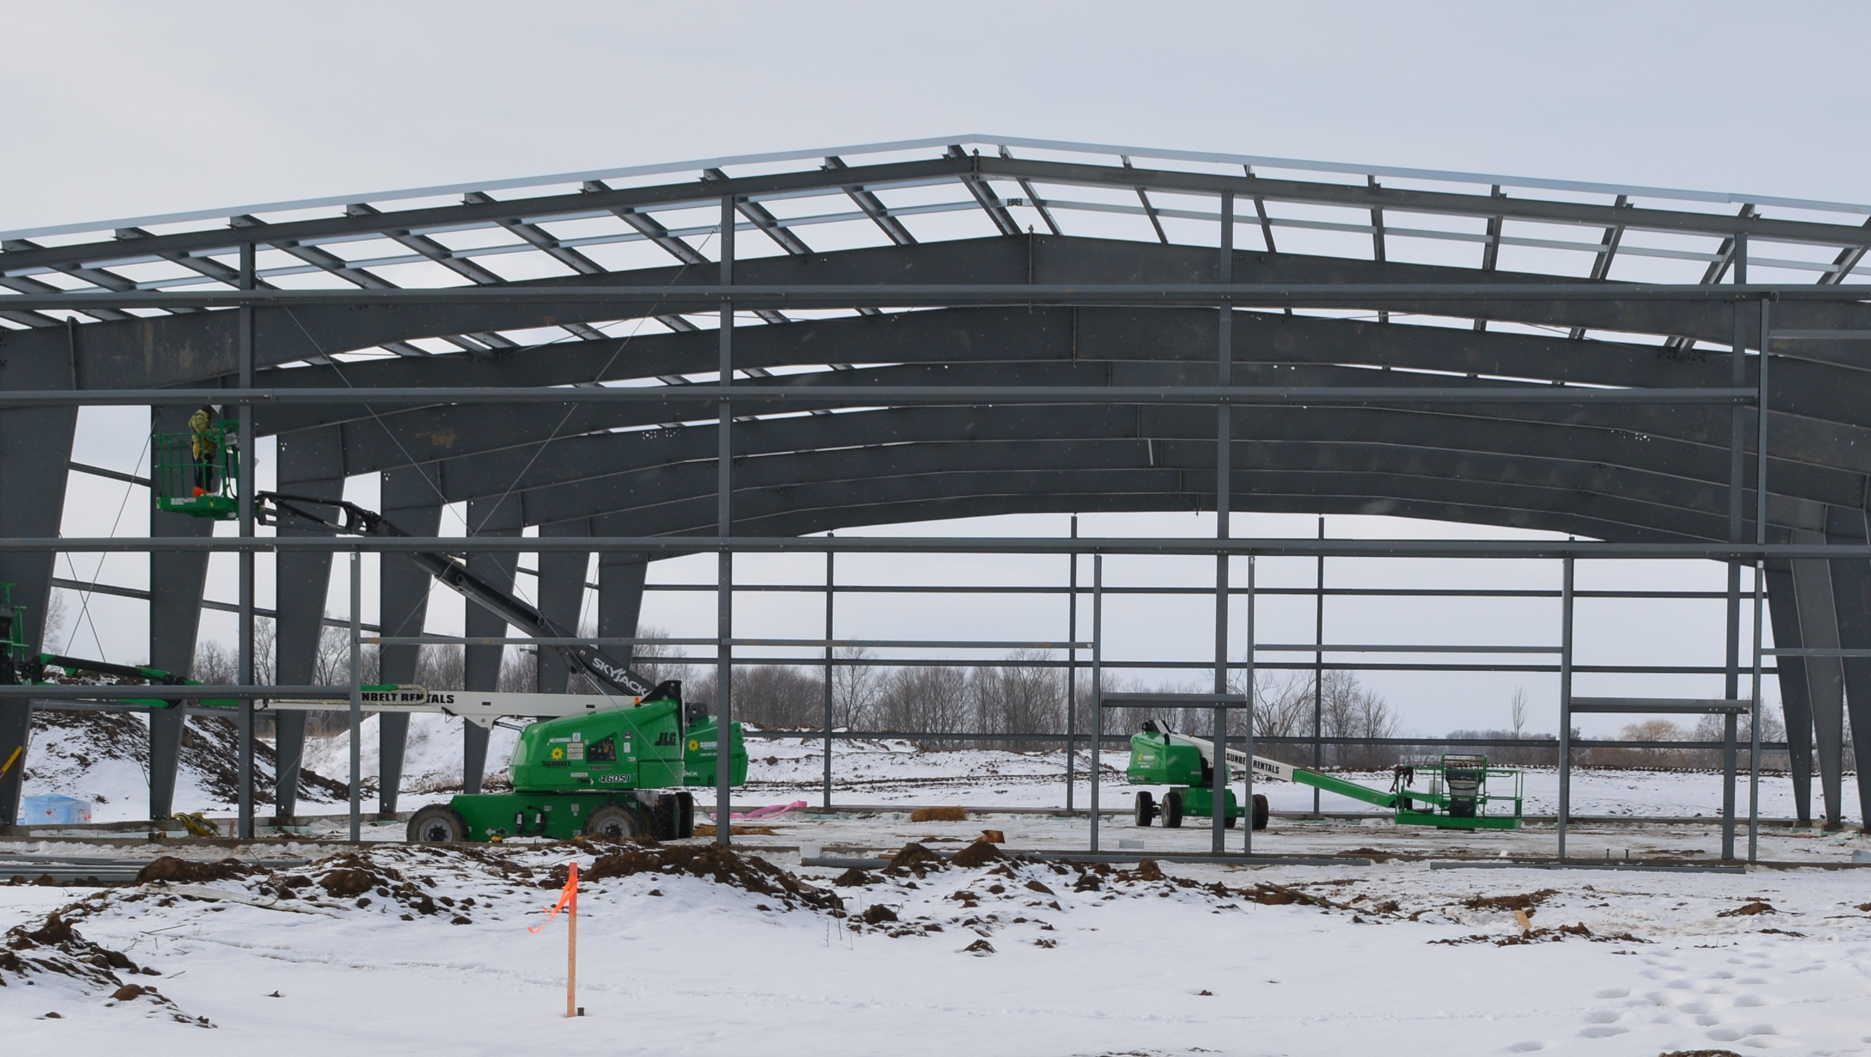
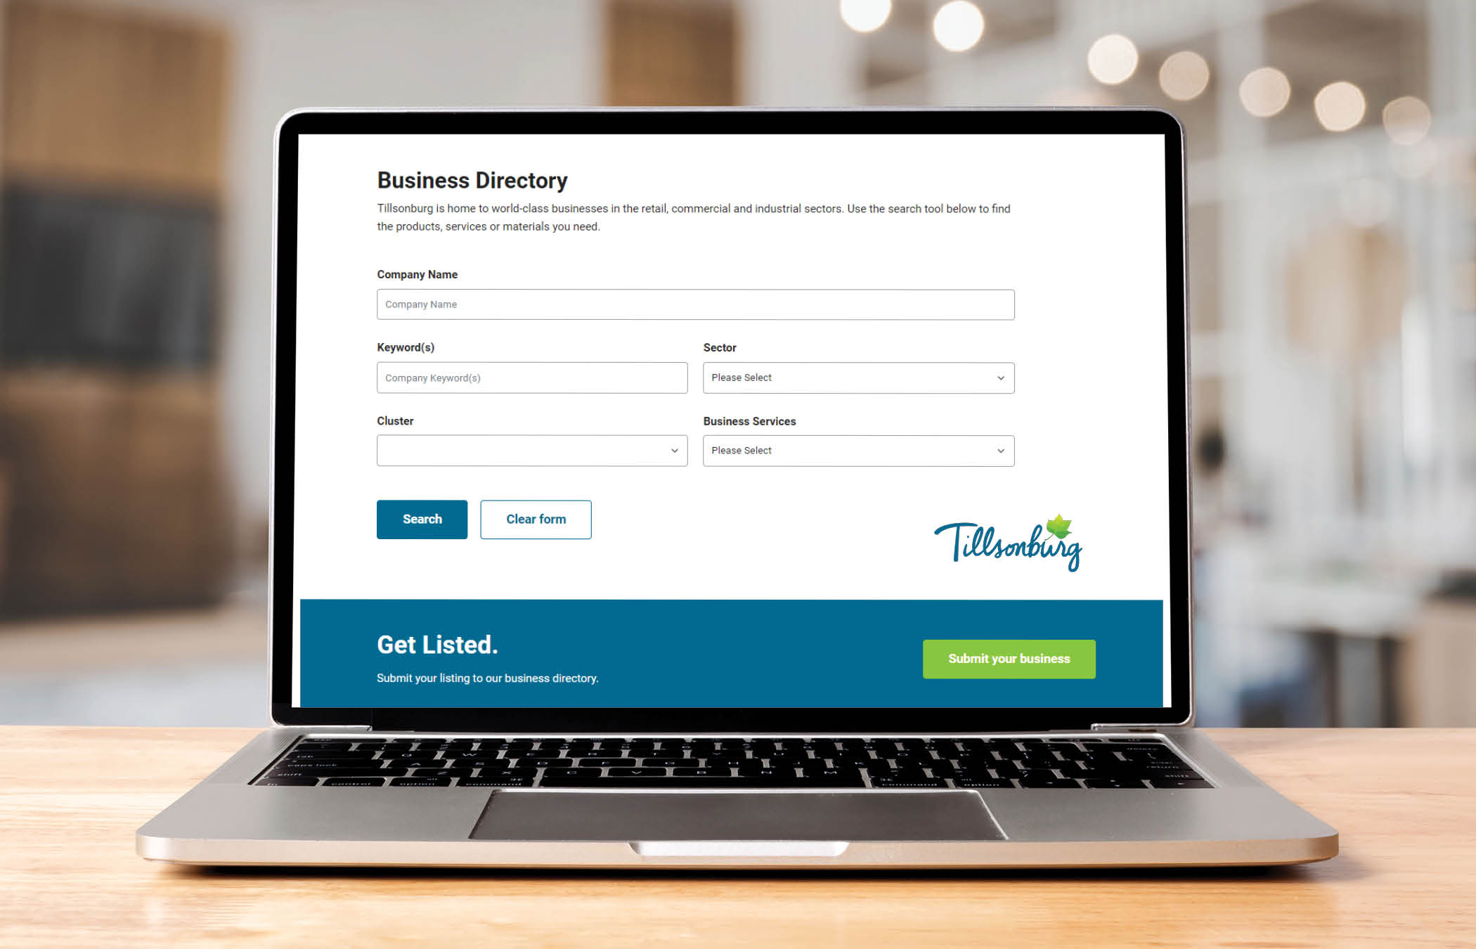
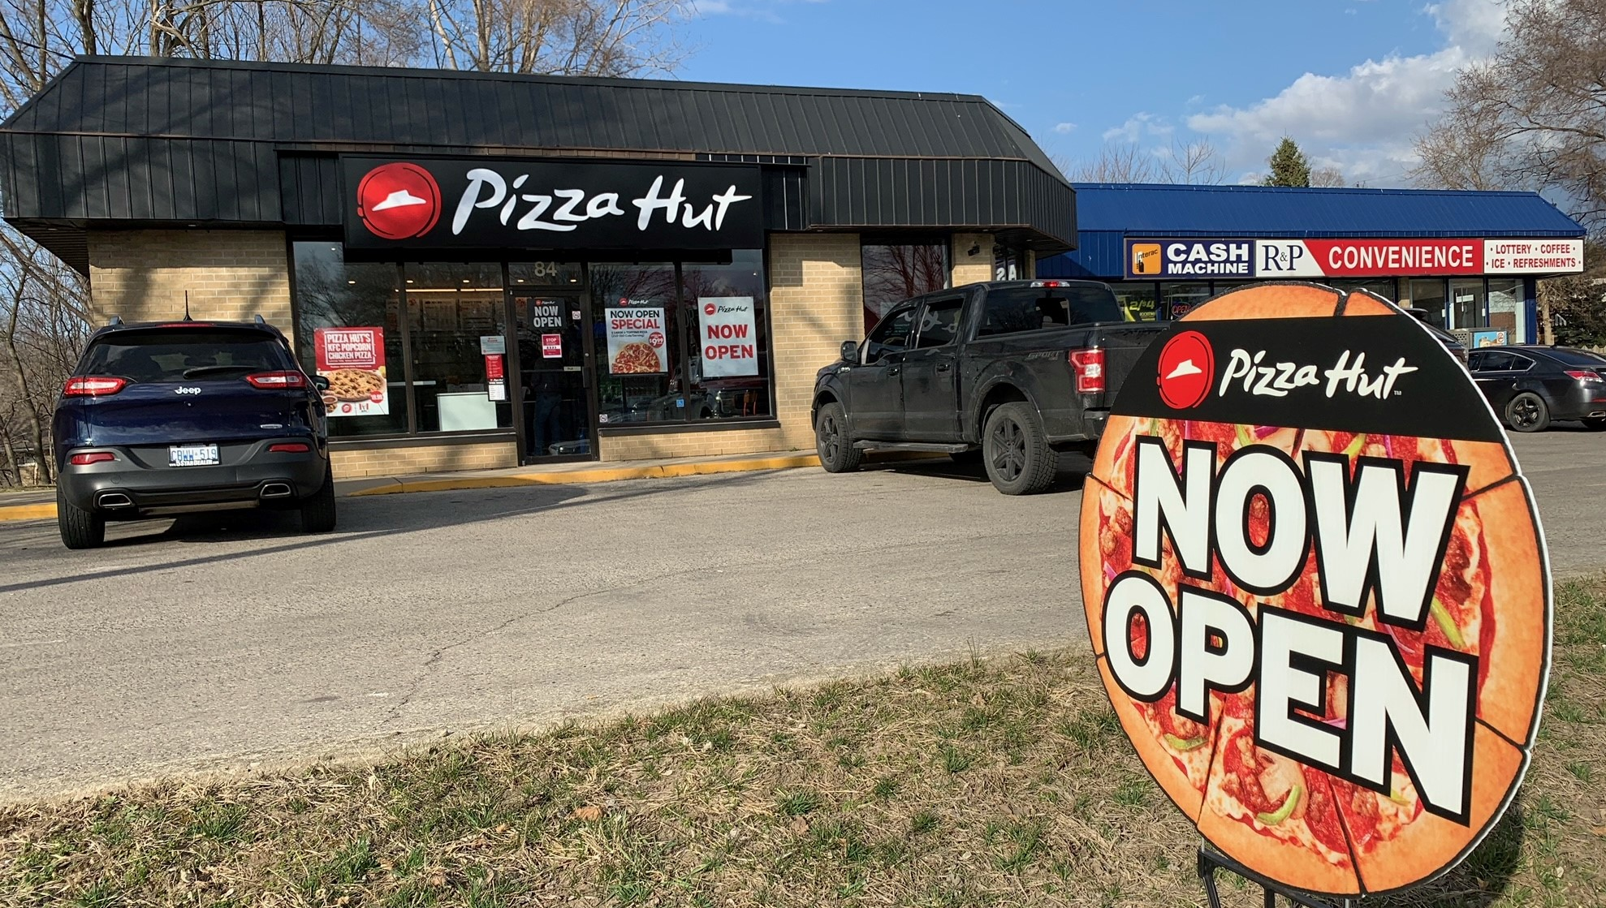
Investment Evaluation on the Back of a Napkin!
February 7, 2024

Slide 2
Billion Dollar Deals???

Slide 3
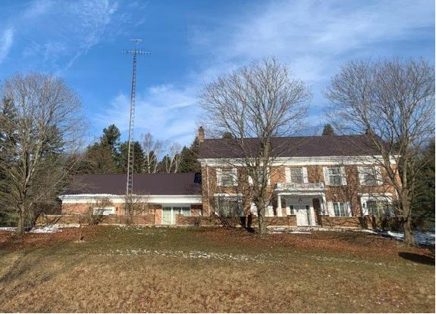
No, Just Million Dollar Deals…
Notes:
https://propertymetrics.com/blog/real-estate-proforma/

Slide 4
Definitions:
Proforma - Simply means cash flow projection
The word “pro forma” is Latin for “as a matter of form” and it is a term used to describe the document that lays out a cash flow forecast
Important because it shows a forecast of all sources of income and expenses for a property as well as a bottom-line cash flow figure
Source: www.PropertyMetrics.com

Slide 5
Simple Proforma/Simplist Proforma
Potential Gross Revenue
– Vacancy/Credit Loss
= Effective Gross Income
– Operating Expenses
= Net Operating Income
– Other Expenses
= Cash Flow Before Tax
Potential Gross Revenue
– Expenses
= Cash Flow Before Tax
Notes:
https://propertymetrics.com/blog/real-estate-proforma

Slide 6
Definitions:
Cash-on-Cash Return
The income earned in a year compared to the cash invested into a property
Source: www.PropertyMetrics.com
Notes:
https://propertymetrics.com/blog/cash-on-cash-return/

Slide 7
Definitions:
Capitalization (Cap) Rate
The ratio of Net Operating Income (NOI) to property asset value
Represents the percentage return an investor would receive on an all cash purchase
Source: www.PropertyMetrics.com
Notes:
https://propertymetrics.com/blog/cap-rate/

Slide 8
Investment Evaluation on the Back of a Napkin – “Tillsonburg Style”
Industrial Park Development
Acquisition & Development Costs
= $17.5 M ($125K/Acre)
Revenue = $21 M ($150K/Acre)
Net Revenue = $3.5 M ($25K/Acre)

Slide 9
Investment Evaluation on the Back of a Napkin – “Tillsonburg Style”
So, a “no brainer”, right???
For rough comparison, the net revenue of $3.5 M results in a 30% Cash-on-Cash return on the total amount of $11.5 M invested ($6 M borrowed)
Sounds good, but what about interest costs, vacancy costs (and for a municipality, the Opportunity Cost of the investment)???
Notes:
For longer term industrial park investments, require a multi-year proforma

Slide 10
THANK YOU
New CRM & Automated Business Directory
Town of Tillsonburg Economic Development & Marketing

