Slide 1


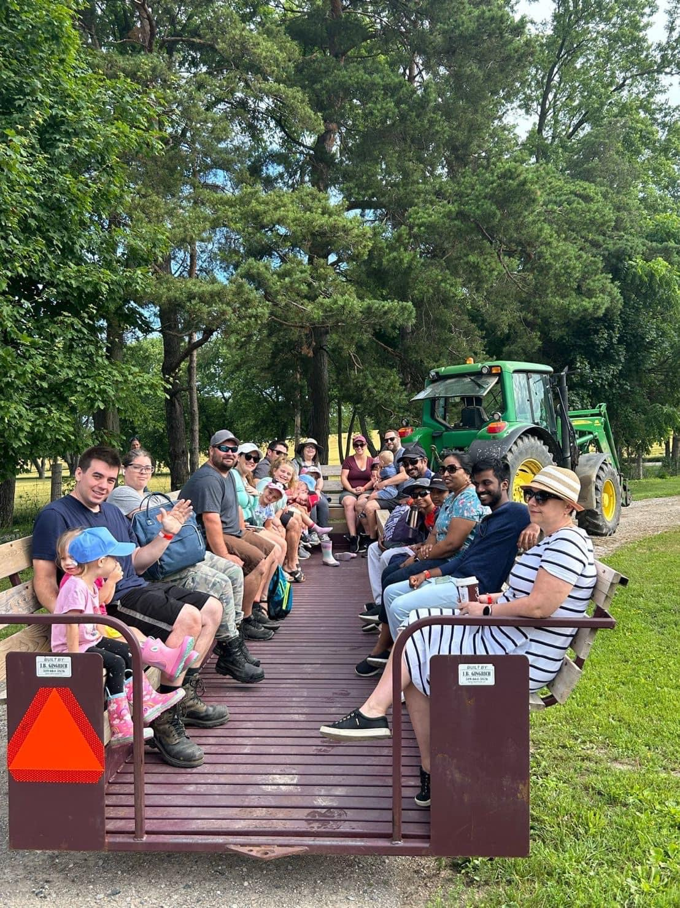

PERTH COUNTY
MYSTERY FARM HOP
An inclusive agricultural event that created a platform for cultural exchange and community engagement

Slide 2
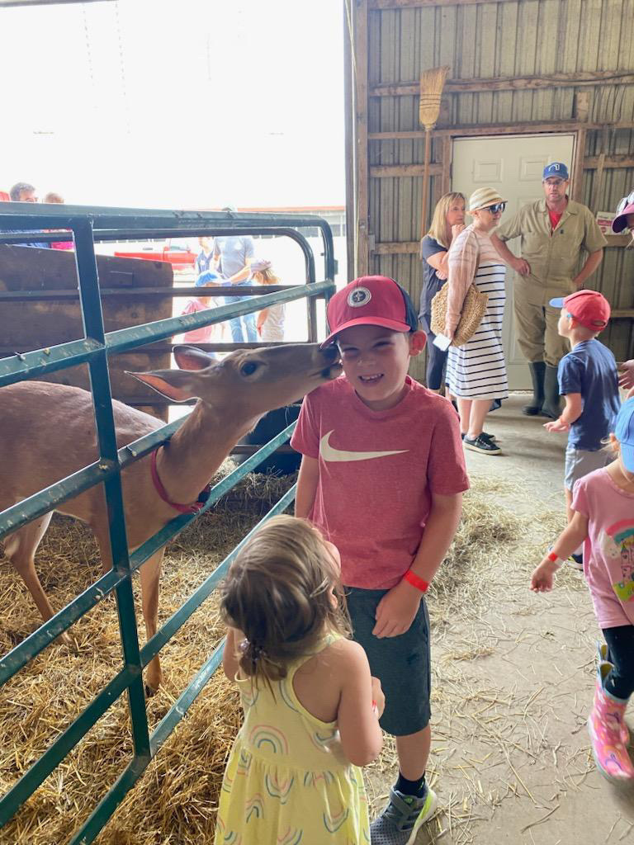
OUR MISSION
Provide participants with the opportunity to embark on a bus tour, visiting four Perth County farms to sample local products, engage with farm animals, and experience new unique rural adventures.
HOST AN INCLUSIVE EVENT WITH NO BARRIERS TO PARTICIPATION
  Provide individuals with the opportunity to learn about local agriculture and farm operations
  Showcase Perth County’s agritourism assets
  Promote PC Connect, Perth County’s public bus service

Slide 3

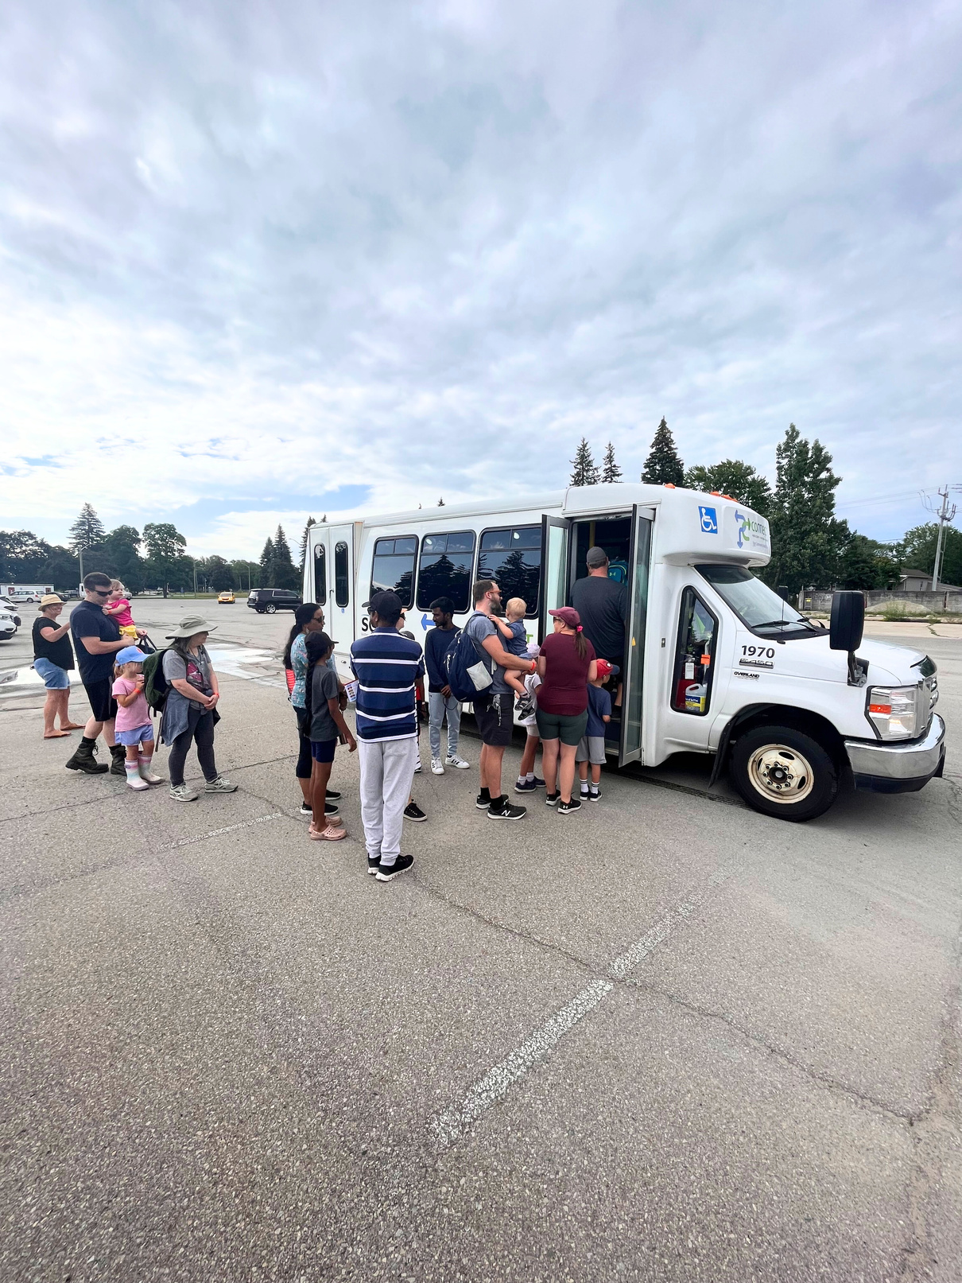
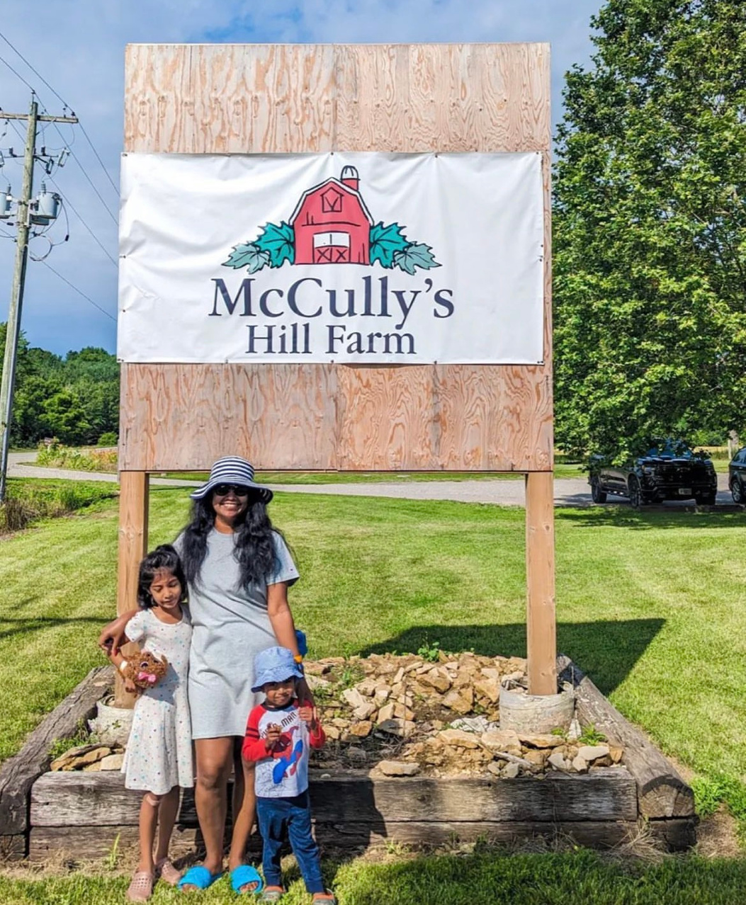
ABOUT THE EVENT
Upon arriving at the starting location, participants were provided with a scheduled itinerary where 4 mystery farms were revealed. Participants boarded PC Connect and were chauffeured from farm to farm. The day included wagon rides, animal interactions, product sampling, an interactive craft, and complimentary local food.
150 PARTICIPANTS
4 FARMS
Within 48 hours of organically launching on social media, the Farm Hop Event completely SOLD OUT!

Slide 4
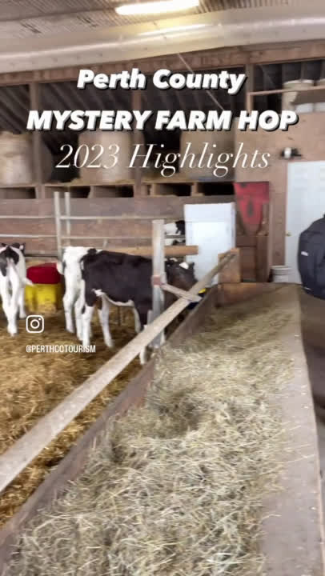
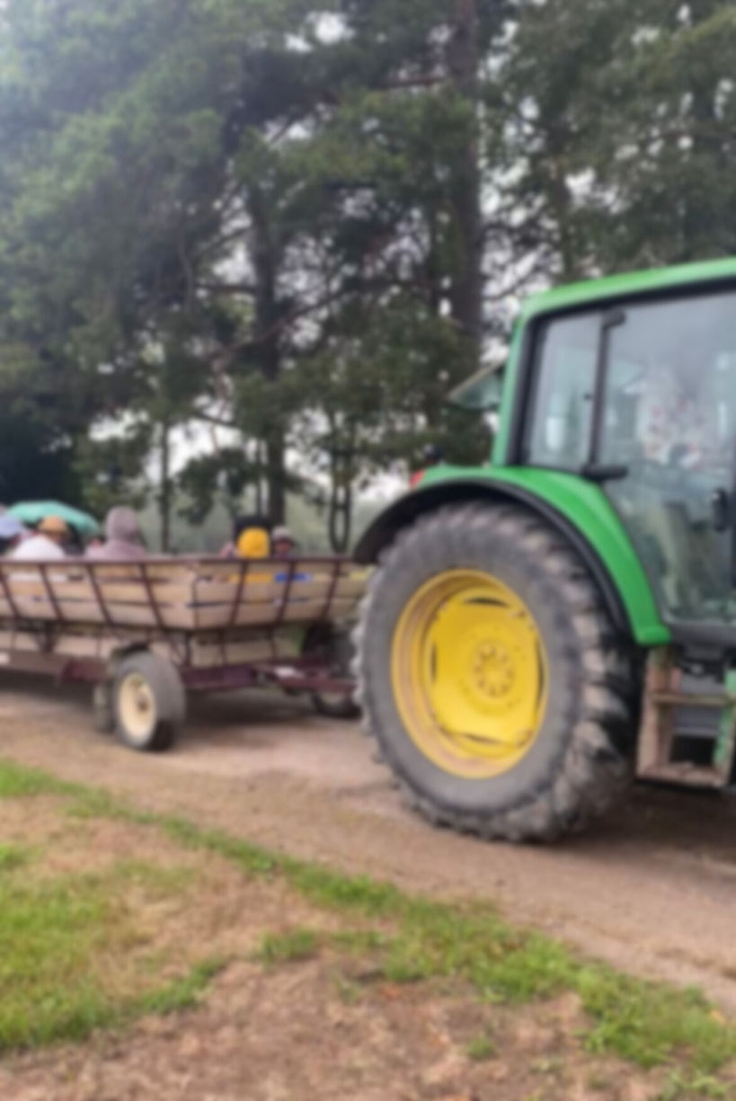
THE OUTCOME
91%
Participant satisfaction
91%
New participants
87%
Likely to ride PC Connect again
22%
Never visited a farm before
100%
100%
VENDOR SATISFACTION
INCLUSIVITY
The FREE event welcomed diverse participants from different cultural backgrounds, ages and socio-economical statuses.
In addition to day-of sales, farm vendors felt they gained several new customers.

Slide 5

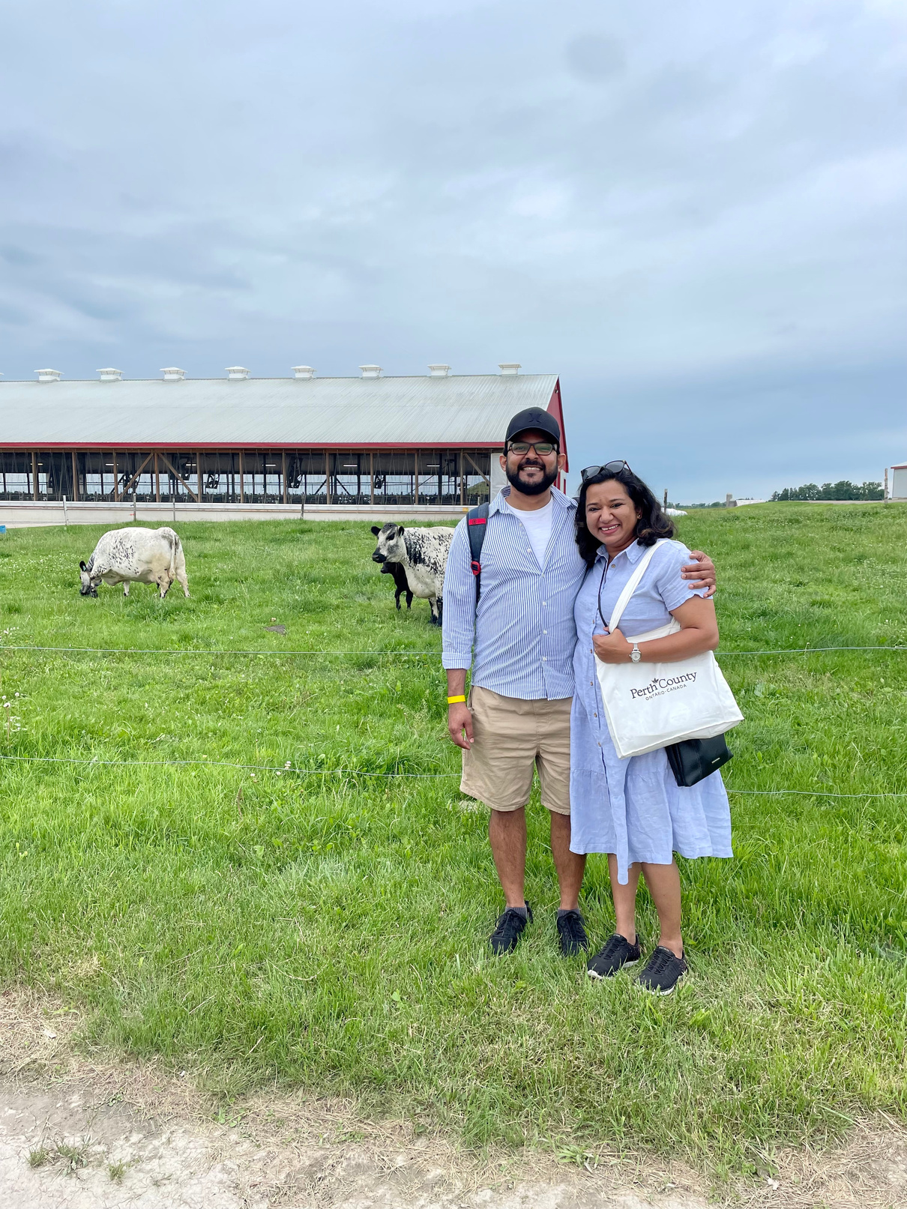
TESTIMONIAL
"The Farm Hop provided a unique opportunity for cultural exchange, fostering understanding and appreciation between different communities. By organizing such inclusive and diverse events, you are creating an environment where immigrants like me can grow roots, find a sense of belonging, and contribute to the broader community. The Farm Hop not only celebrated our cultural diversity, but also highlighted the common bonds we share as residents of Perth County.”
Najma Jose

Slide 6

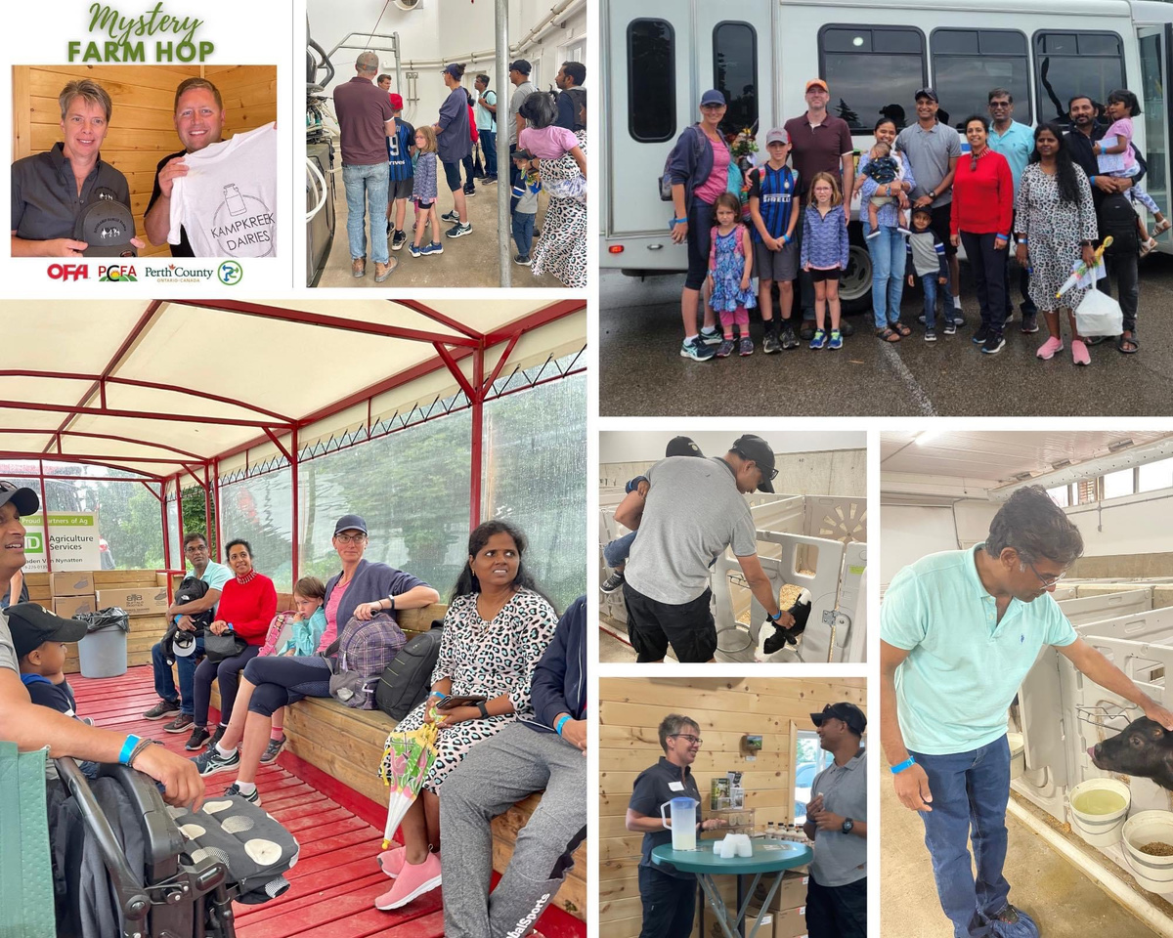
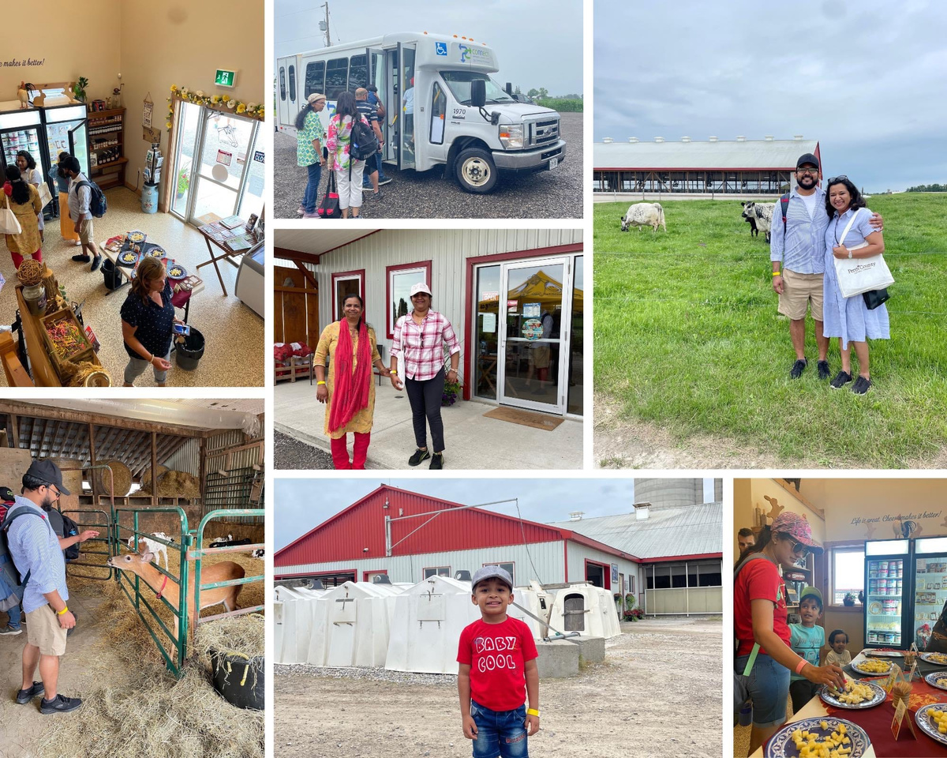
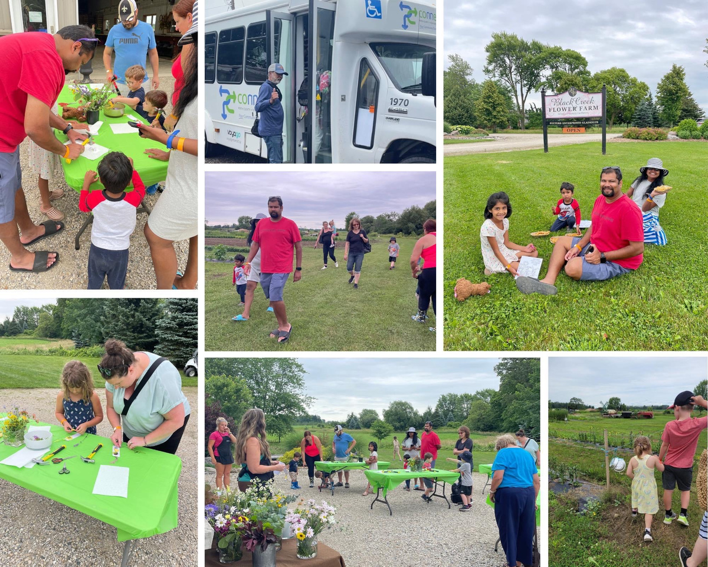
EVENT
Gallery

Slide 7

THANK YOU FOR YOUR ENTHUSIASM
GET IN TOUCH
Meredith Forget, Manager of Economic Development & Tourism
mforget@perthcounty.ca
519.301.1962

