Slide 1
Municipal Community Insights Breakfast Trivia!
EDCO 2024 Early Bird Breakfast and Learn
Presented by: Samuel Lau, Director Business Development, Municipalities

Slide 2
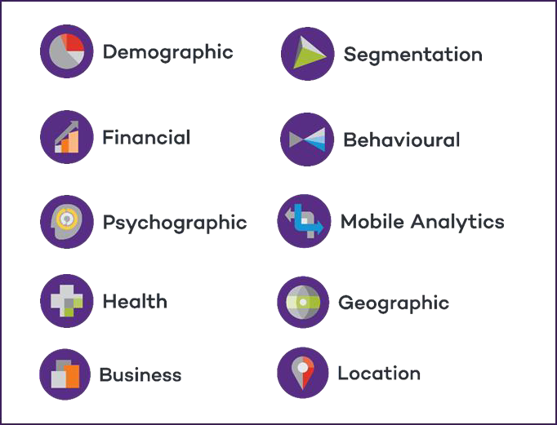
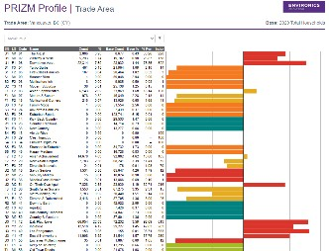
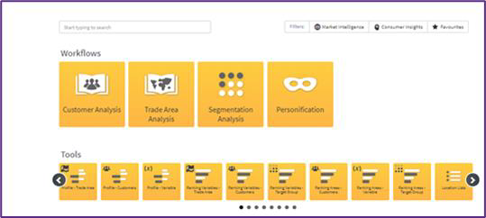
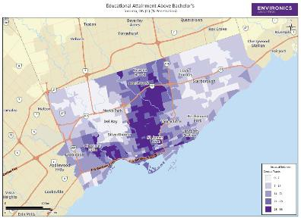
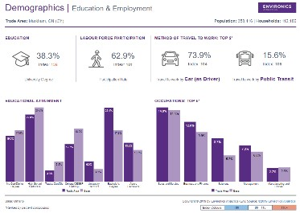
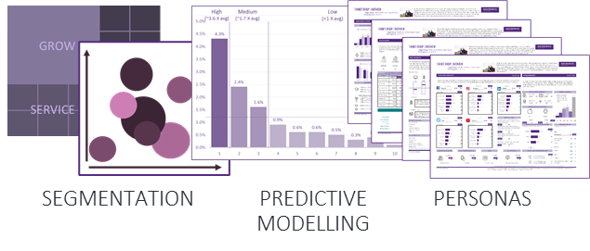
Data to Insights to Activation
ACTIONABLE DATA
ADVANCED ANALYTICS
AMPLIFIED ACTIVATION
The “Intel Inside” in all Channels
Traditional & Digital Channels
Data Collaboration
Used by over 1,000 Canadian Organizations
Purpose-built Saas Platform
Custom Analytics
40,000 Current Variables at Postal Code Level
Comprehensive
Proprietary
Actionable
Privacy Compliant
Strategic Partnerships
M&A
Campaign Activation
Media Measurement & Attribution
Clean Room Services

Slide 3
Environics Analytics at EDCO
Find us at our Booth to learn more!
10:50-11:10 a.m. Knowledge Pod: Shine a SPOTLIGHT on your Community
Learn how to get access yourself to someone of insights you’ll see in today’s trivia!

Slide 4
Trivia Time!
Go to: menti.com and use code displayed
Top 2 Winners gets a Tim Hortons Gift Card!
Hint: Both Speed and Accuracy counts towards points!
Good Luck and Have fun!

