Slide 1
Business Retention in an Automated World!
EDCO Conference Session
February 8, 2024
Notes:
Stephen Slides 1-19

Slide 2
Audience Quick Poll
Are you currently using any automation tools to support your economic development efforts?
Yes
No
Unsure

Slide 3
Business retention and expansion is a program designed to strengthen the connection between companies and the community while encouraging each business to continue to grow in the community.
Through direct interactions, events, and research, the program seeks to gain insight into business practices, planned future actions, as well as the challenges of targeted companies.
Then, to turn this “business intelligence” into value added services, programs, and/or products that address individual and shared company opportunities and problems.
What is
BR+E

Slide 4
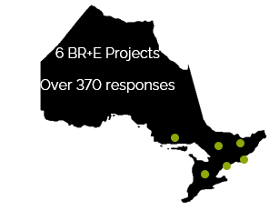
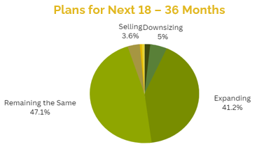
November 1, 2022 – July 31, 2023
41% of businesses hope to expand within the next 18 – 24 months.
48% of businesses are experiencing difficulties hiring.

Slide 5
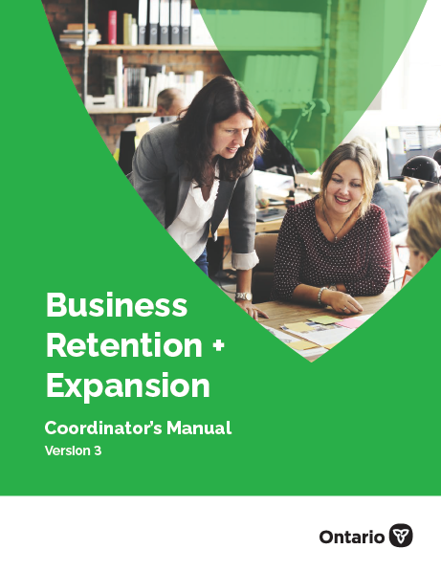
ontario.ca/rural
onregionalecdev.com

Slide 6
The Ontario BR+E Model
Trained volunteers to conduct confidential interviews
Data analysis and action planning to address issues and opportunities
Ideally, it is incorporated into the community’s ongoing economic development strategy
Notes:
Trained volunteers who visit businesses and conduct systematic and confidential interviews with the senior level management, owners or managers.
In some cases, students may be suitable
Volunteers
Recommendation – no politicians (temptation to respond + survey respondents may not be 100% honest). Although, politicians could act as door-openers
Data analysis and action planning is undertaken to address issues and opportunities facing businesses
Such activities can be conducted in a continuous format where the community cycles through all the stages and starts over again, or completes as a one-time approach – smaller communities who don’t have the resources. May take several years between BR+E projects
Hopefully ongoing, but doesn’t have to be. Depends on the size and resources of municipality/region/community

