Slide 1
The Pivot: How to adapt policies, procedures and project management when dealing with a change of context EDCO Conference, 2024
Moderator:
Catherine Oosterbaan, Oosterbaan Strategy
Panelists:
Julia Crowder, Town of Smiths Falls
Belinda Wick-Graham, Town of Minto
Jeff Loney, County of Bruce
Evan Cleave, Toronto Metropolitan University

Slide 2
The one certainty we have is change….

Slide 3
The Economy is always evolving
Plant closures
Natural disasters
Economic shifts
Policy shifts
Pandemic

Slide 4
The Pivot: How to adapt policies, procedures and project management when dealing with a change of context EDCO Conference, 2024
Moderator:
Catherine Oosterbaan, Oosterbaan Strategy
Panelists:
Julia Crowder, Town of Smiths Falls
Belinda Wick-Graham, Town of Minto
Jeff Loney, County of Bruce
Evan Cleave, Toronto Metropolitan University

Slide 5
A Sweet “Hi” and Smoky Low, Fueled by Chocolate and Cannabis - The Boom and Bust of Small Rural Town Ontario -

Slide 6
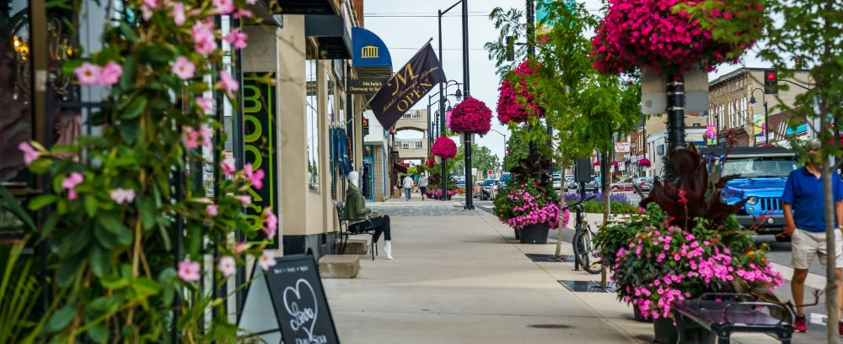
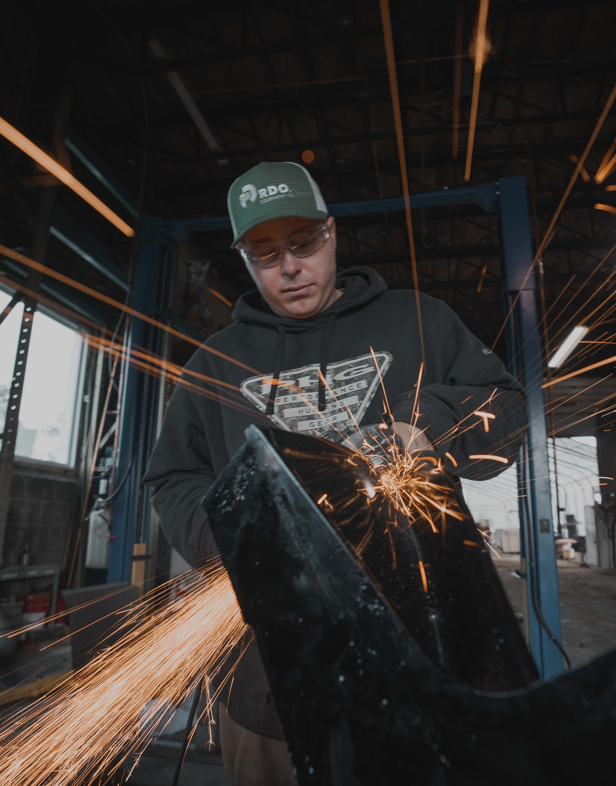
Title
Notes:
If you take a drive to Smiths Falls Today, you would see a picturesque Eastern Ontario Community situated along the Rideau Canal, with ample greenspace, and a beautiful and bustling downtown. You would see newly built homes and apartment buildings and other residential and commercial properties underdevelopment. Resident and visitors enjoy an abundance of recreational, culture and entertainment offerings all year round.
We are the site of Le Boat’s, North American Headquarters, despite the rumors, Canopy still operates their 400K sqft distribution centre here, employing 350 staff. We are home to Guideline Instruments, world renowned for ultra-precise measuring tools. There’s Kilmarnock Enterprises which provides industrial parts and solutions internationally, and has grown 1500% since opening in 2016. We are home to Wonton Crunch, featured on Dragons Den for their innovated food products and RnD Bakery who developed a rigorous methodology to create gluten-free bread products using Oats….and both are in the midst of expansion and working towards international export development…
Since 2019 we have seen 80+ new businesses open, including 22 just last year.
Between 2016-2022 our population grew 5.4%, property values increased, and our tax revenues went up by 34%. We have an emerging young professional demographic, seeing former youth return home to work and raise families, a growing arts community, and tourism, construction and manufacturing sectors.
The Town has seen 10’s of millions in revitalization and infrastructure improvements over the last 5 years, we were in a better position and continuing to pivot invested in a fullscale revitalization of our downtown and this helped bolster and support our retail community through future downturns and uncertainty. We and continues to plan for future investments including a new water town, roads and bridge upgrades, parks and active transportation network improvements, and are in the midst of developing a Revitalization Master Plan for our downtown waterfront area and a new serviced industrial park.
You would never image that 15 years ago our community was in the midst of a catastrophic economic collapse and spiraling to the brink of complete and utter annihilation.

Slide 7
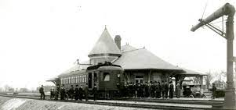
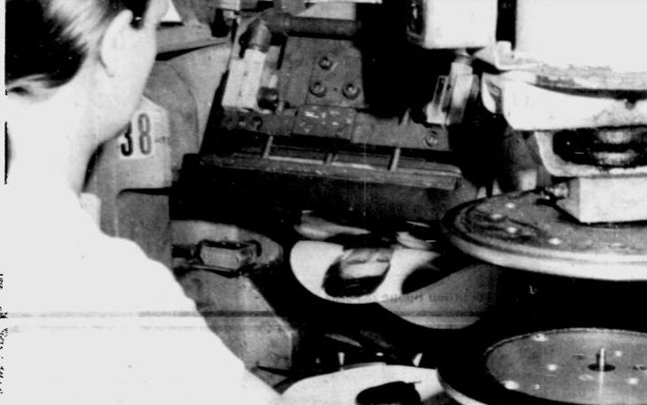
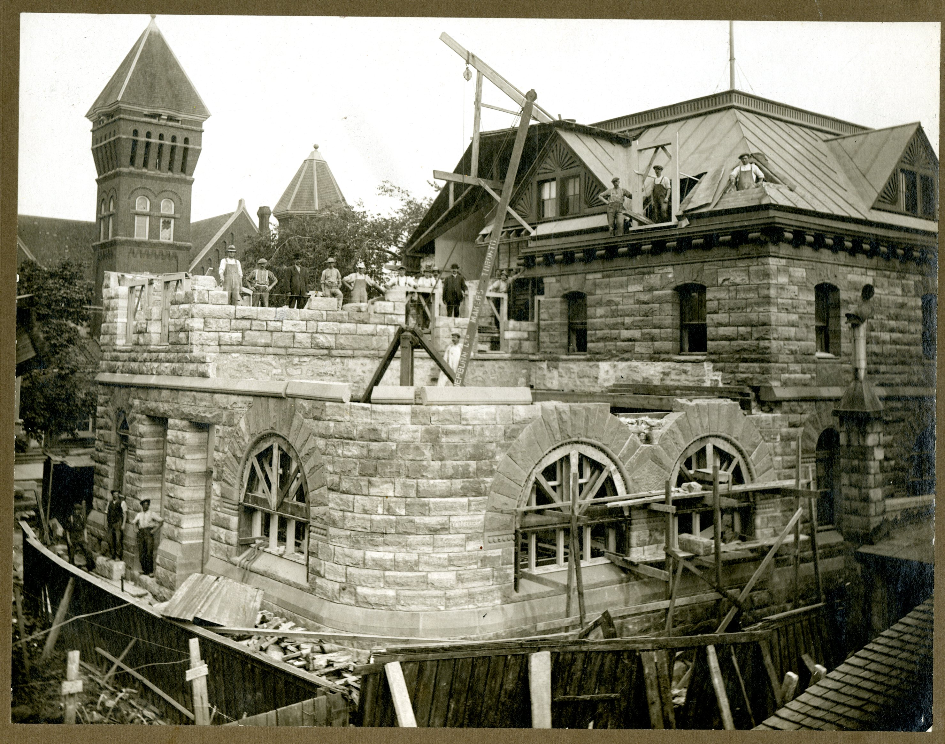
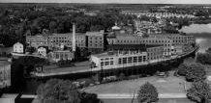
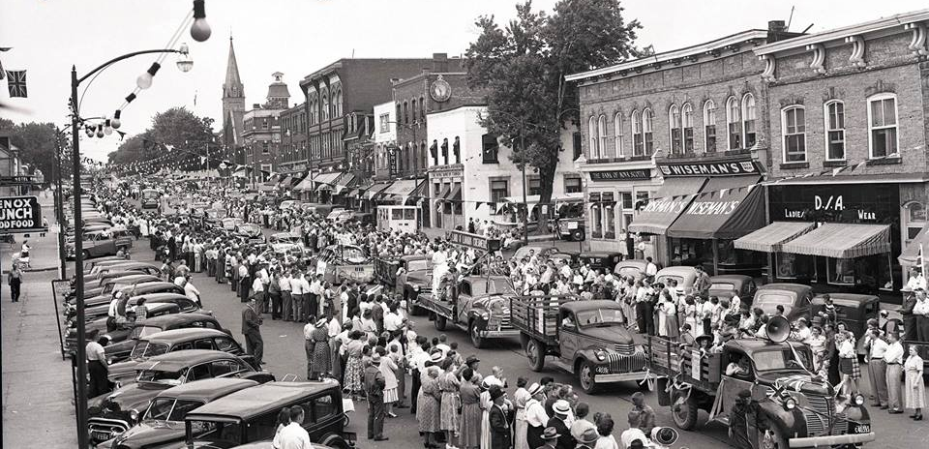
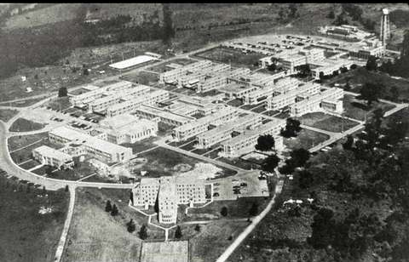
Smiths Falls original station (RMEO Museum)
Title
RCA Records
Post Office Construction (1893)
Downtown Smiths Falls (1940s)
Frost & Wood Factory (Centre Street)
Rideau Regional Centre
Notes:
Smiths Falls has always showed resiliency, enduring boom and bust economic cycles, which are full of stories of pivoting.
The Town was built on the industrial revolution and the Rideau Canal. It saw the rise and fall of steam engine railway having early investment of CP and CN rail lines. A world class farm implements factory called Frost and Wood flourished here for 120 years, and in 1951 the town was restabilized by the opening of the Rideau Regional Centre, which at its peak housed 2,500 people and employed 1500 staff. We were also home to RCA Records which pressed the very first Beatles Record in North America.
The Hershey chocolate factory opened in 1963, being the first Hershey plant outside the US, and by 1966, Smiths Falls’ population peaked at 9,876 residence.
Smiths Falls’s unique location and rail connections made us an ideal place to do business, and we continued to grow into the 1980s, when rural Canada experienced more manufacturing growth relative to the country as a whole. During this time, the Town saw other new manufactures like Stanley Tools, and Shorewood Packaging open, employing hundreds more workers.
Smiths Falls was booming, riding the Manufacturing wave in Ontario, with the sector employing 1/3rd of our population.

Slide 8
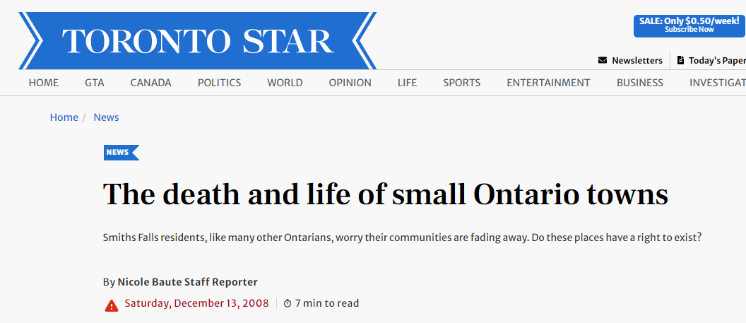
Title
TEXT
Notes:
Globalization saw the shift to offshore manufacturing. The sector had shed 388,000 jobs since a peak in 2002, In November 2008 alone, there were 42,000 manufacturing job losses in Ontario and this ultimately triggered a national recession. Not long after, Statistics Canada reported that the population of Smiths Falls had dropped 4% between 2001 and 2006 – before Hershey even announced its closure.
In December 2008, the Toronto Star reported on the state of Smiths Falls as we were reeling from more than 1,700 good paying local job losses over the course of 4 years, due to major employer shutdowns.
In 2004, Rideau Regional Centre, announced its slow closure as part of a province-wide deinstitutionalization effort. In Feb 2007, Hershey’s, announced it would be closing and moving to Mexico.
Shorewood Packaging in March 2007 announced they were considering closing the Smiths Falls plant. Shortly after in 2008, more jobs vanished when Stanley Tools closed that fall.
Consumer spending slowed, and retail businesses suffered. A By the end of 2009, we had lost 2000+ jobs and the town had almost 2 million square feet of empty commercial and industrial space, there was a mass exodus of businesses and people. A substantial chunk of the towns tax base eroded, and public infrastructure was being neglected - with no savior in site.

Slide 9
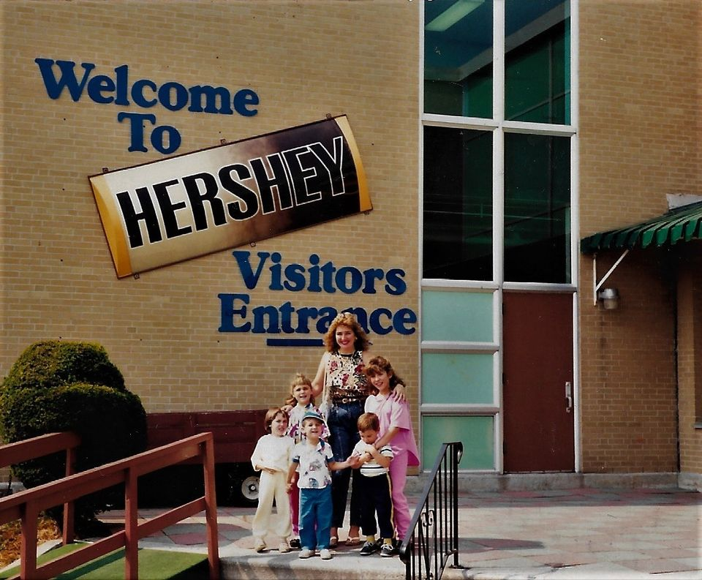
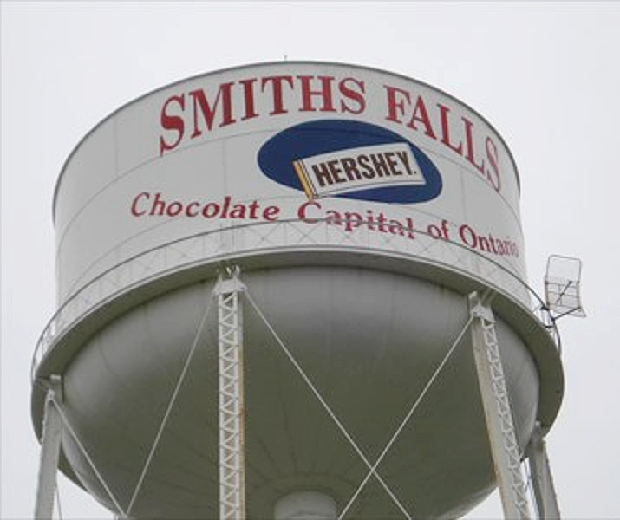
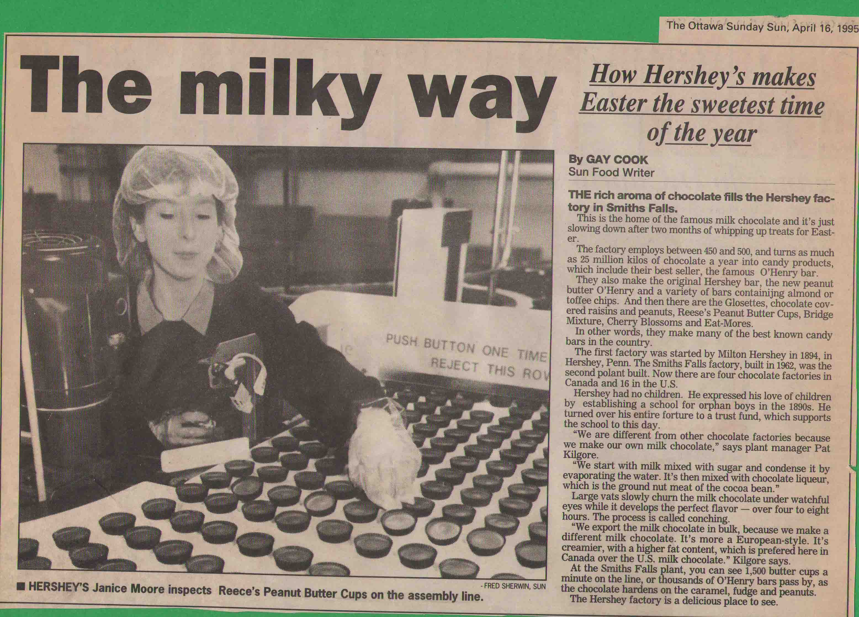
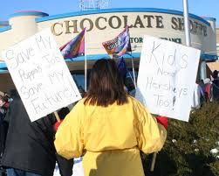
Title
Notes:
For 45 years Hershey’s and other local manufacturers provided stable, high paying jobs. Many employees started as young adults and worked their entire career, it was the bread and butter for hundreds of families. The Town’s economy had crashed and we were in the midst of an identity crisis, We were always know as the “Chocolate Capital of Ontario” Hershey’s was our success story, employed hundreds and brought 10’s of thousands of visitors to our community each year.
What are we going to do? Who were we going to be now? For so long the Town road the sweet success of chocolate, never once considered the potential for decay. There was never any consideration of sector or local GDP diversification. We weren’t diversifying. In the span of a decade, our population had suffered an 8.2% population decrease…and the once bustling 1 Hershey Drive plant, sat empty.
….so where do we go from here?

Slide 10
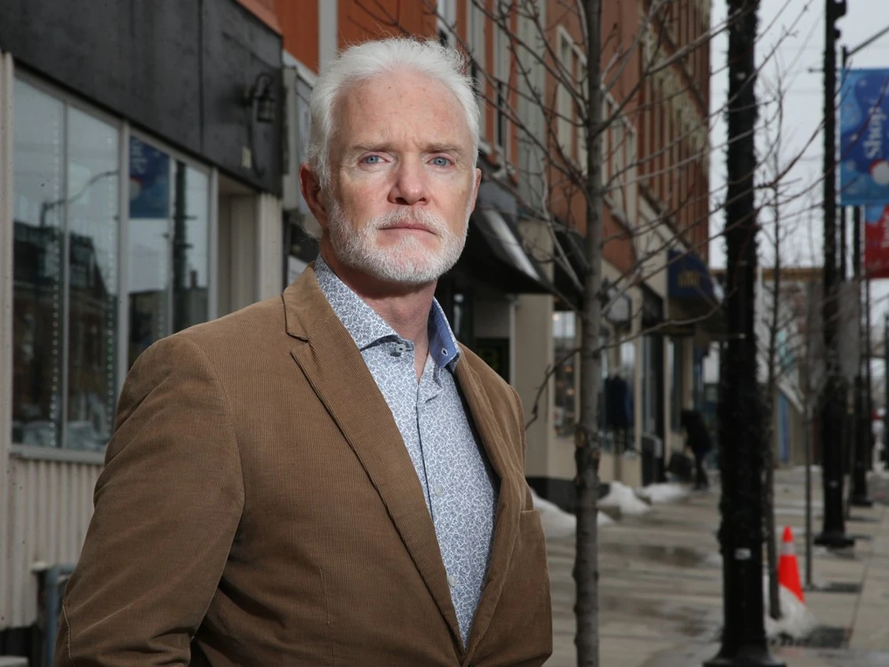
Title
Notes:
The answer…we pivoted. We picked up our chins and looked to the future, like having done so in the past.
With a new innovative Council, open and willing to take a chance on new out of the box opportunities, the Town set out to find themselves again. They hired a new CAO, the Town updated their strategic plan to focus on BR&E and Investment Attraction to diversify into new markets such as tourism. Hired a new economic development manager, they rebranded, developed a new website and other attractions materials…and repainted the watertown. We were actively working towards being prepared for when a new opportunity would present itself. We were ready to “Rise at the Falls”.

Slide 11
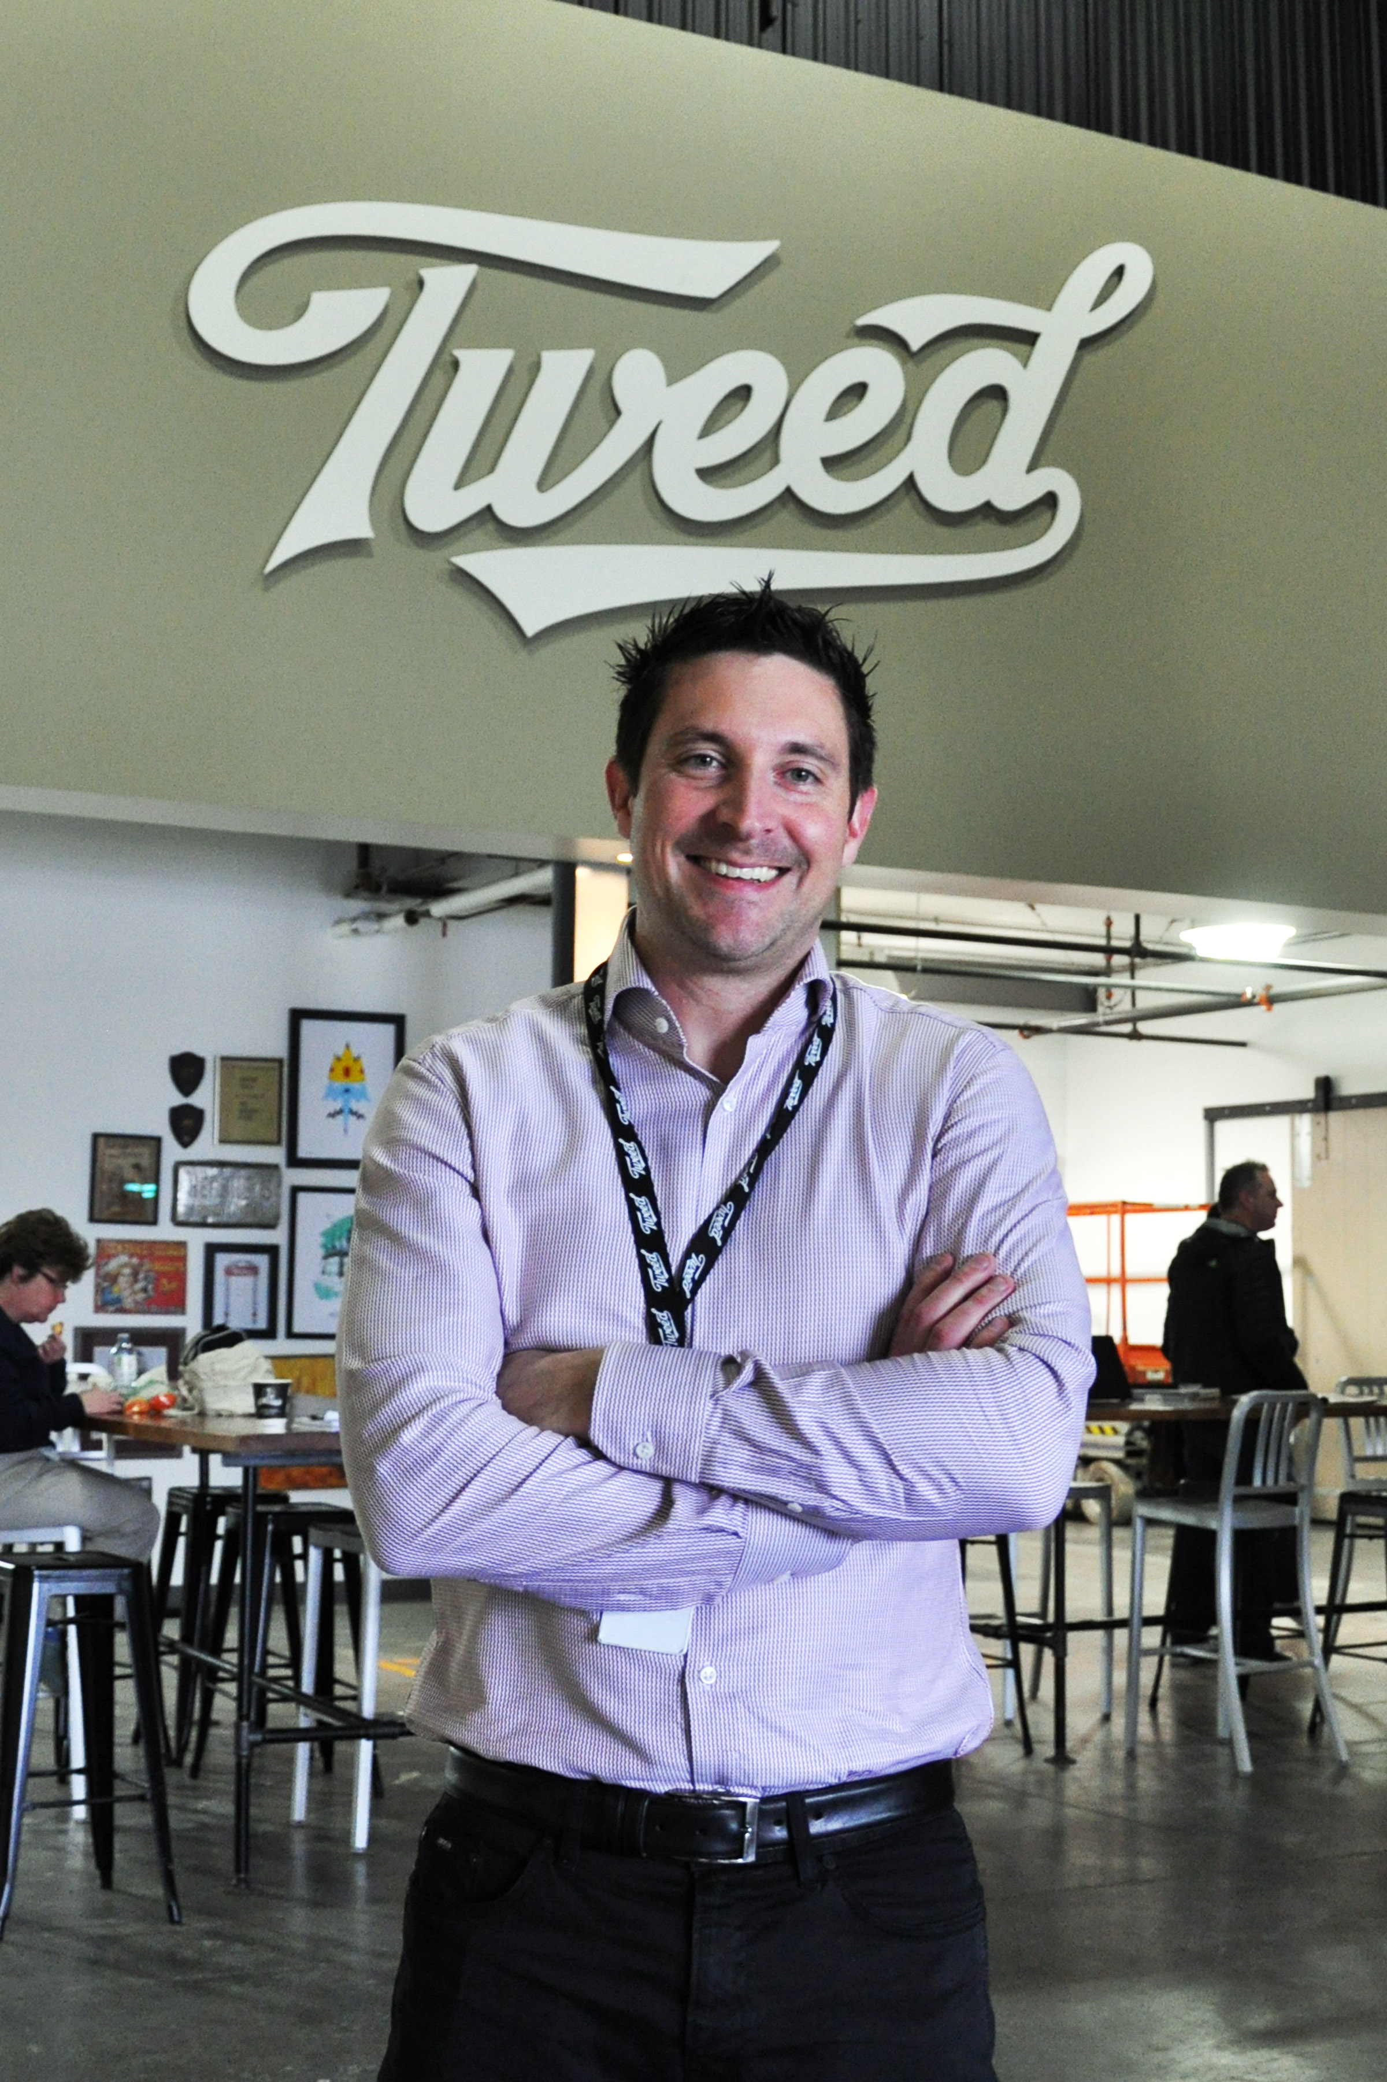
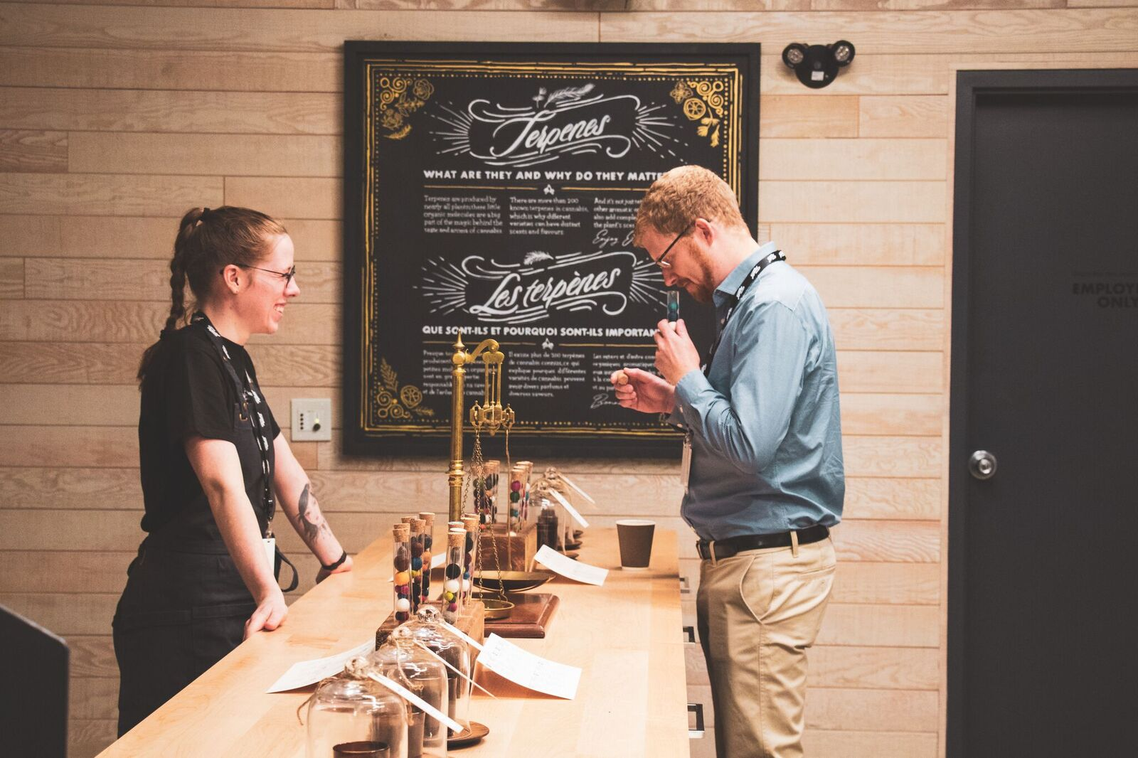
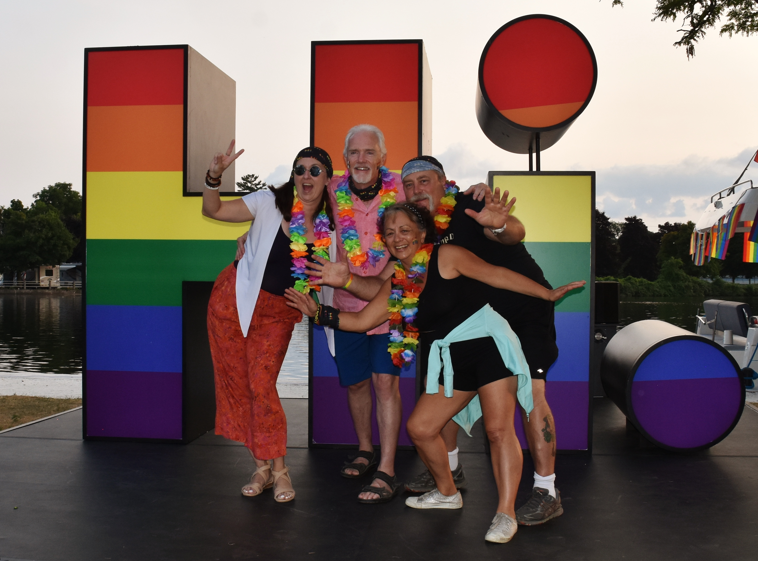
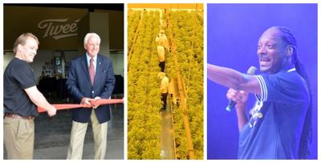
Title
Notes:
Enter the Cannabis Era!
For more than 6 years the Town worked in the background to chart a new path forward.
Tweed, would become Canada’s largest licensed cannabis grower. The road was not easy. In 2013, staring with just a few employee, and the support of the community, they grew to 30 employes, then grew to 500 by 2017 and became our new savyor.
The legalization of recreational cannabis in 2018 brought more expansion and a further economic high for the Smiths Falls. Its opening brought tourists from all over to see the so-called Cannabis Capital of Canada, then Tweed hyped up its presences, hosting an event with 5000+ attendees in Aug 2018, featuring the one and only Snoop Dogg!
By Sept 2018, 750 employees worked at Canopy and that number was expected to growth under New Management to 1000 – 1200K by 2019.
During this time the Town’s Council and Economic Development staff continued to work with Canopy, building on the momentum they had created. A new 5 year Council Strategic plan in addition to an Economic Development and Tourism Strat Plan was developed, which focused on quality of life and placemaking, as well as further growth in our local retail and tourism sectors.
The work and investment was starting to pay off… The Census reported that between 2016 and 2021 the town’s population grew by more than 5%, and its median household income went up by 8%. Unemployment lowered, there was a boom in housing growth (with 500 new home constructed), and Real Estate Prices increased almost 12%, people (and new investments) were starting to take notice of what our small town had to offer.
In May 2018, after years of negotiations at all three levels of government – Le boat officially opened in Smiths Falls – the International Luxury River Boat Rental Company would further legitimize the Town and usher in a new tourism era, which brought further national and international attention to our Small Town.

Slide 12
Title
Here we go again?
Notes:
Then.. in February 2022, after 5 years of small operational shifts and lay offs (while I was here at EDCO..some of you may remember)…the news broke, Canopy had implemented a major restructuring. They were closing up the 1 Hershey Drive plant and hundreds more jobs would be lost, across Canada, including 400 local jobs in Smiths Falls….Here we go again!
Or that’s what the initial thought was.. this time would be different.. We already knew it was coming. Over the years we had built strong relationships with Canopy, but more importantly we learned from the past not to put all our Chocolate Eggs in one basket. We had a strong community brand with international recognition, we had diversified our economy, and invested in quality of life amenities and services for our residents… we now had a large state of the art industrial building space to offer, at a time when there were almost no comparable sites in Canada to support new investment. We had invested in proverbial PPE, to get us through the haze of smoke Canopy exhaled.
Over the weeks and months to follow, we continued to work with Canopy to limit the impact of their decision on the community. We rallied workforce development partners, hosted a regional job fair, created information package for employees out of work so they had resources, supports, and an idea of what new job opportunities were available. We fielded and coordinated investment inquires of those interested in potentially purchasing/leasing the building. We worked with Canopy through the processes of finding a new investor.. The Town and Canopy both wanted to see the property be acquired as fast as possible.. But with the ultimate goal of filling it with the Highest and Best use for the community. One of the most challenging parts was reassuring the community we were going to be OK and changing the perception of loss.. to a new opportunity for something potentially bigger and better.

Slide 13
“Hershey’s return to Smith Falls was serendipitous. The company was looking for opportunities to expand in North America when the facility in Smith Falls became available, and because we had an incredibly positive experience in the past, it was an easy decision to go back. The location works really well within our North America operations, the presence of skilled talent and the warmth of the Town’s leadership have made it a sweet return.”
- Senior Manager, Government Relations
TEXT
Notes:
And we were right. Hershey is coming home, ushering in a new and exciting era which will further contribute to our Towns success and economic sustainability in the years to come.
…. Stay tuned!

Slide 14
Title
Thank you!!
TEXT

Slide 15
Manage a Pivot…
Even when others don’t know…
February 8, 2024

Slide 16
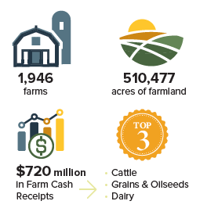
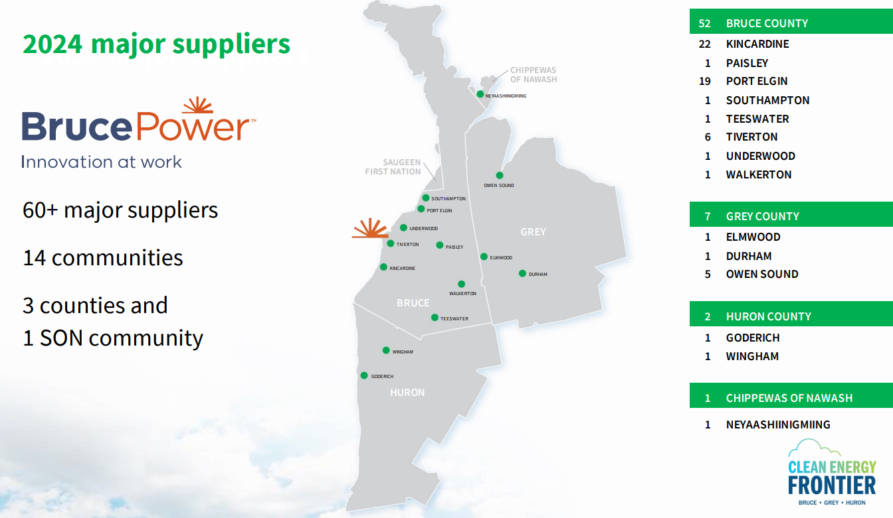
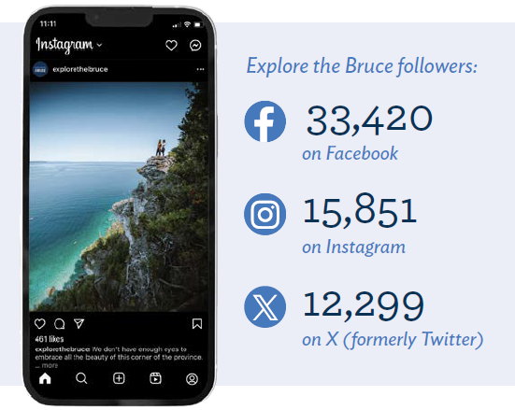
Agriculture
Energy
Tourism

Slide 17
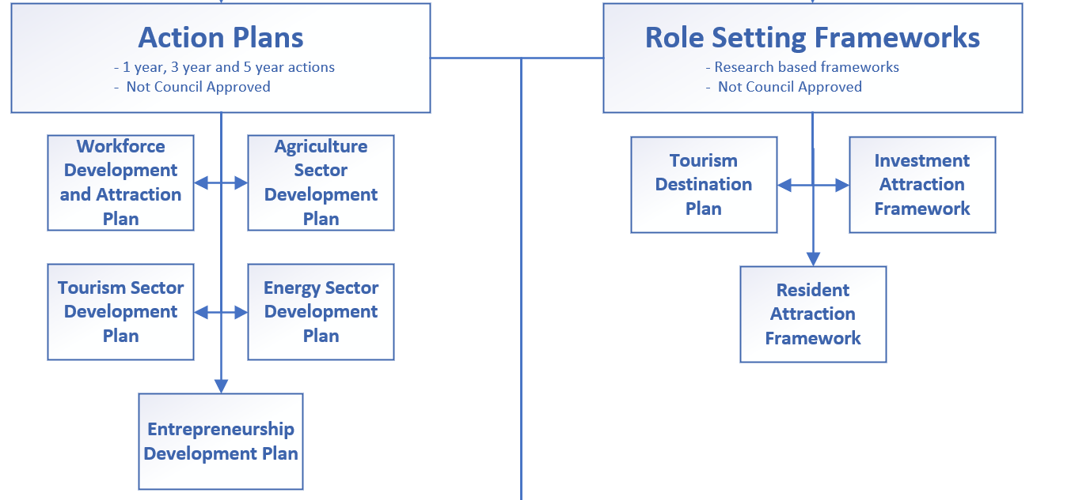
2023 – A hard look at our priorities
Economic Development Strategic Plan approved
Our leading questions:
Is this an action or an objective? Does it have clear deliverables?
Is this something that is within our scope of control?
How does the action align to our core goal?

Slide 18
Energy Sector Development Plan
Already have 60+ Nuclear Suppliers
Bruce Power is working on a significant expansion
Why should we do anything else?
What can economic development do to positively impact this sector?

Slide 19
“What else is there to the energy sector than production?”
- Someone

Slide 20
Input
End User
These are the businesses that support producers and make up the supply Chain
Production
These are the companies that produce energy products including Nuclear, Wind, Solar and emerging technologies
Processing and Distribution
These are the compaies who use the energy produced and further distribute (local distribution companies) and process it into other forms (i.e. hydrogen, battery storage etc.)
These are the companies that support the end user, throughout this plan a focus is on those looking to particiapte in energy transiton.
Solution?

Slide 21
What this has taught us?
Focus on your core ideas
Remember a pivot keeps one foot on the ground
Embed the idea of the pivot in all the work you do
Strategy can be rigid, change is not
Listen to your audience
Break out of your pre-determined definitions
Stay up to Date
Business are moving faster than we are, react to trends.

Slide 22
Thank you!
Jeff Loney, Manager of Economic Development, Bruce County
ECONOMIC DEVELOPMENT
CONTACT
jloney@brucecounty.on.ca

Slide 23
THE PIVOT
HOW TO ADAPT POLICIES, PROCEDURES AND PROJECT MANAGEMENT WHEN DEALING WITH A CHANGE OF CONTEXT
Presented by :
Belinda Wick-Graham
February 8, 2024
February 8, 2024

Slide 24
About
Minto
Amalgamated in 1999
Comprised of the Village of Clifford, Towns of Harriston & Palmerston and the the former Minto Township
Population (2021)
9,094
4.9% increase
Size
300.69 sq. km
Main Industries
Manufacturing & Agriculture
www.town.minto.on.ca

Slide 25
Coming 2026 in Palmerston

Slide 26
Streetscape Post-Dig

Slide 27
Developing Plans & Task Forces

Slide 28
Promoting Buy Local

Slide 29
Collaborating with Partners
County
Contractors
Engineers
Suppliers
Chamber of Commerce
Local Radio
Local Newspaper
Local TV

Slide 30
Community & Partner Engagement

Slide 31
Creative Tactics

Slide 32
Creative Tactics

Slide 33
Communication

Slide 34
Connect
with us!
Belinda Wick-Graham
Website
519-338-2511 ext. 241
www.town.minto.on.ca
belinda@town.minto.on.ca

Slide 35
The Pivot: How to adapt policies, procedures and project management when dealing with a change of context
Moderator:
Catherine Oosterbaan, Oosterbaan Strategy
Panelists:
Julia Crowder, Town of Smiths Falls
Belinda Wick-Graham, Town of Minto
Jeff Loney, County of Bruce
Evan Cleave, Toronto Metropolitan University
EDCO 2024
February 8, 2024
Notes:
Introduce myself and Dr. Arku with a few brief words.

Slide 36
Background
Study exploring LED responses to COVID-19 in Ontario.
Interviews conducted with 38 LED practitioners from 35 municipalities.
Research focus on ‘changes of context’ and what LED practitioners (and their communities) do in response.
Notes:
Introduce the report very briefly.
Although this report focused on Covid-19, there are many broader lessons that can be learned. What was unique about Covid was that it affected everyone at the exact same time (as well as the public health and lockdowns/restrictions on work and mobility). But stepping back, many of the processes occurring can be seen in other – individual – cases. This could be changing government priorities, where provincial or federal level interventions or policy have local impacts (i.e., immigration, investment and de-investment in green energy manufacturing, housing and urban expansion plans), or changes in the work (i.e., plant closures, layoffs), or shifts in priorities in the economy.
I want to highlight the key takeaways from the interviews and the report – focusing on what can be applied the next time a community has to pivot. And then extend that with other work that Dr. Arku and I have done looking at manufacturing, LED planning, and local capacity.

Slide 37
Key Takeaways
Emergencies Can Impact the Economy Too
Increased Risk Tolerance and Faster Decision-Making: Stay Innovative and Responsive
Many Hands Make More Efficient and Effective Work
Virtual Environments
Changing Nature of the Labour Market
Maximize Regional, Provincial, and National Supply Chain Opportunities
Rethinking Downtowns and Office Space
Notes:
These were the main ‘forward looking’ themes from the report. Lessons or areas of focus that were consistently were identified by those we interviewed. They highlight a shift in the way we think about economies – and especially local economies; the ways communities respond in times of crisis, as well as how the nature of work is changing.
(I will go into a few of these in a bit more detail – like a sentence or two, to best align and build on what the other three say)

Slide 38
The importance of planning
Reactive Planning
Development of emergency action plans once the pivot has begun
Example: Covid response task forces
Pre-active Planning
Developing plans that provide a response framework to respond to one change specific change of context
Examples: immigration, climate change/energy, manufacturing
Strategic Planning
Integrating potential future pivots into more comprehensive community-wide LED plans
Notes:
Most communities did have to engage in some form of reactive planning. Rather than make ad hoc decisions, there was at least some structure in the responses/policies/approaches
Many we interviewed – especially from larger communities – indicated that they were now going to include emergency planning in the future. Sometimes in isolation, sometimes in conjunction with a broader strategy. The purpose is to not be caught completely off-guard again. And this can apply beyond covid. Understanding the SWOTs of the community can identify where pivots may occur in the future (i.e., where there is the greatest exposure) and then where there are opportunities to pivot towards.
Every day is a day to prepare.

Slide 39
Know your community
Putting my ‘geographer hat’ on…
Remember that your local context matters.
Decide how to best allocate your time and resources
Focus on incremental improvements.
Notes:
It is easy to say that your community should have plan in place, or networks of stakeholders/organizations lined up and ready to help, or strong relationships with local council or businesses. But of course, we don’t have endless time or money to throw at problems – especially ones that may seem far in the future or nebulous. And what was clear from all the interviews – for this covid research and beyond – is that there is a wide range in the capacity in LED offices. So, you have to prioritize what steps will work for you based on the time and resources you have. You need to think about what can maximize returns – for some it may be that developing emergency preparedness plans is too much to take on, so instead you need to focus on building community relationships, or even formally evaluating what you have in your community and what your businesses and residents need.
But wherever you currently stand think about what the next small step you can take is. Doing that will put you in the best position in the next pivot. And here with the panel today we can hear challenges and responses other communities have faced. So with that I will pass it back to Catherine.

Slide 40
Panel Discussion

Slide 41
When it is time to pivot and how do you decide what to focus on during a pivot?

Slide 42
How do you get elected officials/management/partners/stakeholders onboard with your new direction?

Slide 43
What tactics and strategies worked well, or not, through the pivot? Are there things that you would recommend doing to prepare and plan that can make it easier to address future pivots?

Slide 44
Every day is a day to prepare for the pivot! Thank you

