Slide 1
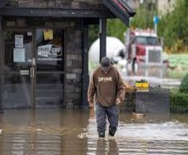
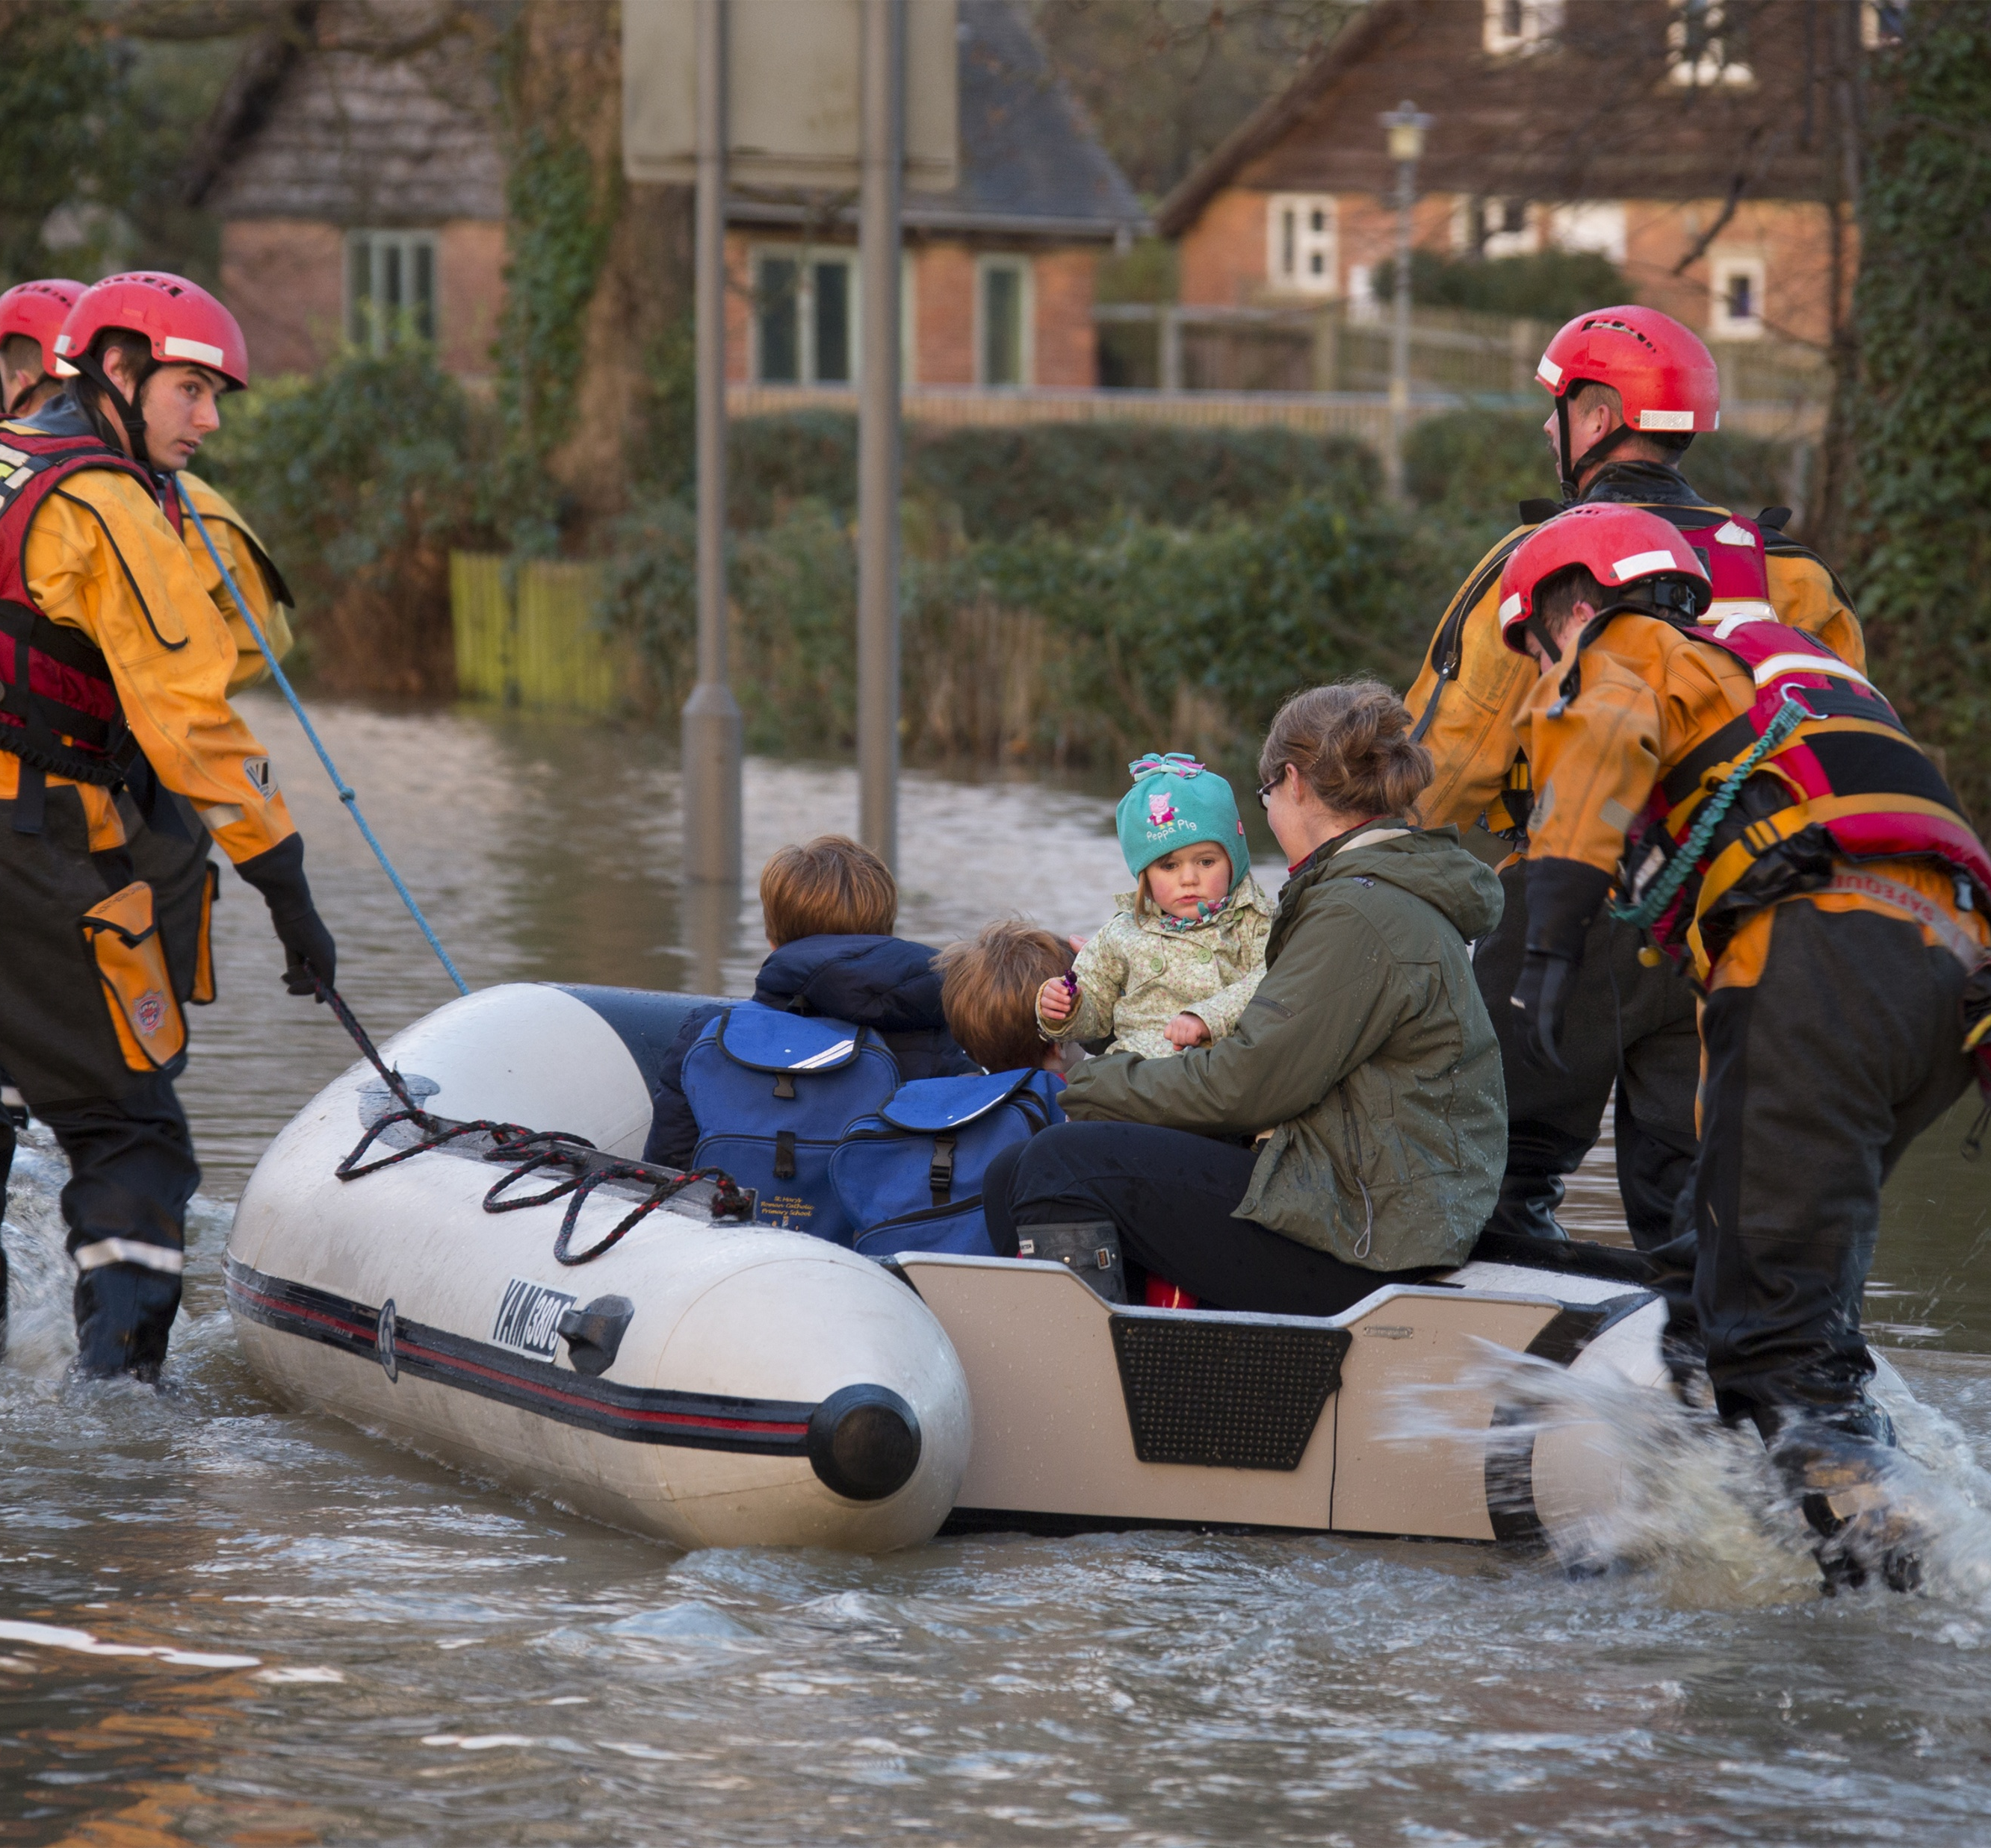

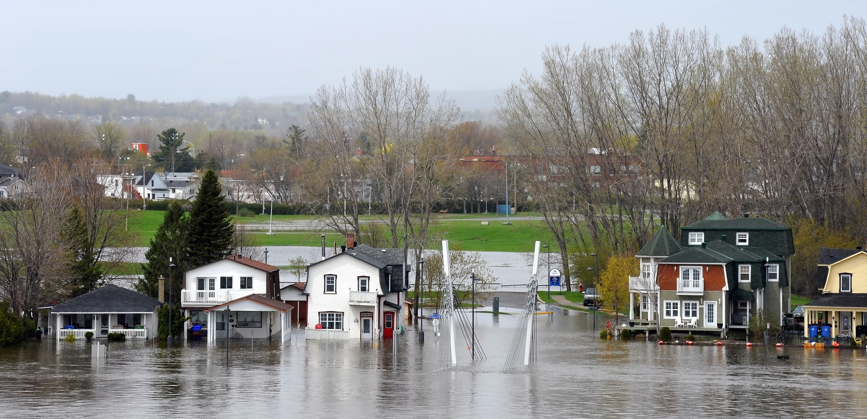

Reframing Risk for Economic Development
October 8, 2026
Climate Resilience:
Kathryn Bakos
Managing Director, Finance and Resilience
Intact Centre on Climate Adaptation, University of Waterloo
kbakos@uwaterloo.ca

Slide 2
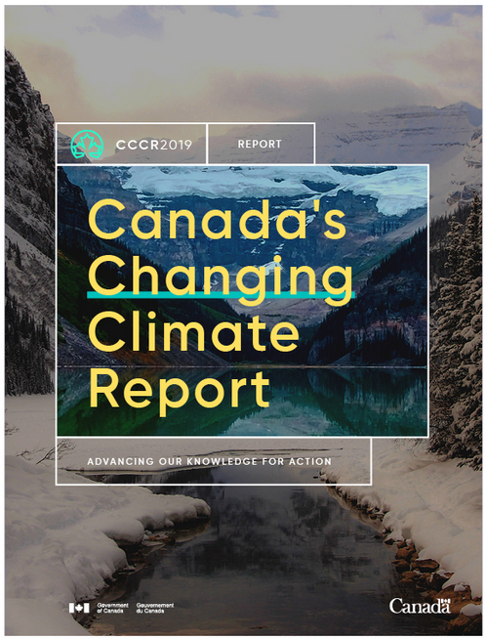
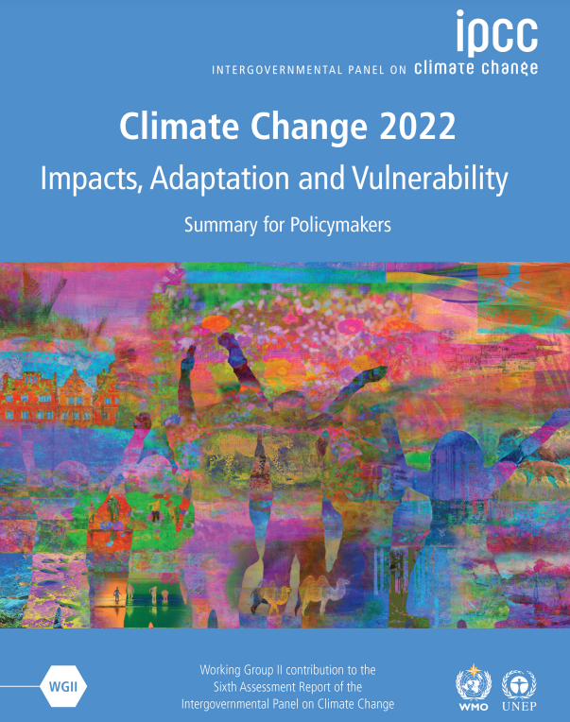
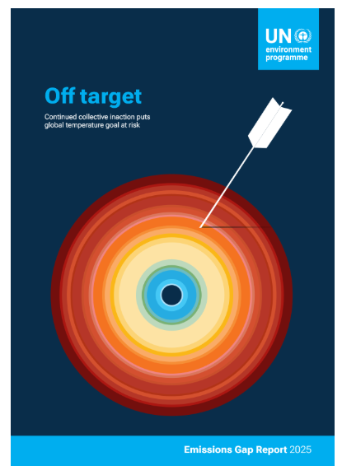
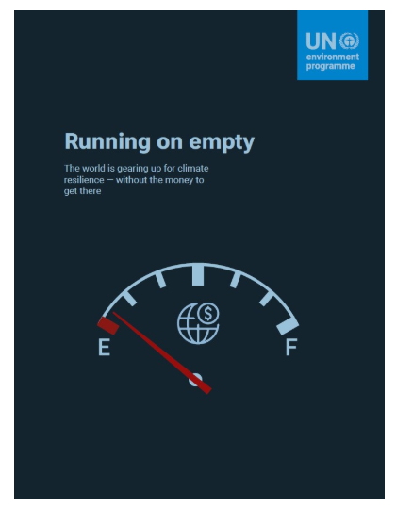
Climate Change is Irreversible:
Severity of Weather Will Increase
Canada’s climate has warmed and will warm further in the future, driven by human influence... this warming is effectively irreversible
ECCC/CCCR 2019
It is indisputable that human activities are causing climate change, making extreme climate events, including heat waves, heavy rainfall, and droughts, more frequent and severe
IPCC 2022
Climate pledges have only slightly lowered global temperature rise – leaving the world heading for a serious escalation of climate risks and damages.
UNEP, 2025
Gap in climate adaptation finance, planning and implementation are putting lives, livelihoods and entire economies at risk.
UNEP, 2025

Slide 3
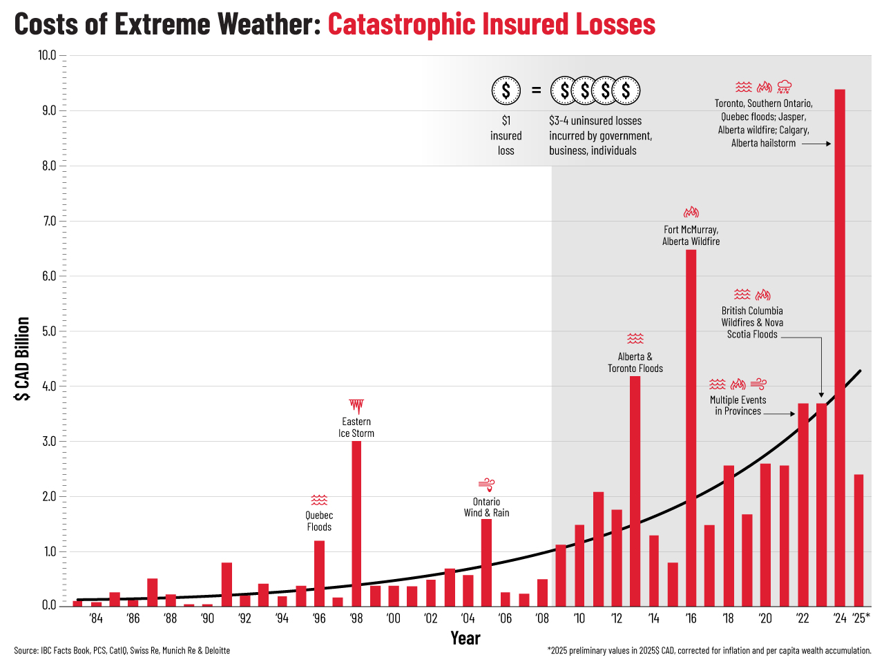
Residential Flood Facts:
6% of homes uninsurable for flooding
(850,000 homes across Canada)
average cost of house flood $56,000 (2026)
following flood, house value reduced 8%
multiple impacts in 2024 unprecedented
Mental Health Impacts:
↑ prescription drug claims, ↑ counselling services , ↑ lost time from work
Commercial Real Estate
10% total number of claims

Slide 4
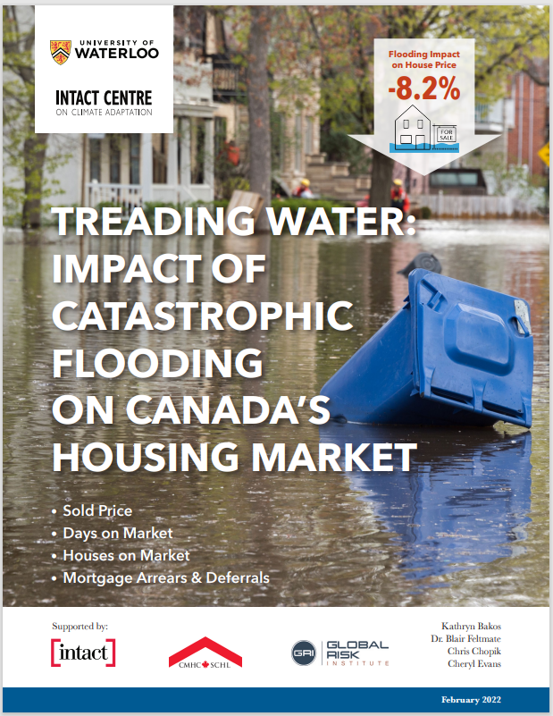
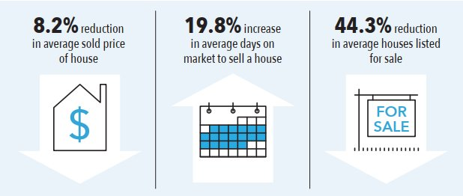
Impact of Flooding on Residential Housing
Main Sources of Flooding:
Intense rainfall
Rivers
Coasts and shorelines
All residences are at some risk of flooding.

Slide 5
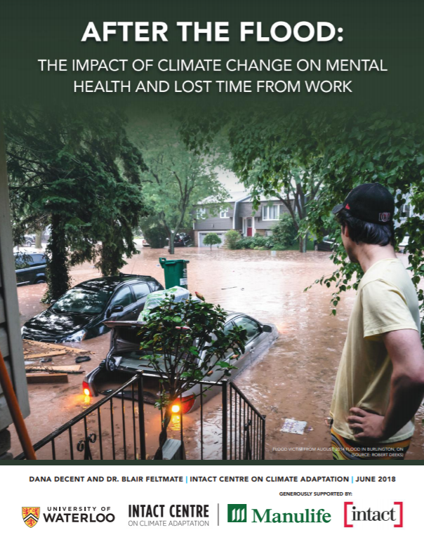
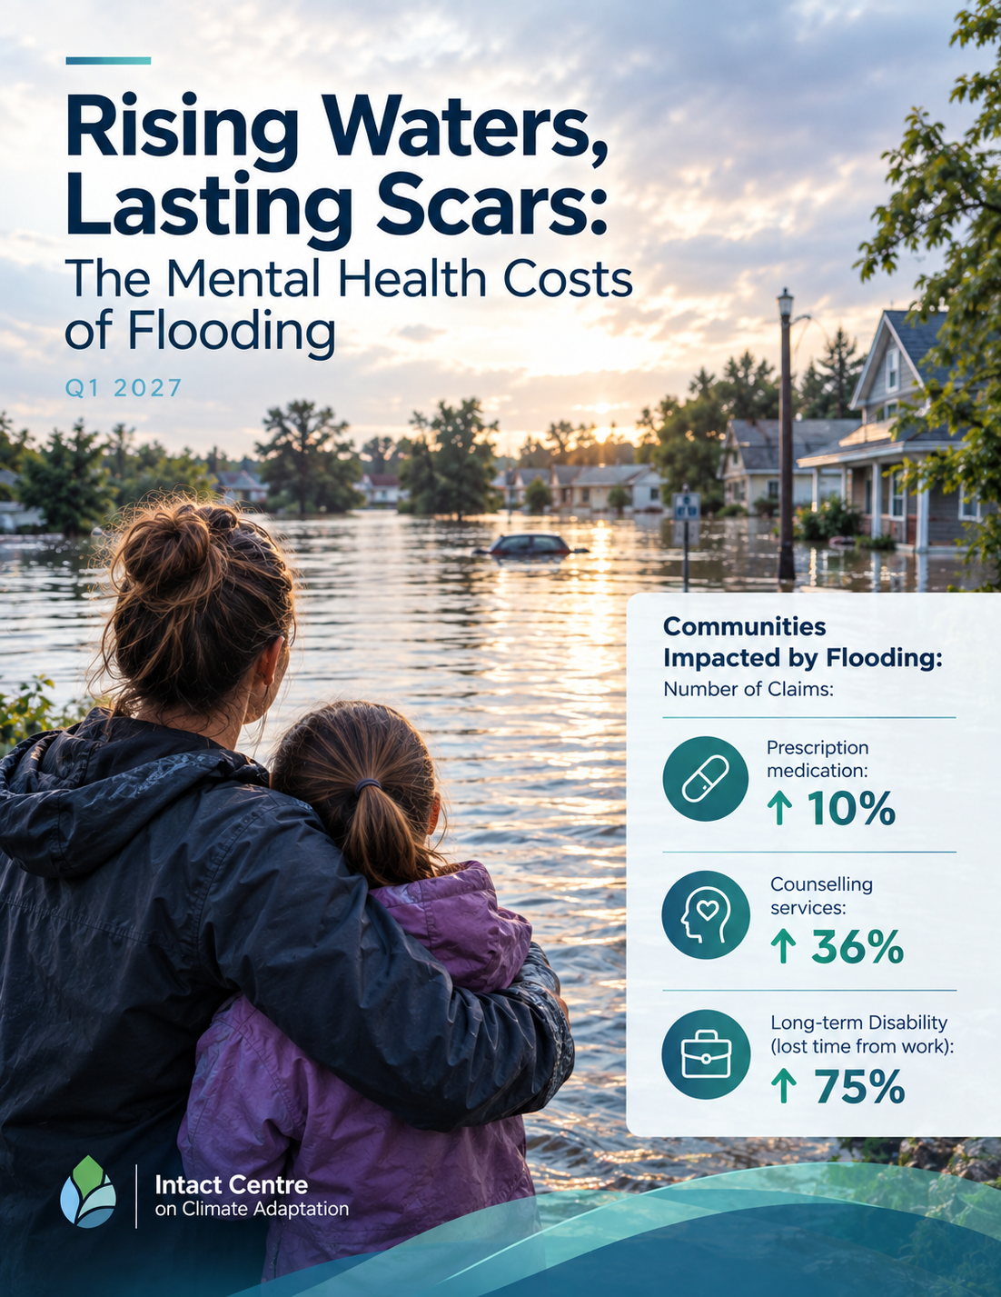
  Mental Health Impacts of Residential Flooding
  (Life & Health Challenge)

Slide 6
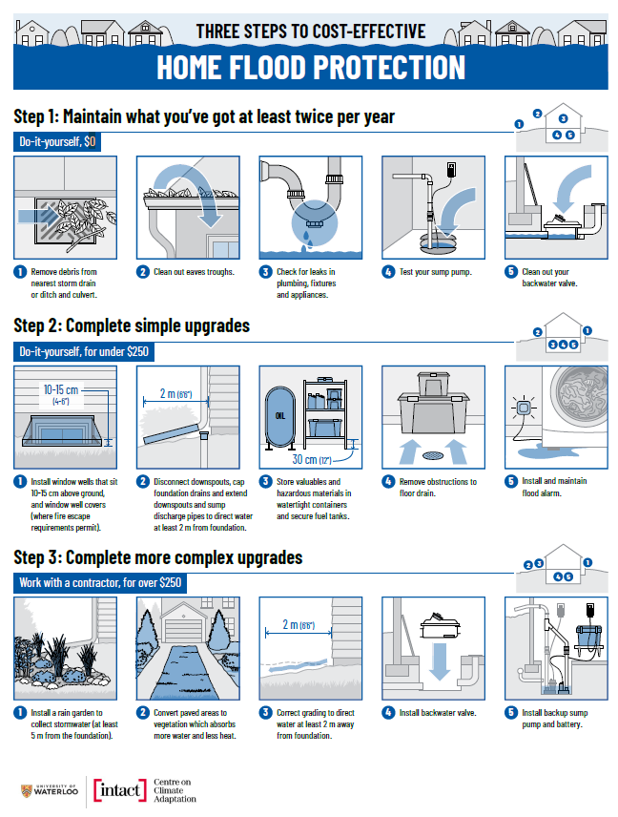
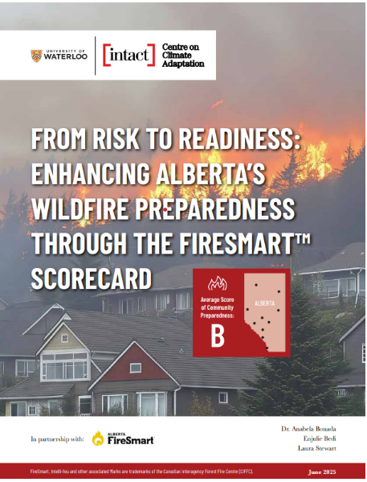
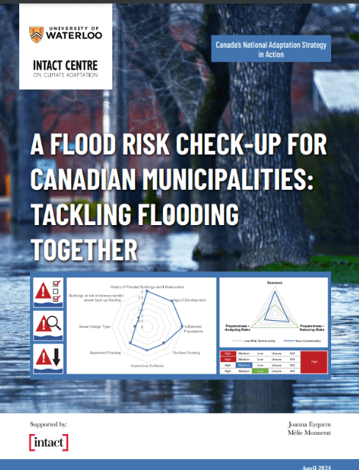
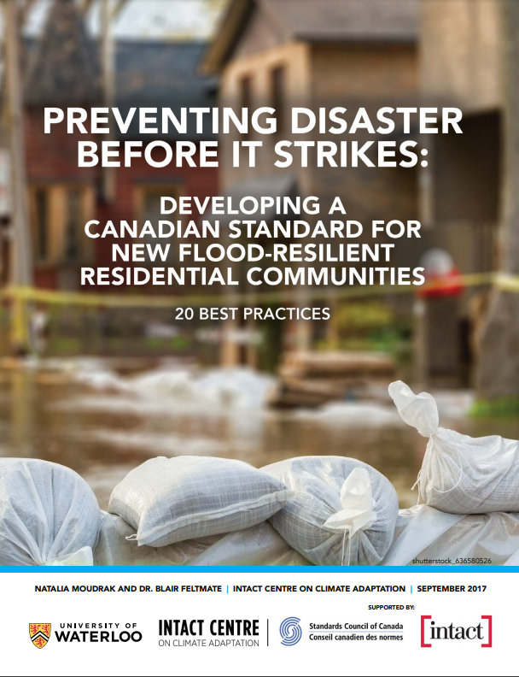
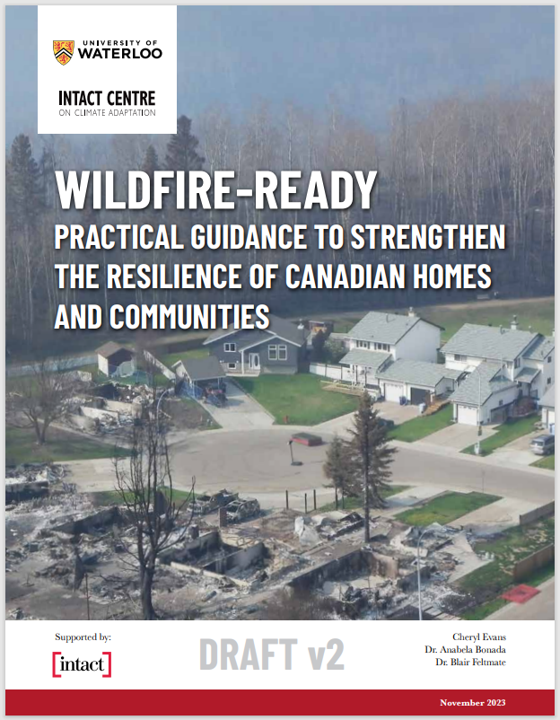
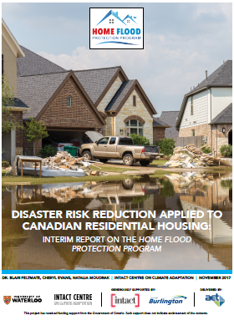
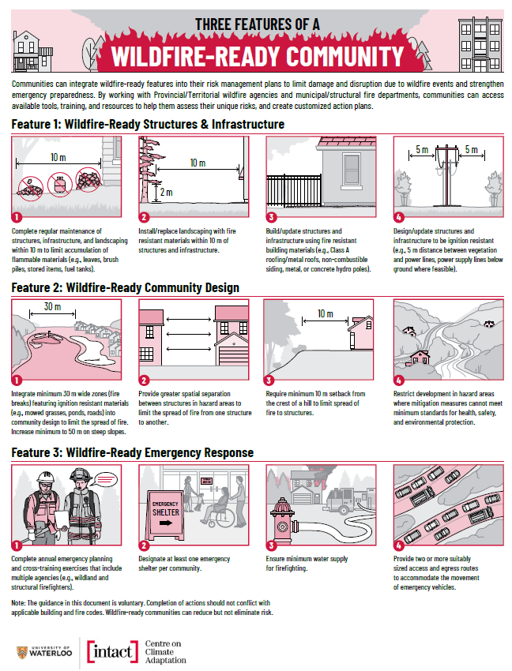
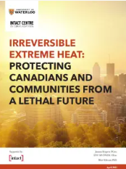
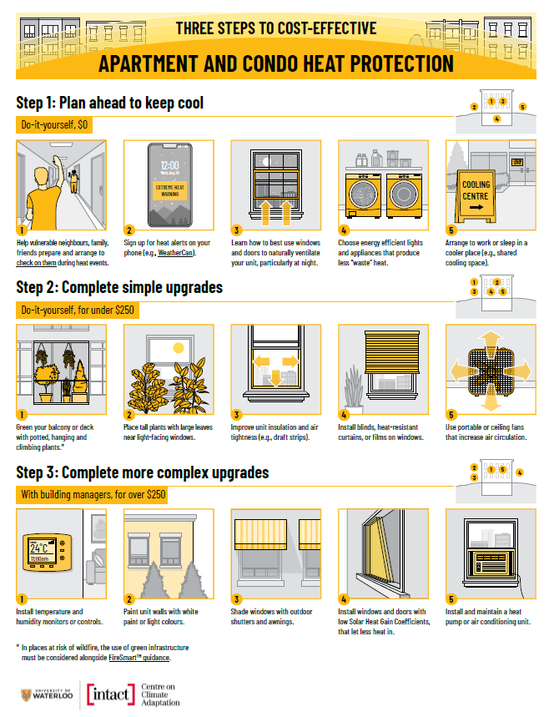
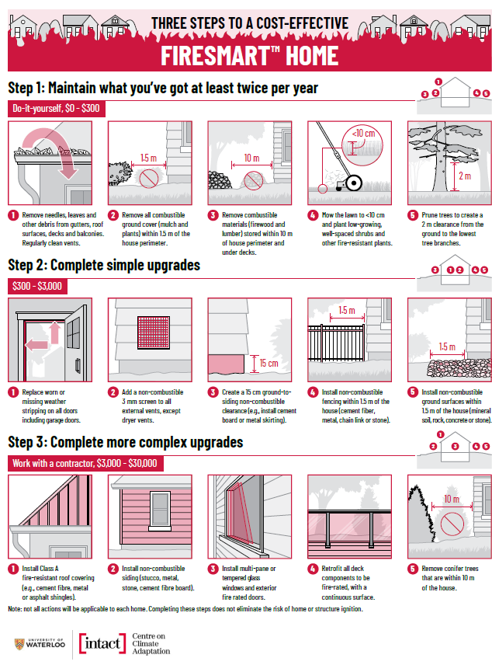
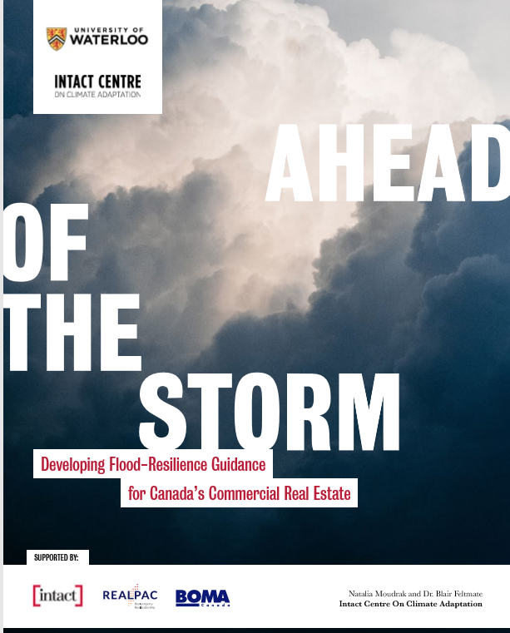
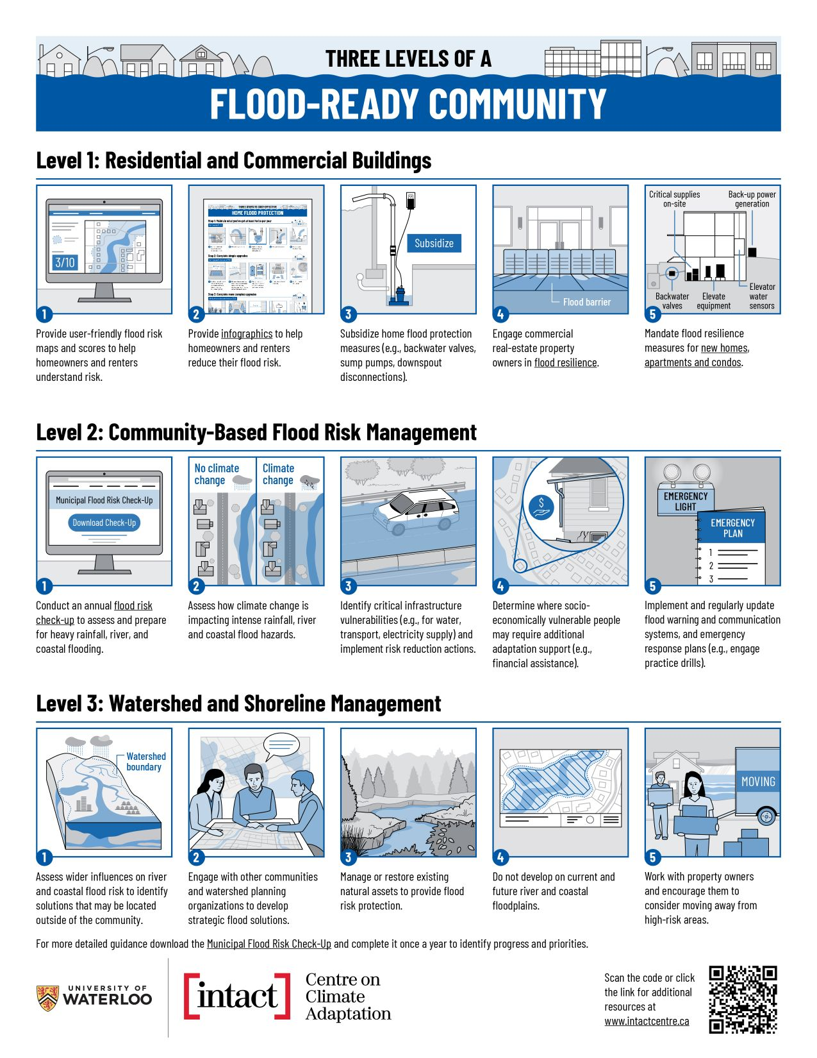
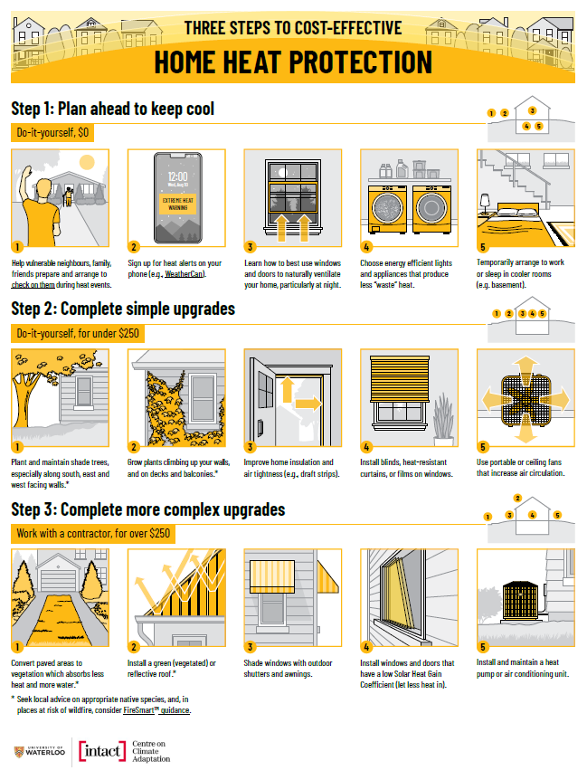
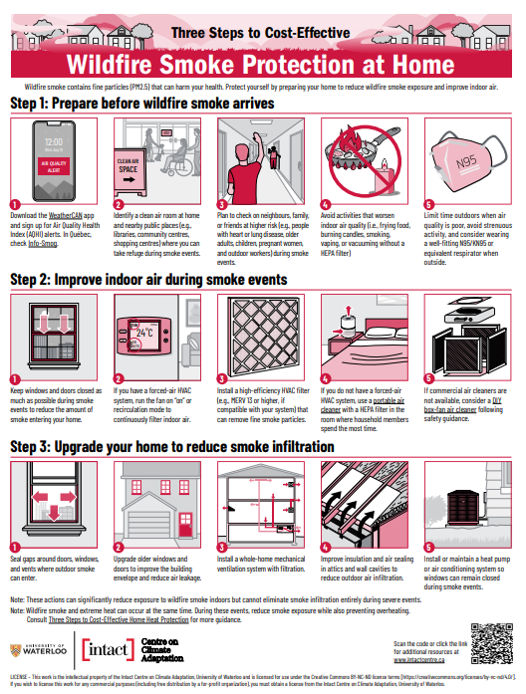
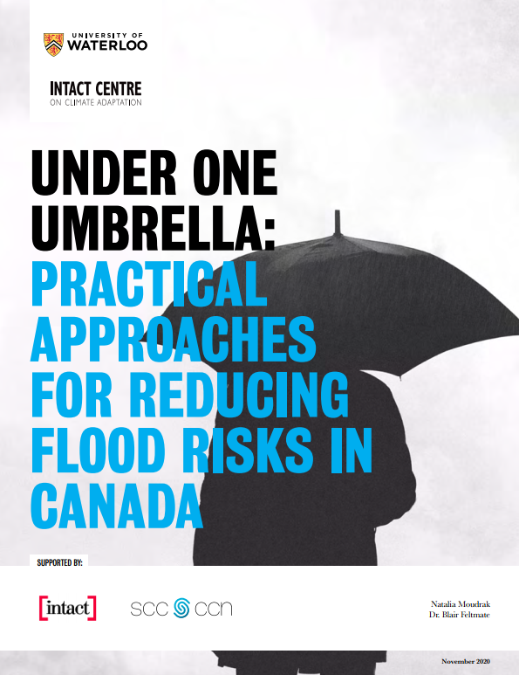
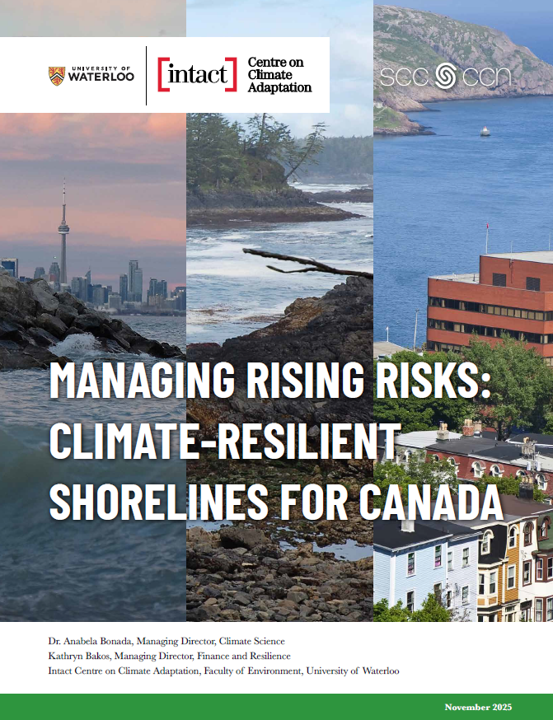
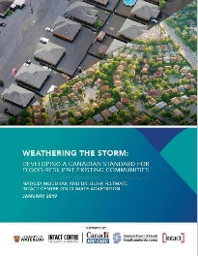
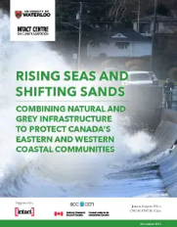
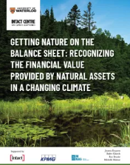
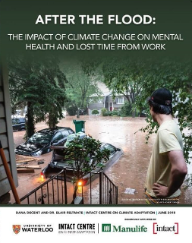
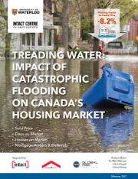
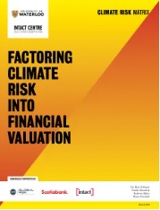
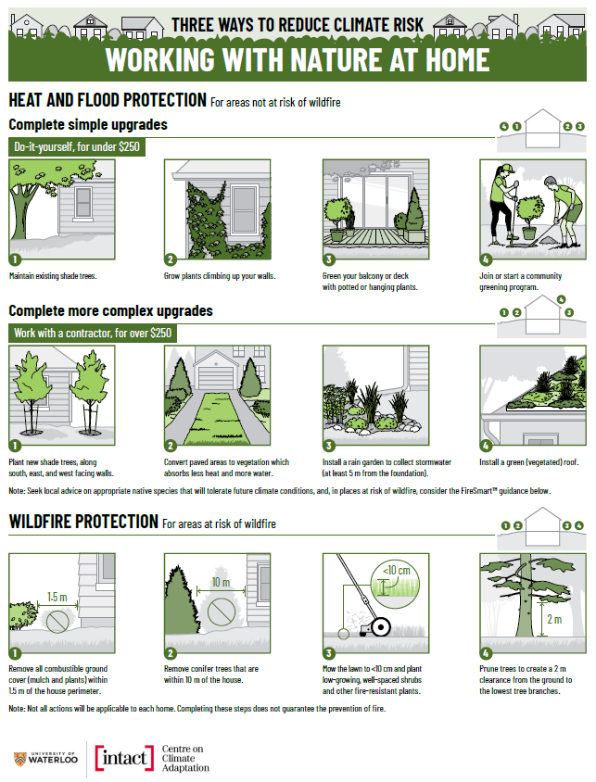
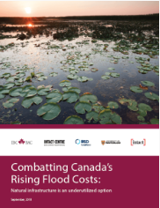
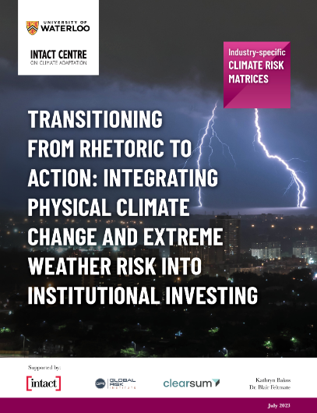
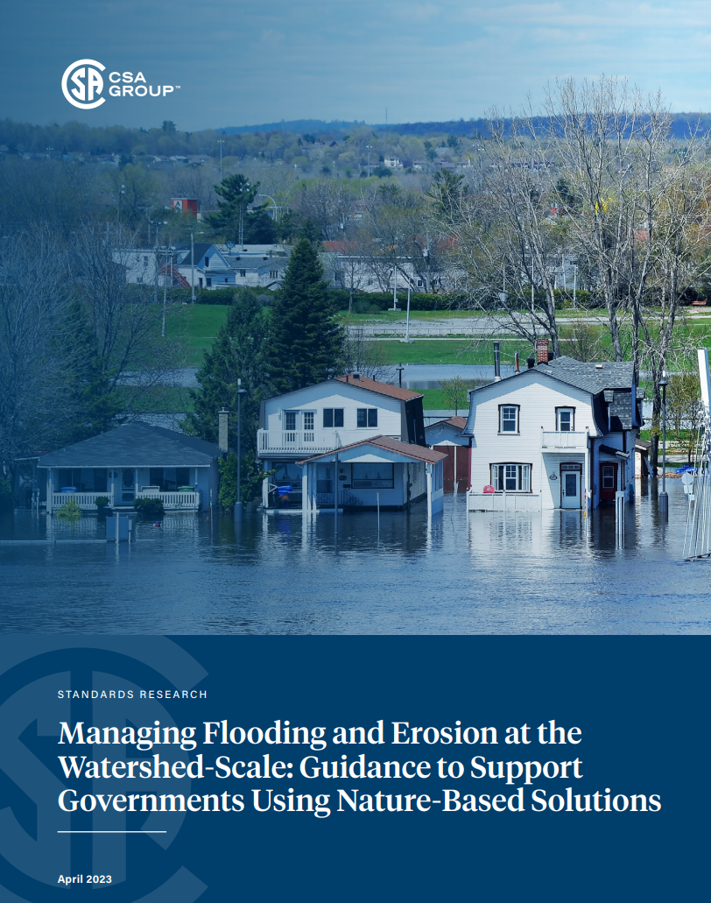

Guidance to Limit Impacts of Floods, Wildfire and Extreme Heat
WILDFIRE
EXTREME HEAT
FLOOD
NATURAL INFRASTRUCTURE
HEALTH
CAPITAL MARKETS

Slide 7
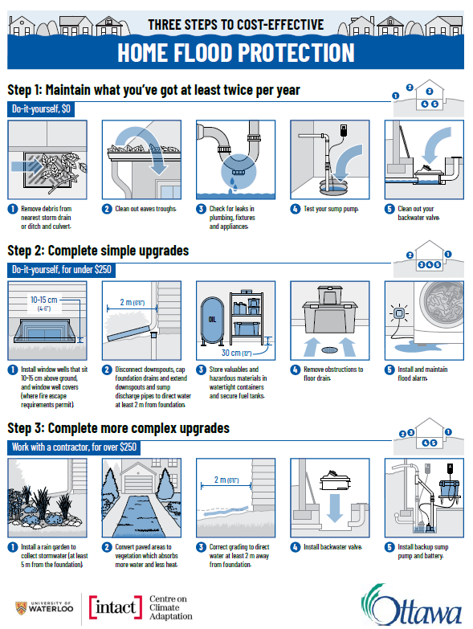
Promote Home Flood Protection
Upon receiving the infographic, within six months, 70% of homeowners take two actions to limit basement flooding
Provincial and Municipal Governments can be key in distributing the HOME FLOOD PROTECTION infographic to:
  Homeowners
  Renters
Potential distribution channels:
  MPP, Mayor and Councillor newsletters
  Utility bills
  Property tax notices
  Provincial and Municipal websites, transportation advertising, etc.

Slide 8

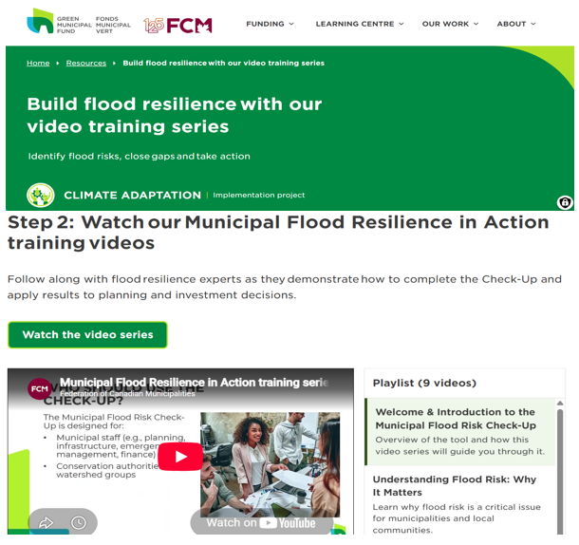
Municipal Flood Risk Check-Up
https://greenmunicipalfund.ca/resources/build-flood-resilience-our-video-training-series
Notes:
The Municipal Flood Risk Check-Up is a free, easy-to-use tool that helps communities identify, assess, and reduce flood risks across four hazard types: intense rainfall and sewer back-up, river flooding, coastal and shoreline flooding, and combined hazards.
The Check-Up generates a clear, standardized scorecard that municipalities can present to council to support funding prioritization, capital planning, and project sequencing. It also provides a consistent structure for tracking year-over-year improvements, giving municipalities a clear picture of how preparedness is evolving over time.

Slide 9
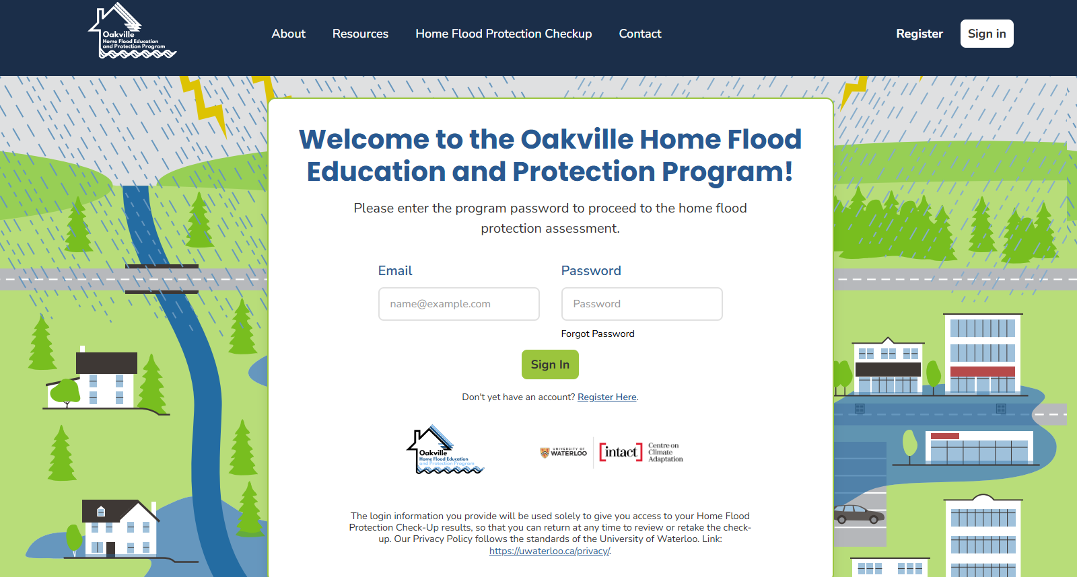
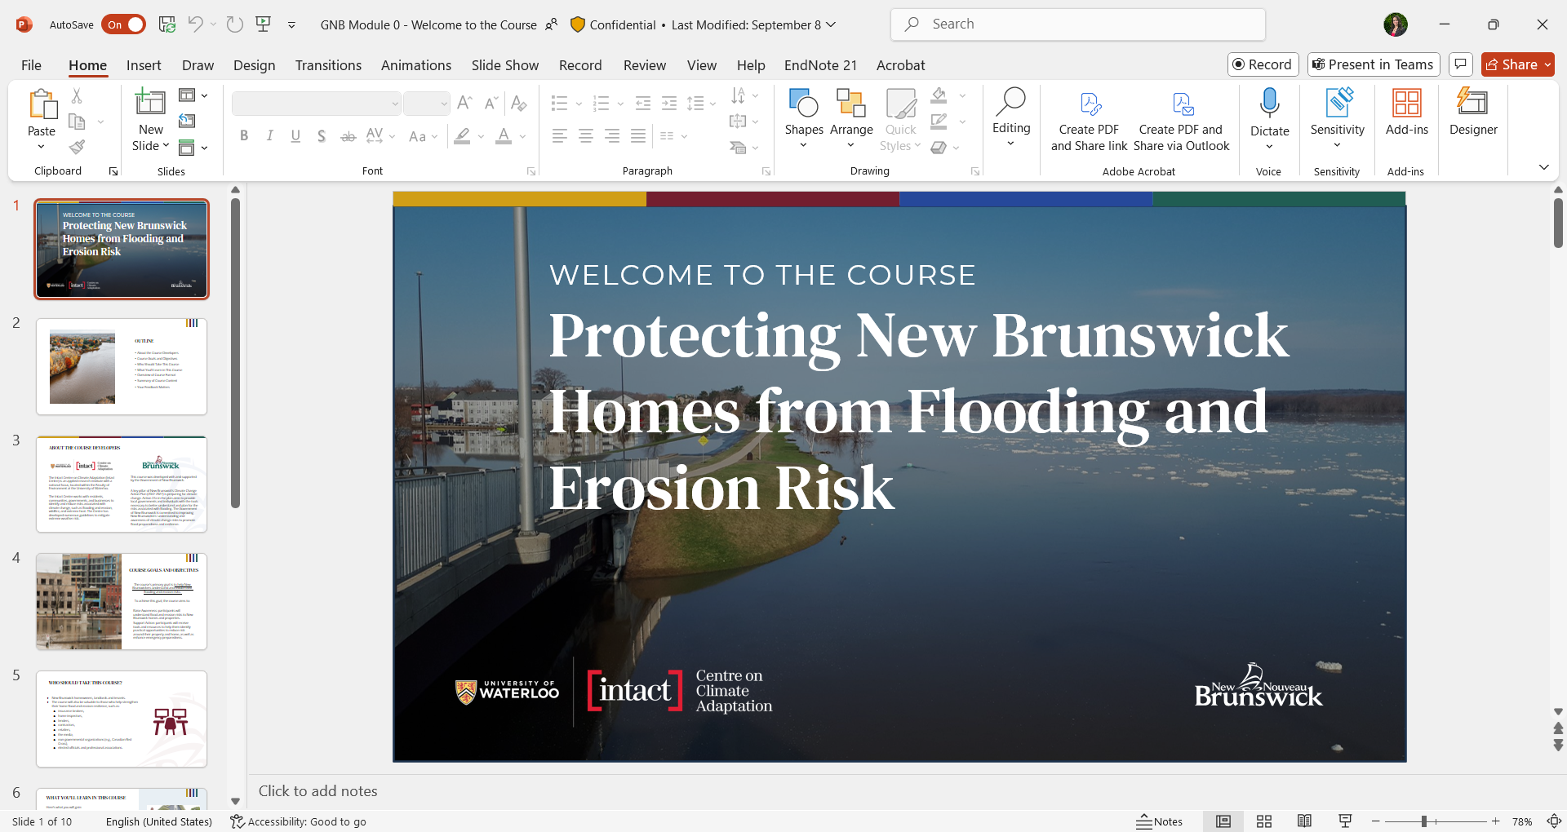
Flood Education and Protection Programs
These resources have been adopted by provinces, municipalities, and insurers, and are used in resident outreach programs nationally.

Slide 10
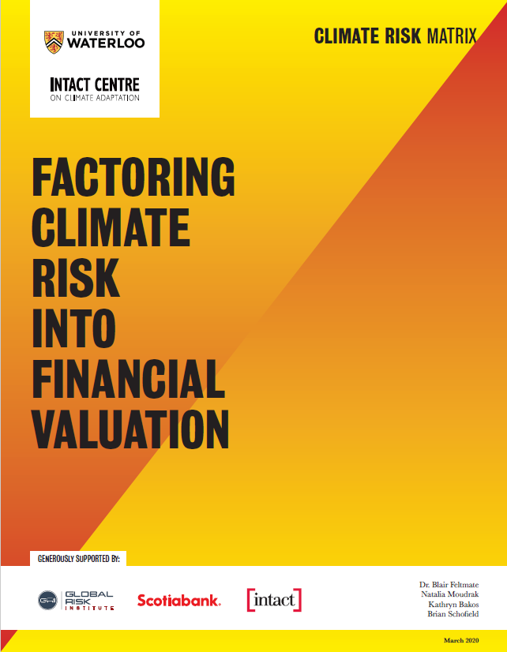

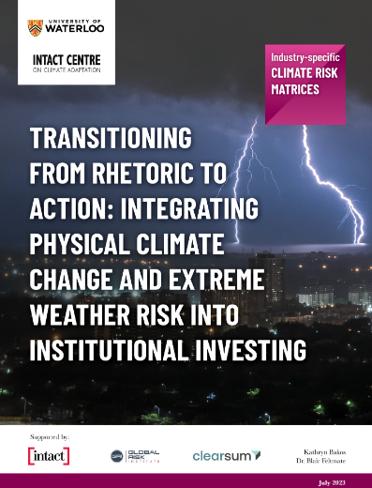
  Industry Specific Physical Climate Risks
Climate Risk Matrices (CRMs) offer a practical means to incorporate physical climate risk into institutional portfolio management, securities disclosure, credit rating adjustments and Board oversight.
CRMs developed: Commercial Real Estate, T&D Electricity, Insurance (P&C), Banking (mortgages), Hydro Electricity Generation, Wind Electricity Generation

Slide 11
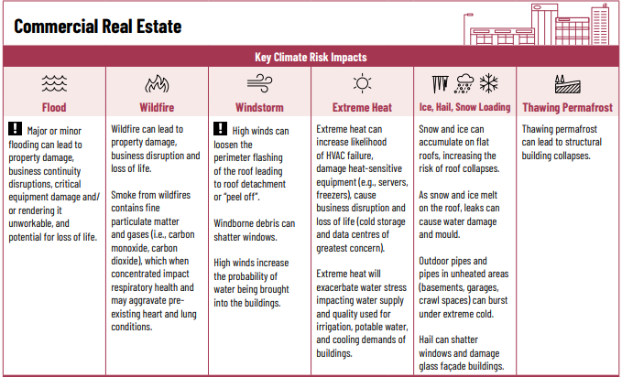
Notes:
In the reports it is in one page, but for ease of this presentation, I’ve broken them up across two slides.
So, based on subject matter expertise within the commercial real estate as an example, we were able to identify the top physical climate risks most material to business operations in Canada, which are listed in the top row.
Now, when speaking with institutional investors they said that even this was too much information. So we narrowed it down to the greatest two risks, flooding and windstorms, which are denoted by the use of an exclamation mark in each column.
So, we’ve identified what the key risks are. Then we identified “key climate risk impacts” or more specifically how each of these individual risks would manifest on the ground. If we focus in on flooding, the greatest risk is that property damage and business continuity disruptions increase if critical equipment is damaged or rendered unworkable.
Next Slide Please.

Slide 12
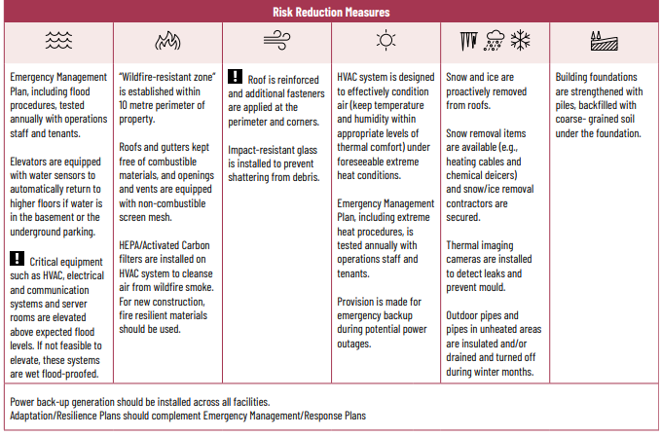
Notes:
Below that row, we identify “risk reduction measures”. In the case of flooding those managing commercial real estate should ensure critical equipment is elevated above expected flood levels. If that isn’t feasible, these systems must be flood-proofed.
So we’re able to identify what the key risks but also what the key measures that need to be put into place to reduce that risk need to be.
The climate risk matrices even offer key questions that institution investors, credit rating agency, can ask to ensure companies are incorporating adaption into decision making. The questions sum up to - have you (as a company) identified your risks and are you mitigating against these risks? If either of those answers are no – no we have not identified these risks and no we have not put measures into place to reduce those risks would be a red flag to a credit rating agency on how they want to grade a company, investors in whether they would want to direct assets to that company, or other financial market participants (lenders or insurers) may not want to loan that business money or provide insurance, or they may loan at a higher rate or provide insurance at a higher premium. Or, if you’re doing something to reduce risk loan at a lower rate or provide insurance at a lower premium. So by asking these questions alone, we are now able to price risk and opportunity in the system.
POINT 1: Which in my opinion global disclosure standards and frameworks like the TCFD, SASB, ISSB don’t do. They ask companies “you tell me what your risks are and what you’re doing about them”. So we’re starting granular level which makes standardization so incredibly difficult. In my opinion, we need to start broad, what are the key risks across industry sectors, based on georgraphic location (you’re only going to have a max of 10 globally anyway) and then what are the key measures that should be put into place to reduce that risk. I believe starting there actually could allow for standardization then allowing for granularity into the system. (comparison of assets - commercial real estate 20 key actions).
By combining this tool with established disclosure frameworks like TCFD, SASB, and ISSB, businesses can move beyond reporting to action — standardizing how risks and risk-reduction measures are identified, priced, and disclosed.
POINT 2: So, stepping back— it’s not just about keeping operations running. Extreme weather affects your employees, your customers, and the communities you depend on. Building resilience at every level — from individual households, communities (which I didn’t go into but happy to provide more information on what can be done from that presepctive) and corporate operations — is what ensures continuity and stability across the system.
Ultimately, resilience is a shared responsibility. Strengthening your operations means helping strengthen the community around you. And when communities are resilient, businesses — and the people who make them run — thrive as well.
So, this is a very high-level overview of our work at the Intact Centre.

