Slide 1

Lake Simcoe Regional Airport
EDCO Regional Event
October 8, 2026

Slide 2
Canada's Airports Drive Economic Growth
435,800 jobs supported nationwide
$49.6B GDP contribution
$123.5B economic output
“Whether moving passengers, supporting businesses, providing emergency services, or enabling investment, airports are critical infrastructure that help communities connect, compete, and grow.”
Source: Canadian Airports Council, 2024 Economic Impact Study
Notes:
Set the macro level stage
Canadian Airports Council Study over 60 airports - supported 435,800 full-time jobs, contributed $49.6 billion in GDP, and generated a total economic output of $123.5 billion in 2024.
Key point - Critical infrastructure supporting trade, tourism, investment, and business connectivity

Slide 3
Airports as Economic Infrastructure
Approximately 80 municipal and public airports across Ontario that support business connectivity, emergency services, tourism, trade and economic development
Ontario's airports operate under a range of ownership models
Major airports primarily support scheduled passenger travel, air cargo, and national and international connectivity
Regional airports support aerospace manufacturing and aviation related industries, aircraft maintenance, repair and overhaul (MRO), corporate aviation, charter flights, flight training, air cargo, air ambulance, wildfire response (suppression and evacuation), remote community access and regional connectivity
Notes:
AMCO's research identified approximately 80 airports across Ontario that support business connectivity, emergency services, tourism, trade, and economic development.
Ontario's airports operate under a range of ownership models, including municipal, airport authority, provincial, Indigenous, and private ownership – MANY are municipally owned
Not all airports serve the same purpose. While major airports are focused on passenger travel and global connections (Pearson, Ottawa, Hamilton), regional airports (LSRA, Peterborough, Muskoka) are often economic development assets that support activities shown on the screen (or a mix of both) – emergency services, aviation related industries, corporate aviation, etc. LSRA had 2000 evacuees

Slide 4
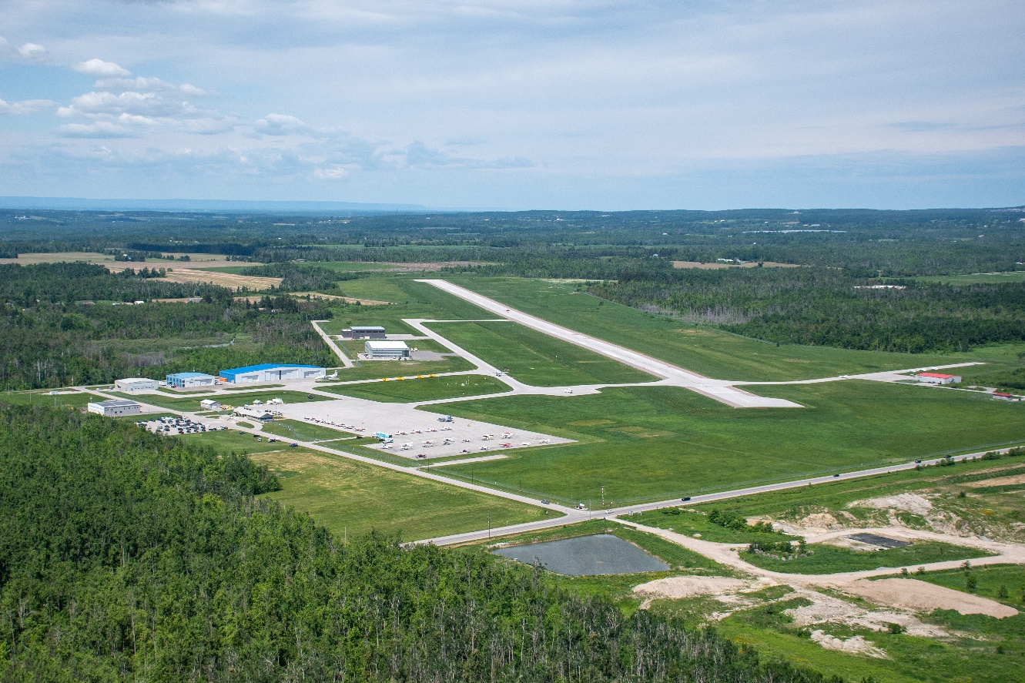
What Airports Enable
Business attraction and expansion
Tourism and visitor spending
Critical emergency access
Job creation
Connectivity and Market Access
Employment Lands and Investment
Cluster / Sector Development
Notes:
Aircraft
Hangars
Flights
Operations
Infrastructure
Transportation Asset
Beyond serving aircraft, the airport provides the infrastructure needed to attract aerospace and aviation related employers, develop employment lands, strengthen connectivity to markets, and support long-term economic growth across Simcoe County and the broader region.“
Even if that company never ships products by air, executives, engineers, customers, suppliers, investors, and specialized workers often travel through airports.
A strong airport can reduce travel times, improve connectivity, and increase a region's competitiveness.
When we think about economic infrastructure, we typically think about highways, railways, water systems, and industrial parks. Airports belong in that same conversation. They provide connectivity that helps businesses reach customers, suppliers, talent, investors, and markets while also supporting emergency services and high-value employment.
Aircraft
Hangars
Flights
Operations
Infrastructure
Transportation Asset
and trade connectivity
Support business attraction and expansion
Support tourism and visitor spending
Provide critical emergency services infrastructure
Employment Lands and Investment
Supports Strategic Industries

Slide 5
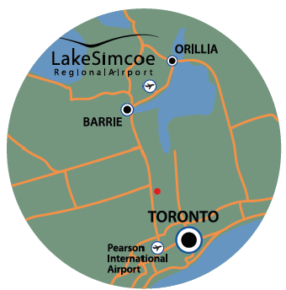
Lake Simcoe Regional Airport – Overview
Located in the Township of Oro Medonte
Owned and operated by the County of Simcoe
Supports general aviation, business and charter operations, emergency services, and regional economic activity
Approximately 36,000 aircraft movements annually
Guided by the Strategic Plan focused on developing LSRA as a key regional economic development asset
Notes:
The LSRA provides a full range of aviation services supporting general aviation, business and charter operations, emergency services (air ambulance, search and rescue) and regional economic activity.
Approx. 36, 000 movements in 2025 – seeing that # continue to grow
One of the largest user groups of the airport are Essential Service providers such as the Ontario Provincial Police, Ornge Air Ambulance and Hydro One Helicopter Services with other essential service providers such as the DND and the RCMP. - over 50% of jet traffic last year
Strategic Direction: The LSRA Strategic Plan sets out a long-term vision for developing LSRA as a key regional hub supporting economic development and job creation, with growth occurring in phases based on demand​
There are 14 staff at the airport in administrative and operational roles.
The airport is staffed 7 days per week, 14 hours per day with 24-hour call-out availability.

Slide 6
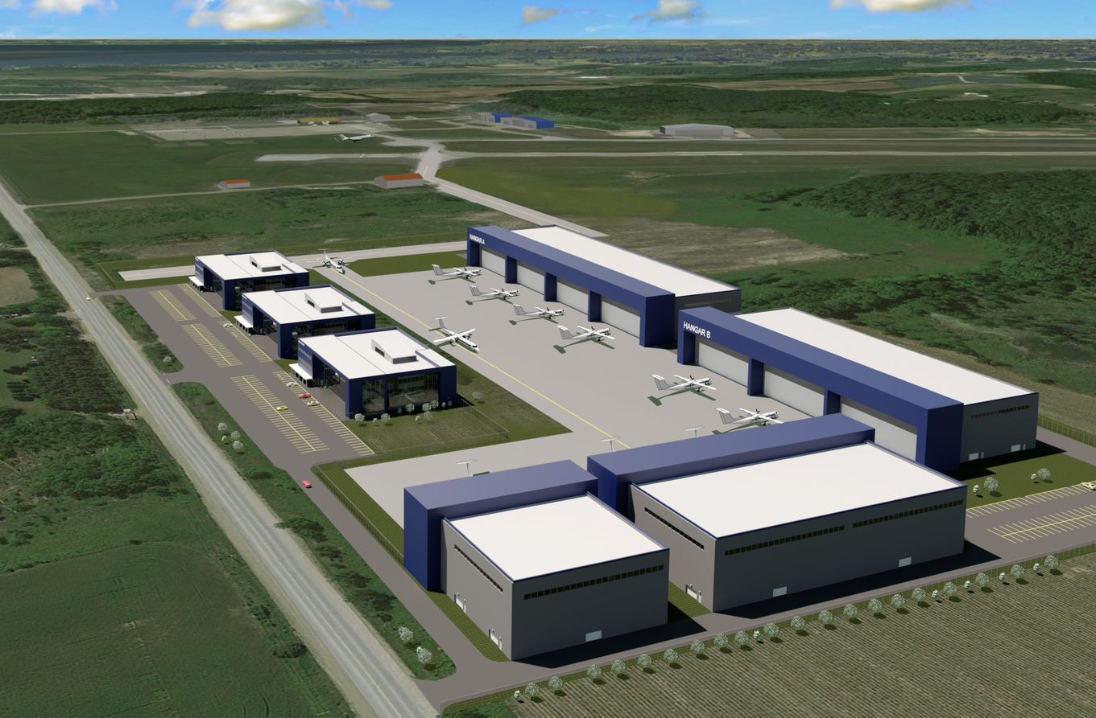
Lake Simcoe Regional Airport – Strategic Plan
Conceptual – N.E. Commercial Area
Phase I (multi-year, in progress)
Position Airport to Enhance Corporate Aviation & Maintenance, Repair and Overhaul (MRO) Opportunities
Phase II
Further Development of Air Service Business Case
Phase III
Support Sustained Scheduled Commercial Air Service
Notes:
Phase I: Position the Airport for Growth
(Multi‑year, in progress)
Phase I is focused on strengthening the airport’s foundation by positioning it to attract and support corporate aviation and Maintenance, Repair and Overhaul—commonly referred to as MRO—opportunities.
Key outcomes include improving infrastructure readiness, advancing employment land development, and creating the conditions needed for aviation-related businesses to operate and expand at the airport.
By focusing on high‑value employment, stable aviation activity, and revenue generation, Phase I supports long‑term airport sustainability.
KEY PROJECTS –runway widening complete, runway extension to 7000’, working towards airport certification with Transport Canada
Phase II: Further Development of the Air Service Business Case
Phase II builds on the foundation established in Phase I by advancing the business case for scheduled air service.
This phase focuses on better understanding market demand, travel patterns, and carrier requirements through detailed air service and demand studies.
Engagement with airlines, the private sector, and other partners is a key component, helping to assess feasibility and identify realistic service opportunities.
The objective in Phase II is not immediate service launch, but rather ensuring there is a credible, data‑driven case that supports future commercial air service and mitigates financial risk.

Slide 7
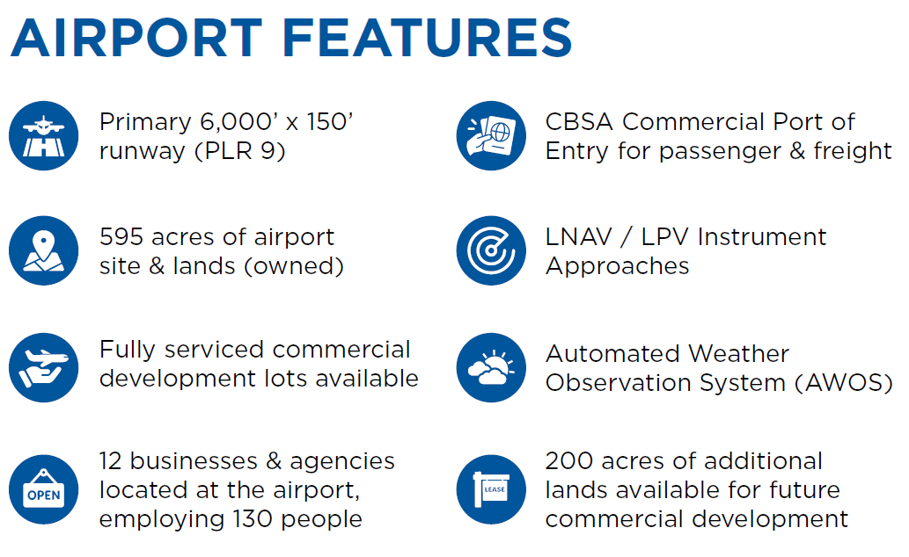
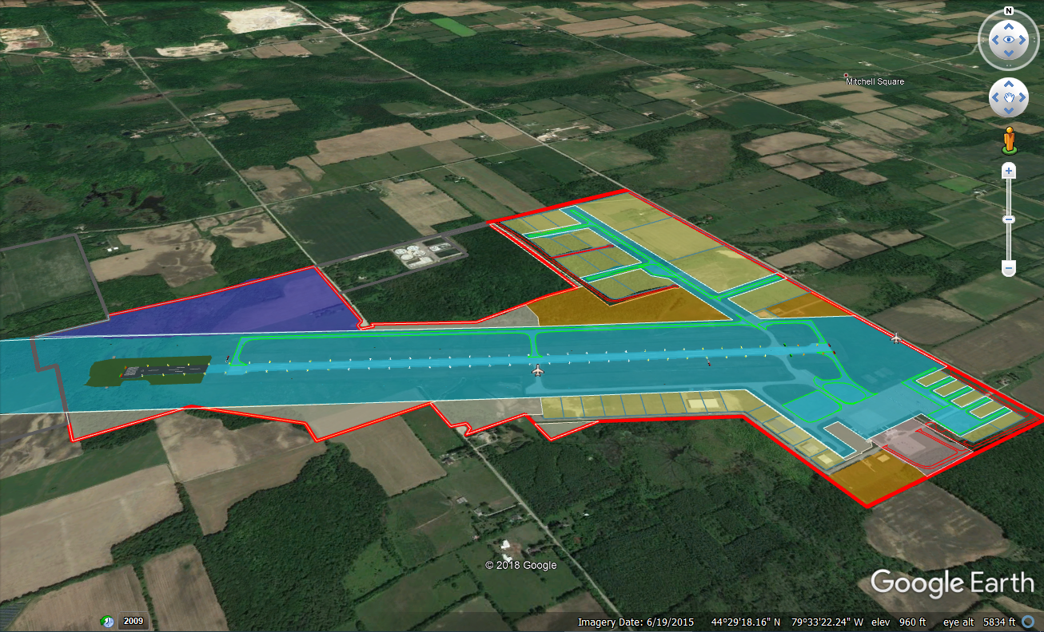
Lake Simcoe Regional Airport – Overview
Notes:
6,000’ x 150’ runway
Overall airport site 595 acres
Fully commercial development lots – only 3 lots remaining.
12 businesses & agencies located at the airport, employing 130 people - Cumulative 130,000 sq. ft. of commercial hangar space/businesses.
CBSA provides international-clearance services that enable CYLS to operate as a Commercial Port of Entry for passengers and freight
Transit services through LINX
Approximately 200 acres of additional unserviced lands available for future commercial development

Slide 8
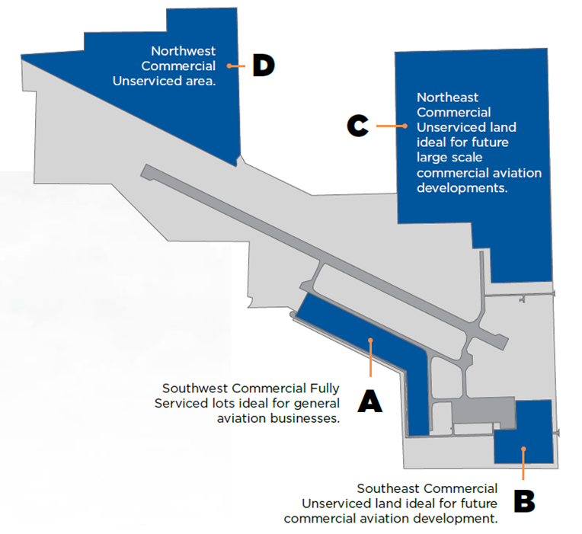
Lake Simcoe Regional Airport - Employment Lands
These lands are intended to support aviation-related and complementary industrial uses, including aerospace, aircraft maintenance (MRO), logistics, advanced manufacturing, and other employment activities that benefit from proximity to an airport.
There is a strong focus on creating high-value employment, supporting skilled trades, technical professions, and innovation-driven businesses rather than low-intensity land uses.
Notes:
The employment lands at the Lake Simcoe Regional Airport are a key component of the airport’s long-term economic development strategy and a significant opportunity for regional job creation.
Approx 200 acres of employment land
County owns approx. 200 additional acres adjacent to the S.W. ​
These lands are intended to support aviation-related and complementary industrial uses, including aerospace, aircraft maintenance (MRO), logistics, advanced manufacturing, and other employment activities that benefit from proximity to an airport.
The employment lands’ value is driven by the airport’s strategic location, airside access, and regional highway connections.
There is a strong focus on creating high-value employment, supporting skilled trades, technical professions, and innovation-driven businesses rather than low-intensity land uses.
Overall, the employment lands represent a long-term economic asset for the region—supporting job growth, expanding the tax base, and reinforcing the airport’s role as a catalyst for economic development.

Slide 9
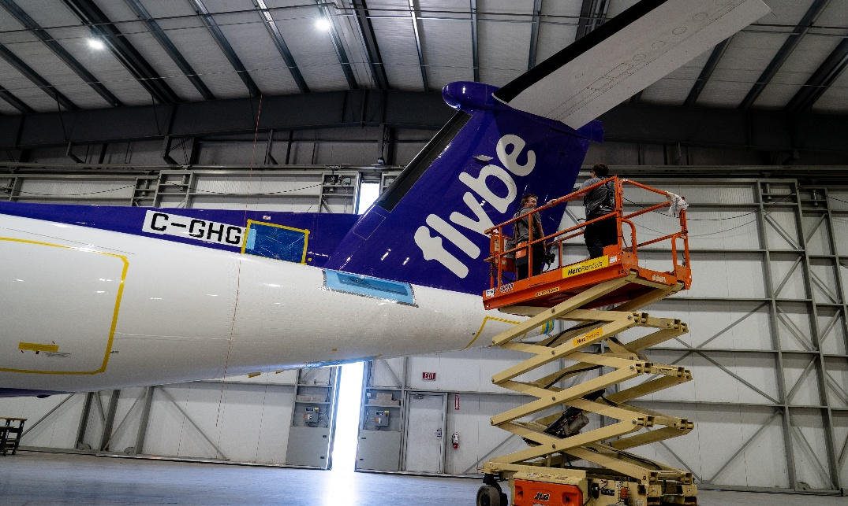
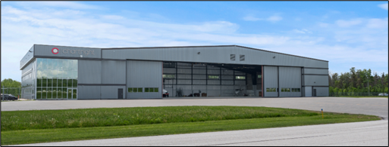
Lake Simcoe Regional Airport – Airport Community
SmartAMS
SmartAMS is an aircraft-maintenance company with a global customer base
Workforce growth from 5 to 35 in the past 2 years
Fixed wing – Pilatus next generation PC-12
Chartright
Full-service FBO operated by Chartright Air Group, supporting corporate, charter, and private aviation
Supports business attraction and continued airport growth

Slide 10

Lake Simcoe Regional Airport – Development Activity
Ontario is investing $93M to expand Ornge’s air ambulance fleet; four new fixed‑wing aircraft, and construction of a new hangar at LSRA (approx. 90,000 sf.)
New base will enhance provincial fixed‑wing emergency response capabilities.
OPP Aviation Services will occupy dedicated space within the facility.
Fixed wing – Pilatus next generation PC-12
Notes:
Ornge
Province announced $93M investment (2024) to expand Ornge’s fleet and build a new LSRA hangar, facility will also house OPP’s provincial aviation headquarters.
The development will support larger, high‑speed fixed‑wing aircraft, doubling long‑distance patient transfer capacity, provide specialized medical transport and 24/7 operations capability.
90K sq.ft. hangar, expected to have 100 employees.
Construction targeted to start in 2026 with occupancy planned Q4 2027 / Q1 2028.
LSRA completed a servicing study; resulting in water/wastewater improvements, new well, pumps, and fire suppression infrastructure.
air crew, flight-medics (specific to Ornge) aviation mechanics, support staff and administration

Slide 11
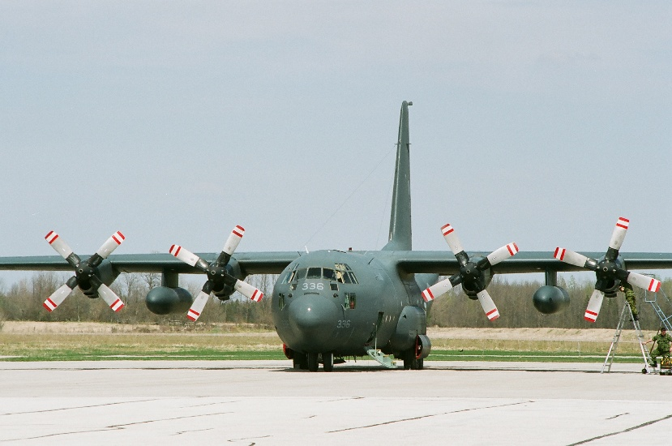
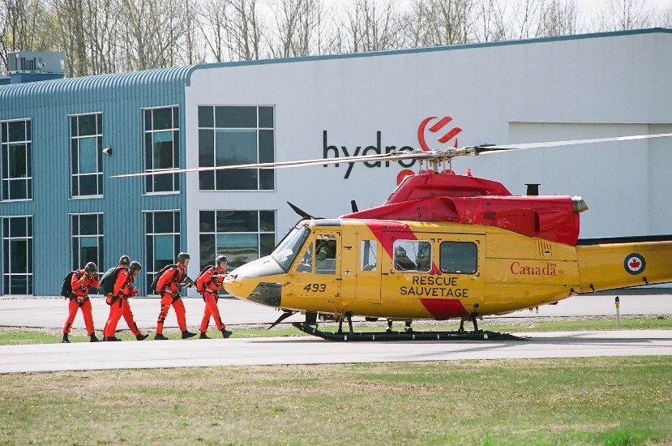



Aerospace & Defence Investment Strategy
The County of Simcoe’s Economic Development Office is developing an Aerospace & Defence Investment Strategy to define the priorities and objectives required to enhance and expand these critical sectors across the region.
Evaluating aerospace and defence activities that can leverage the LSRA, complementary airports, and employments lands across Simcoe County.
Notes:
As of March 2026, Canada has achieved the NATO defence spending benchmark of 2% of GDP, investing more than $63 billion annually in defence across the Department of National Defence (DND), the Canadian Armed Forces (CAF), and other federal partners.
The federal government plans to significantly increase defence expenditures, with total investments projected to exceed C$1.2 trillion over the next decade, and a new target of reaching 3.5% of GDP in direct military spending by 2035.
This increased level of defence spending presents a strong opportunity for Simcoe County to further diversify its manufacturing and industrial base, which is currently heavily concentrated in the automotive sector.
Objectives
The strategy will:
Establish a clear long-term vision and priorities for aerospace and defence sector development across Simcoe County.
Identify opportunities to attract high‑value investment and generate high‑quality employment.
Position LSRA as a catalyst for innovation, industry growth, and cluster development.
Strengthen regional competitiveness by aligning with national and provincial aerospace and defence priorities.
Support the retention, expansion, and attraction of businesses across land, naval, aerospace, and joint forces markets.
Enhance partnerships with academia, industry, government, and innovation networks.

Slide 12
Thank You
LakeSimcoeAirport.com

